Slide 1
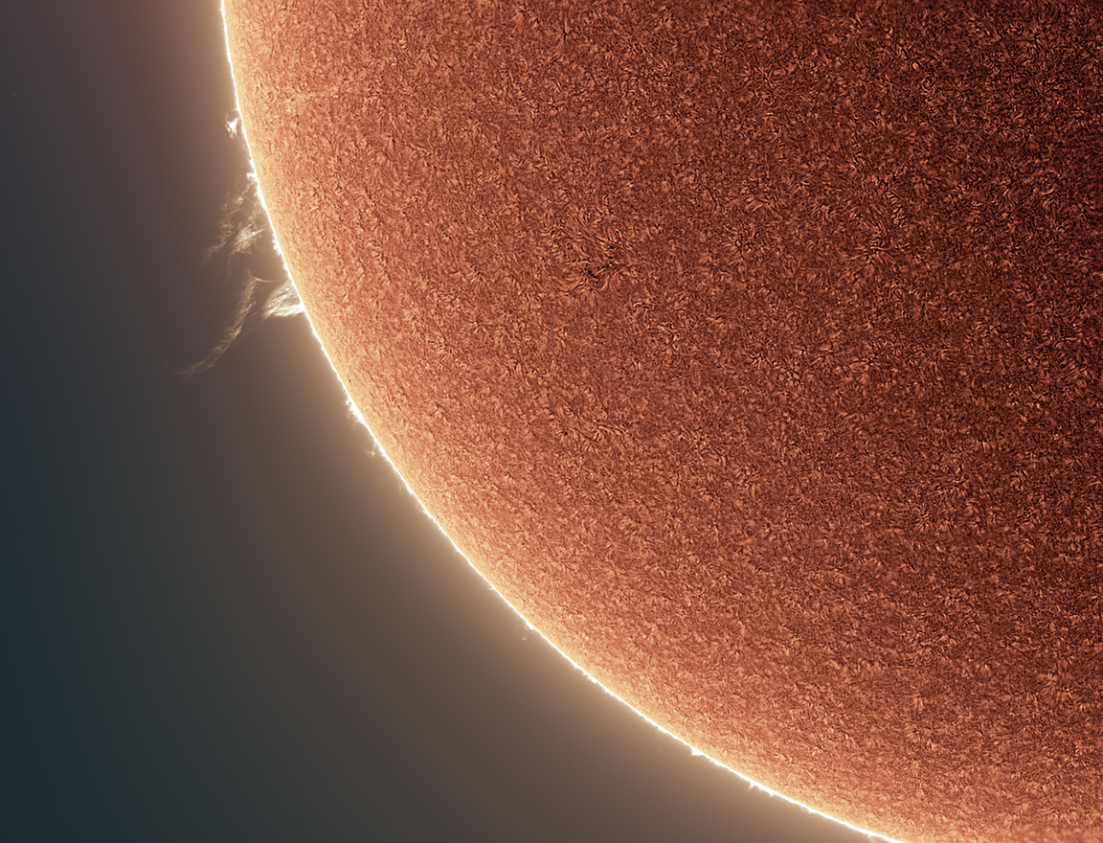
WELCOME!
Thank you for your curiosity about why we see round images of the Sun through non-round holes!
NASA PUNCH website: https://punch.space.swri.edu /
Section 1:
How to Use the
3-Hole PUNCH
Pinhole Projector
Scan here to access all PUNCH Outreach products or visit:
https://punch.space.swri.edu/punch_outreach_products.php
For questions or to request our 1-page monthly newsletter: Contact PUNCHOutreach@gmail.com
Photo: Alan Friedman

Slide 2
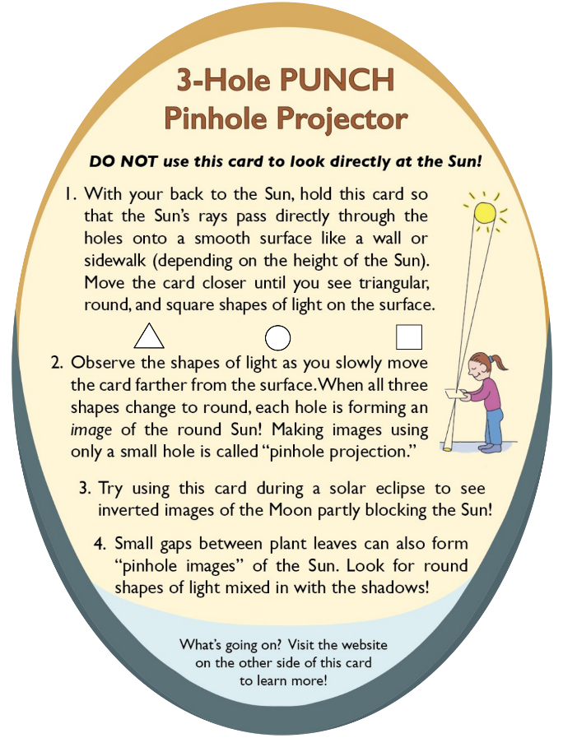
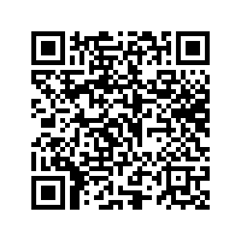
[Really] Understanding Pinhole Projection of the Sun
Outreach for the NASA PUNCH mission
Follow along with our playful learning adventure!
And PLEASE give us feedback on these questions at the link below:
Insights gained?
Remaining questions?
Ideas for improvements?
​https://tinyurl.com/PinholeFeedback
MARK 3 Version
Final Release for use up to and including the Annular Eclipse on 14 Oct 2023
FRONT
BACK

Slide 3
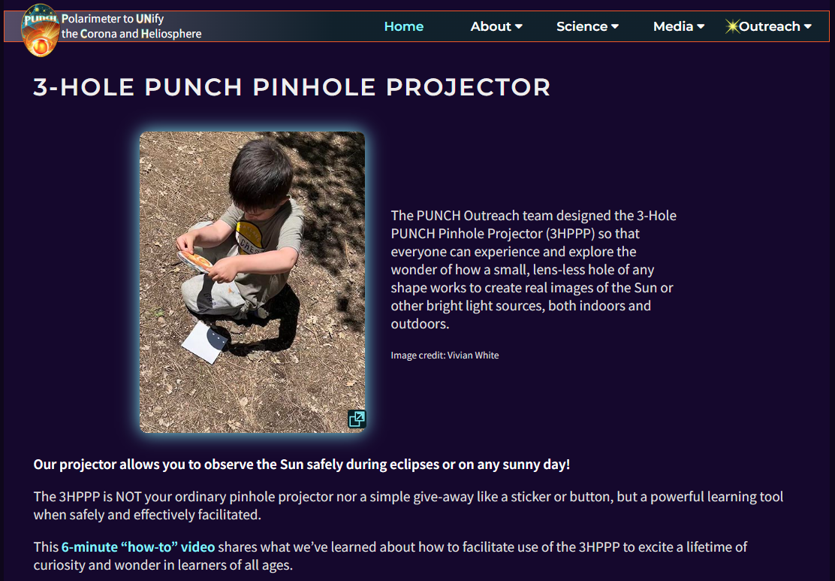
Essential viewing: 6-minute “how-to-facilitate” video [ https://punch.space.swri.edu/punch_outreach_pinholeprojector.php ]
Outreach for the NASA PUNCH mission

Slide 4
[Really] Understanding Pinhole Projection of the Sun
Introducing Bhanu
[BAH-noo]
Bhanu means
“ray of light”
in Sanskrit
Outreach for the NASA PUNCH mission
Bhanu helps guide our way through these Sections. You are in Section 1 of 5.
Section | Title of Section | Description of Section
1 | How to Use the 3-Hole PUNCH Pinhole Projector | introduces the 3-Hole PUNCH Pinhole Projector, demonstrates how to use it both outdoors and indoors, and describes its differences from a pinhole camera/viewer.
2 | Observing Pinhole Images of the Sun in Our Everyday Environments | teaches you how to observe the phenomenon of pinhole images of the Sun in our everyday world, both indoors and outdoors.
3 | Exploring Pinhole Projection Using Your Own Hands | invites you to explore the behavior of pinhole projection by experimenting with your own hands (try both palms up!)
4 | Explaining and Understanding How Pinhole Imaging Happens | interactively guides your quest for explanations and deeper understanding of how pinhole imaging happens. After this, you will really understand why small, lens-less holes can create images.
5 | APPENDICES A-E: More Insights & Fun Resources | offers more insights & resources (e.g., explaining the relationship between pinhole images and the view through “eclipse” glasses)
CONTACT:
Dr. Cherilynn Morrow, Outreach Director for the NASA PUNCH mission [cherilynn.morrow@gmail.com]

Slide 5
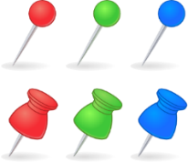
How to Use the 3-Hole PUNCH Pinhole Projector
Outreach for the NASA PUNCH mission
Bahnu says: “Pinhole” describes a projector or camera that does not use a hard lens but only a small hole or gap to make images of the Sun or other objects. A “pinhole” does not have to be pin-sized to create an image of the Sun, nor does it have to be round!
Section 5: Appendix C explains the difference between a lens-less “pinhole” and a lens and helps you to appreciate more what a lens is doing to make a clear image.
CONTACT:
Dr. Cherilynn Morrow, Outreach Director for the NASA PUNCH mission [cherilynn.morrow@gmail.com]

Slide 6
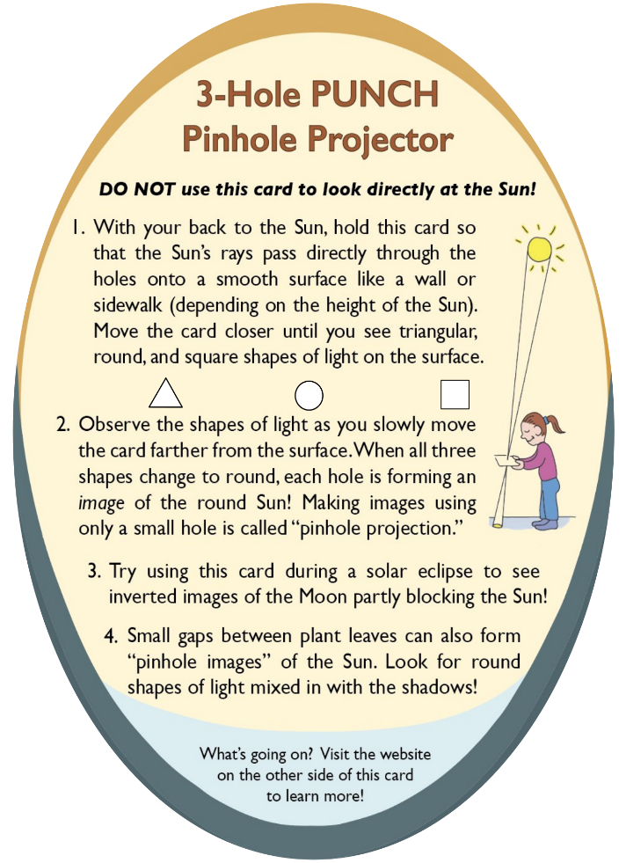
Introducing the
3-Hole PUNCH Pinhole Projector
6 inches
(~15 cm)
FRONT
BACK
The NASA PUNCH Outreach team has developed the 3-Hole PUNCH Pinhole Projector so you can have fun exploring how small, non-round holes can project real images of the round Sun. This can be done on any sunny day, not only when the Sun is eclipsed by the Moon!

Slide 7
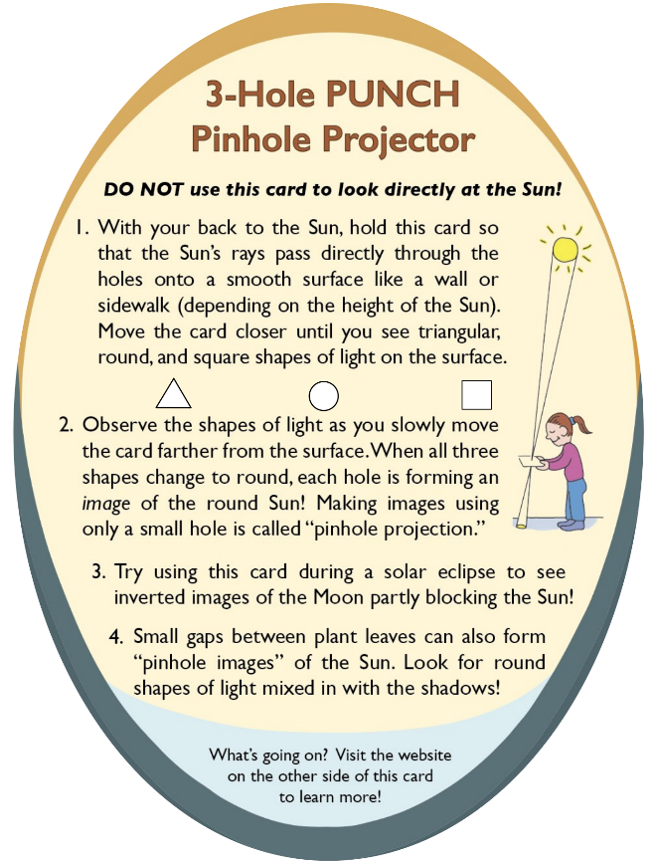
Introducing the
3-Hole PUNCH Pinhole Projector
Our projector is printed on card stock with three small (~5 mm) holes of different shapes: square, round, and triangular.
6 inches
(~15 cm)
FRONT
BACK
Our design has carefully considered the size, position, and spacing of the “pinholes” so that the projector can work well indoors or outdoors in broad daylight. Section 5: Appendix D explains our design trade-offs.

Slide 8
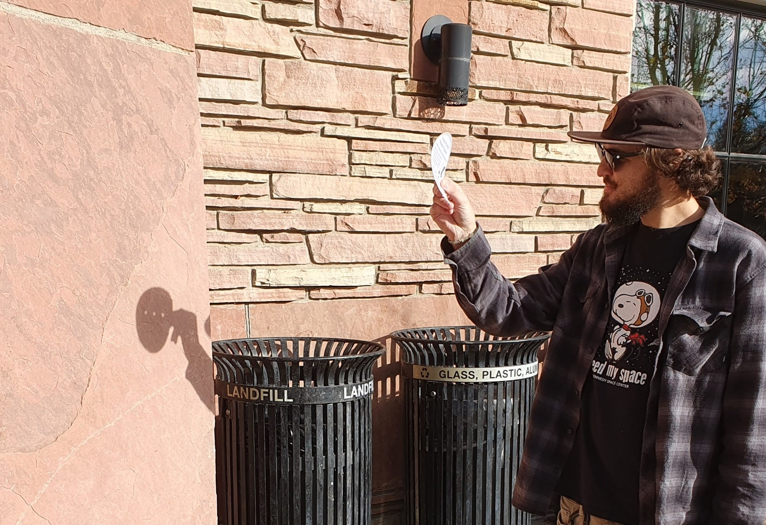
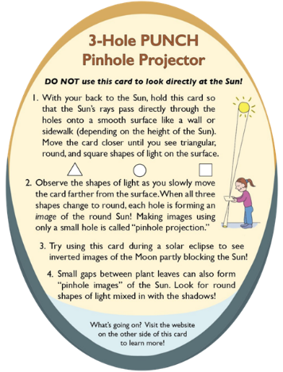
Using the PUNCH Pinhole Projector
NEVER EVER look at the Sun through the holes in the card!
1
Sunlight comes from this direction
Outreach for the NASA PUNCH mission
2
Passes through the 3 different shaped holes
Smooth flat
projection surface
JO is observing in the morning in December
3
3 round images
of the Sun appear
in the shadow of projector
JO is using a vertical wall as the smooth flat projection surface because the Sun is lower in the sky. If the Sun were higher, then a horizontal surface like a sidewalk might work better.

Slide 9
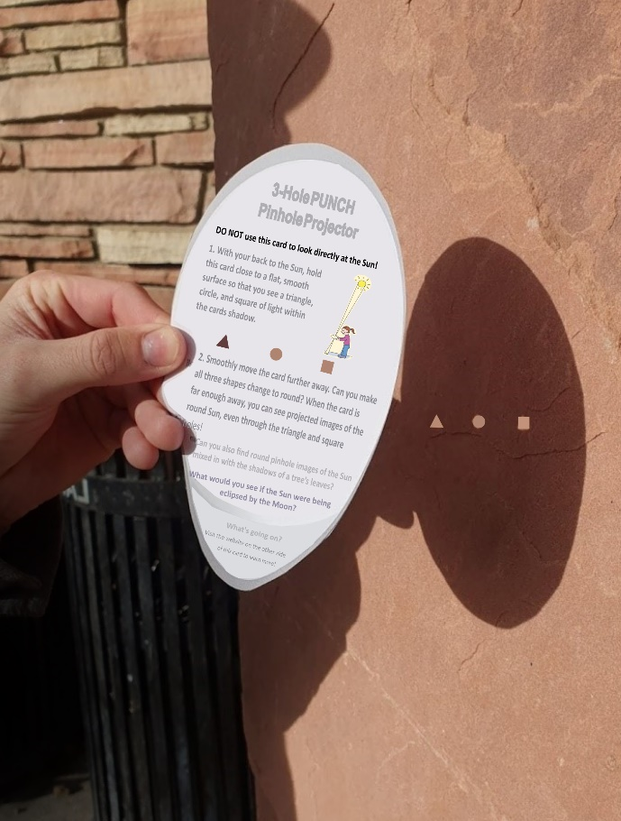
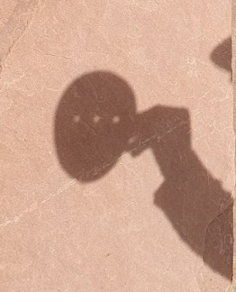
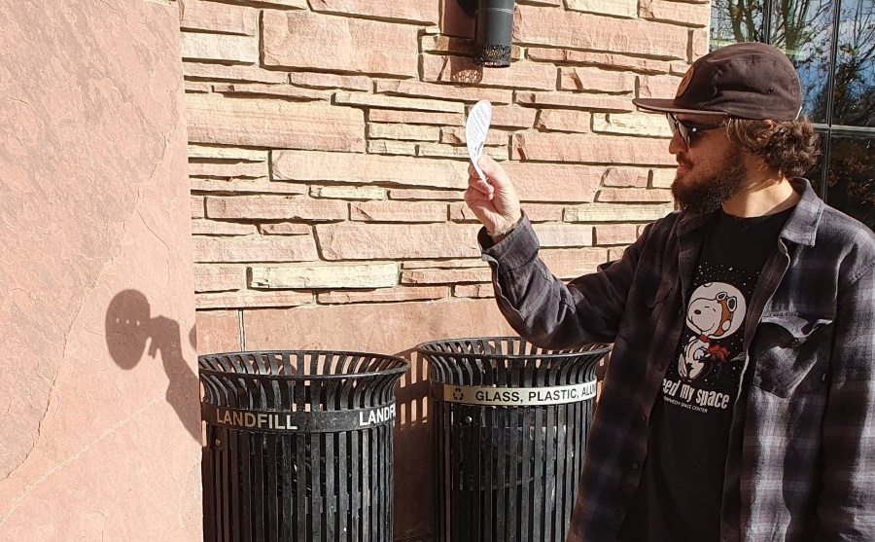
1. Projector close to surface. Triangle, round, and square shapes of light are sharp.
2. Projector farther away from surface. All three shapes of light are round and fuzzier.
Case 1
Smooth flat
projection surface
Case 2
Outreach for the NASA PUNCH mission
Were you able to observe both Case 1 and Case 2?
Image of round Sun through square hole
Sunlight comes from this direction and passes thru the holes
square shape of light
KEY QUESTION: Why don’t we see round images of the Sun when the projector is held closer to the projection surface (Case 1), but we do see them when we move it farther away (Case 2)?
JO is observing in the morning in Dec

Slide 10
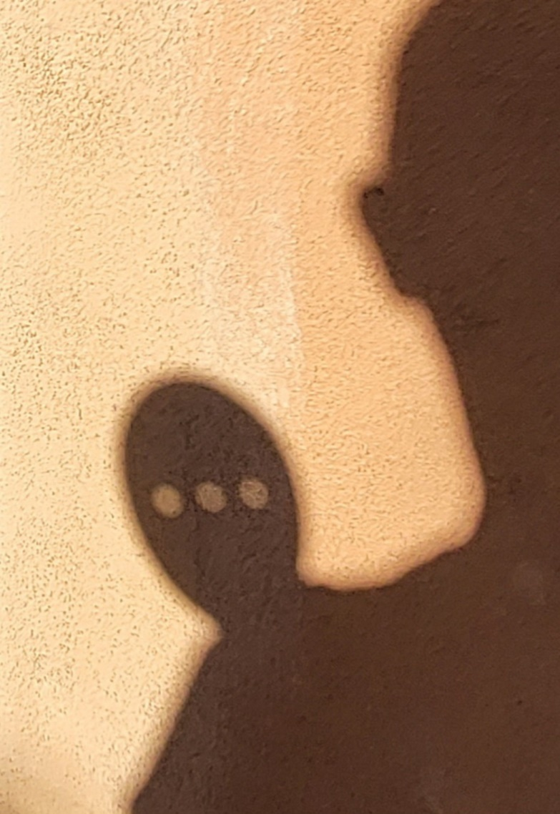
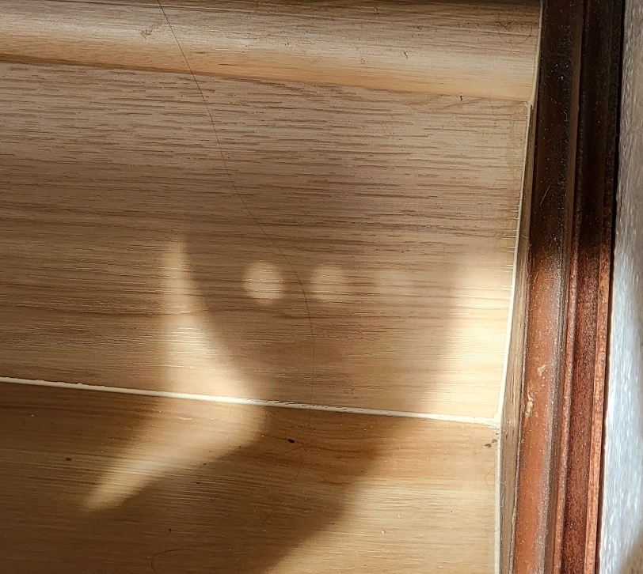
Indoor Use of the PUNCH Pinhole Projector
You can try out using the projector where sunlight streams through a window. You will get the same effects as outdoors, but there is less stray light indoors compared to broad daylight. Thus, as you move the projector farther away from the projection surface you can more easily perceive larger, dimmer, and somewhat sharper images. The projected image size can become much larger than the hole size.
Play with your Projector in different situations to see what can happen!

Slide 11
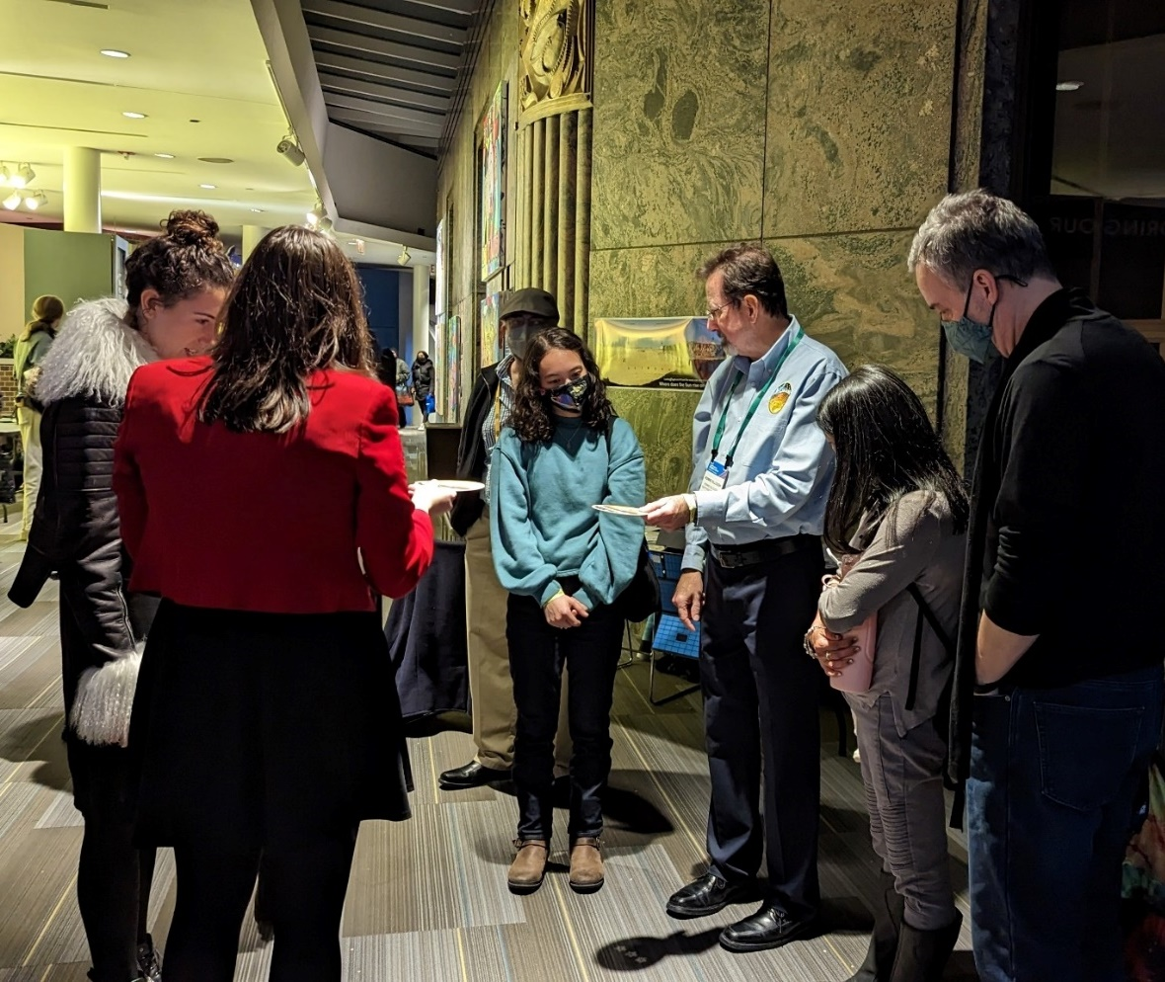
Using an Indoor Light Fixture as a Light Source Instead of the Sun
Being observant and playful leads to cool discoveries!
In Dec 2022, PUNCH team members and collaborators contributing to a public engagement program at the Adler Planetarium in Chicago discovered that our projector could project images of the ceiling lights! As you can see below, at the Adler, the spotlights in the ceiling are star-shaped!*
RK demonstrates our pinhole projector indoors for Adler visitors.
The projections are star-shaped because the light source is star-shaped.

Slide 12
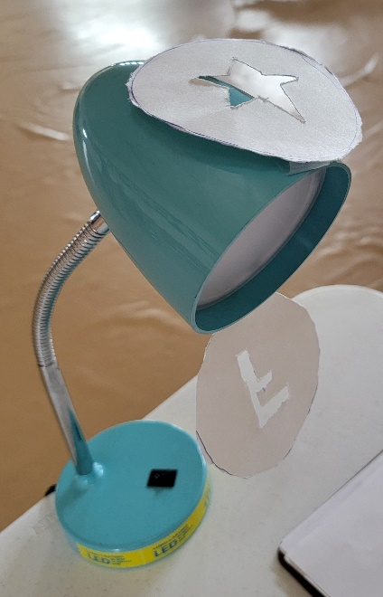
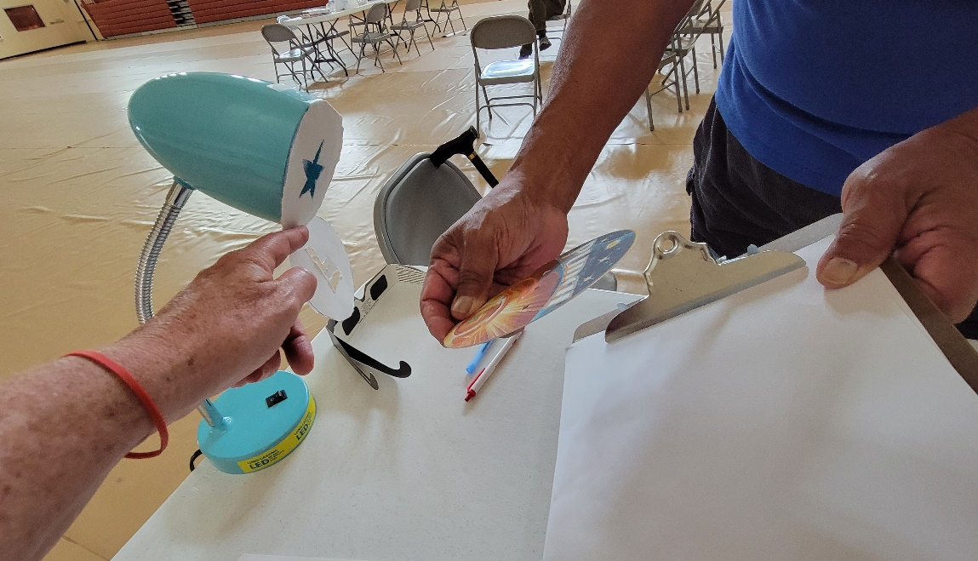
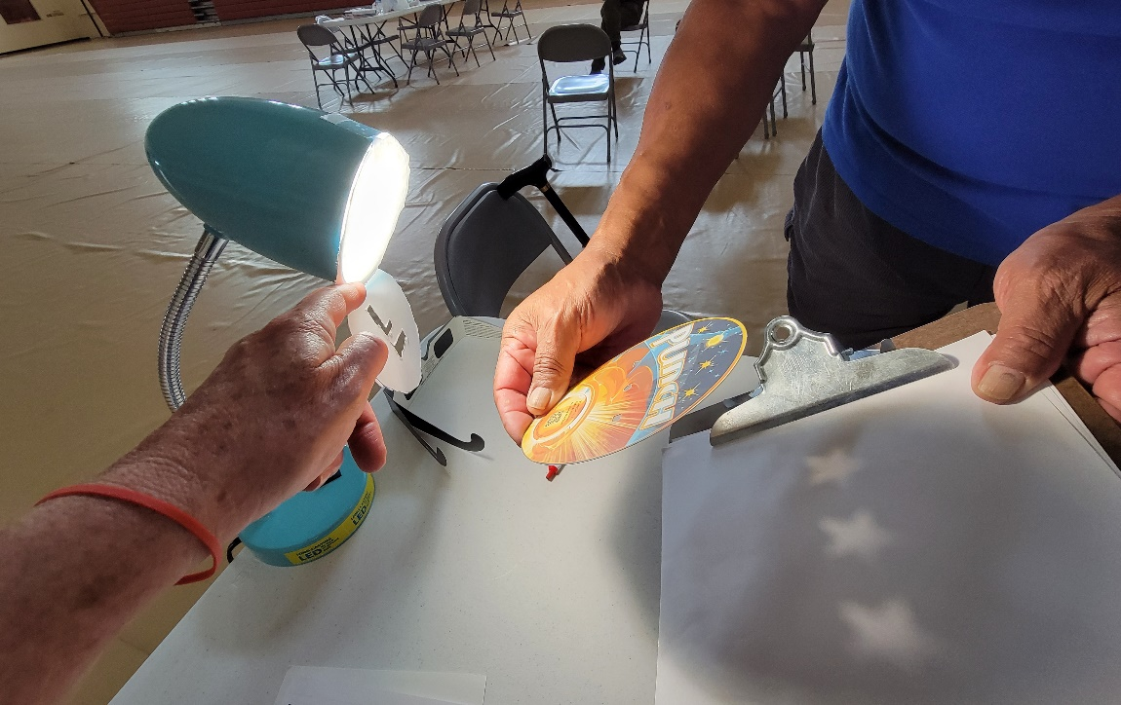
Pinhole Projection Using a Masked LED Lamp as the Light Source Instead of the Sun
Lamp OFF
Projection surface
The mask changes the shape of the light source.
Try using our projector with a (low-temperature) LED light fixture.
Use a cut out to alter the shape of the light source.
Lamp ON
NOTE: If the Projector were held closer to the surface, we would still see the triangular, round, and square-shaped holes.
The Projector holes are each imaging the star shape of the light source.
NOTE: See Section 5, Appendix A for a neat demo using the F-shaped mask.

Slide 13
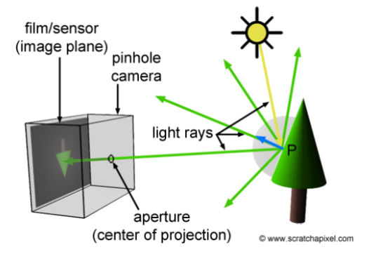
What is the difference between our Pinhole Projector and a Pinhole Camera?
Set-up for a Pinhole Viewer or Camera
Set-up for a Pinhole Projector
Darkened Projection
surface
Projection surface in broad daylight
Image of round Sun through square hole
Pinhole camera
Light rays
P
Pin-sized pinhole
Sunlight comes from this direction and passes thru the 3 holes
Adapted from Figure 3
https://www.scratchapixel.com/lessons/3d-basic-rendering/3d-viewing-pinhole-camera
Important differences are the size of the hole and whether the projection surface must be in the dark rather than working in broad daylight. See Table on the next slide.
Section 5: Appendix D provides details about our design trade-offs and why our pinhole projector has larger holes than pinhole cameras which have pin-sized holes.
3-Hole PUNCH Pinhole Projector with ~ 5mm holes

Slide 14
What is the difference between our Pinhole Projector and a Pinhole Camera?
Compare the images on the previous slide to help interpret the Table
Outreach for the NASA PUNCH mission
 | Pinhole Camera | Pinhole Projector
Size of Hole | Pin-sized hole | Larger holes (~5 mm)
Object being imaged | Can be the Sun but is usually an object reflecting the Sun’s light | Can be the Sun or other bright light source, even indoor lighting fixtures
Projected images | To see the dim image formed through a tiny hole, you must enclose the projection surface in a space that is completely dark. | Images can be seen in broad daylight. They appear on a projection surface in the shade of projector.
Photography | Photos can be created using light-sensitive paper or film on the projection surface | Does not record photos
Bahnu says: Prove that a pin-sized hole won’t create an image of the Sun that you can see in broad daylight. Use a pin or thumb tack to poke a hole in our projector so you can compare what happens with a pinhole-sized hole vs the 5mm holes of the Projector. Remember that Section 5: Appendix D explains our design trade-offs.

Slide 15
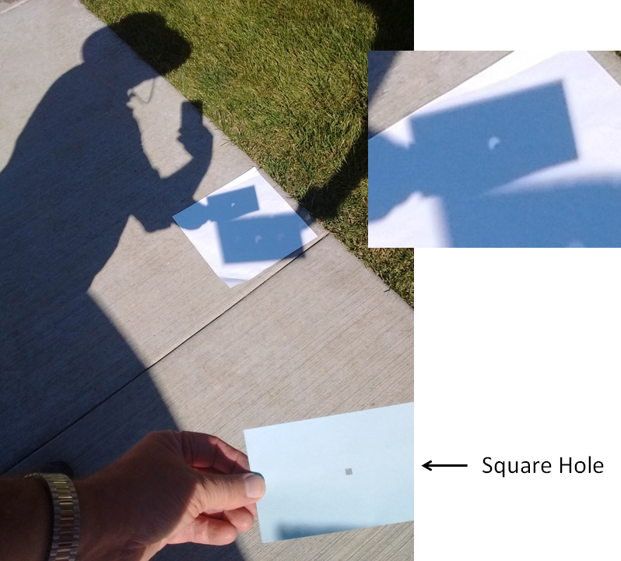
Pinhole Projection of the Sun
Observing the 2017 solar eclipse using a simple pinhole projector with a single square hole.
Outreach for the NASA PUNCH mission
RB is observing on 21 August 2017
in Roberts, Idaho
at 10:52 am
Pinhole image of the round Sun being eclipsed by the Moon during the 2017 Great American Eclipse
Rays of sunlight
square hole in a 3 x 5” card can be a “pinhole” projector

Slide 16
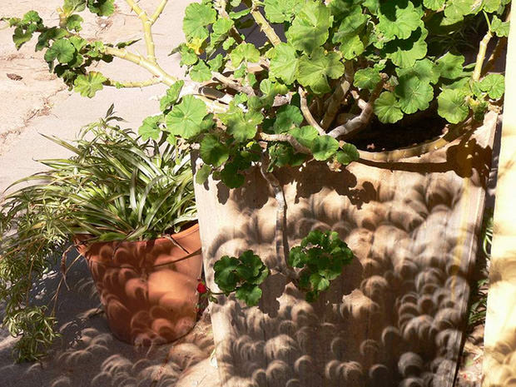
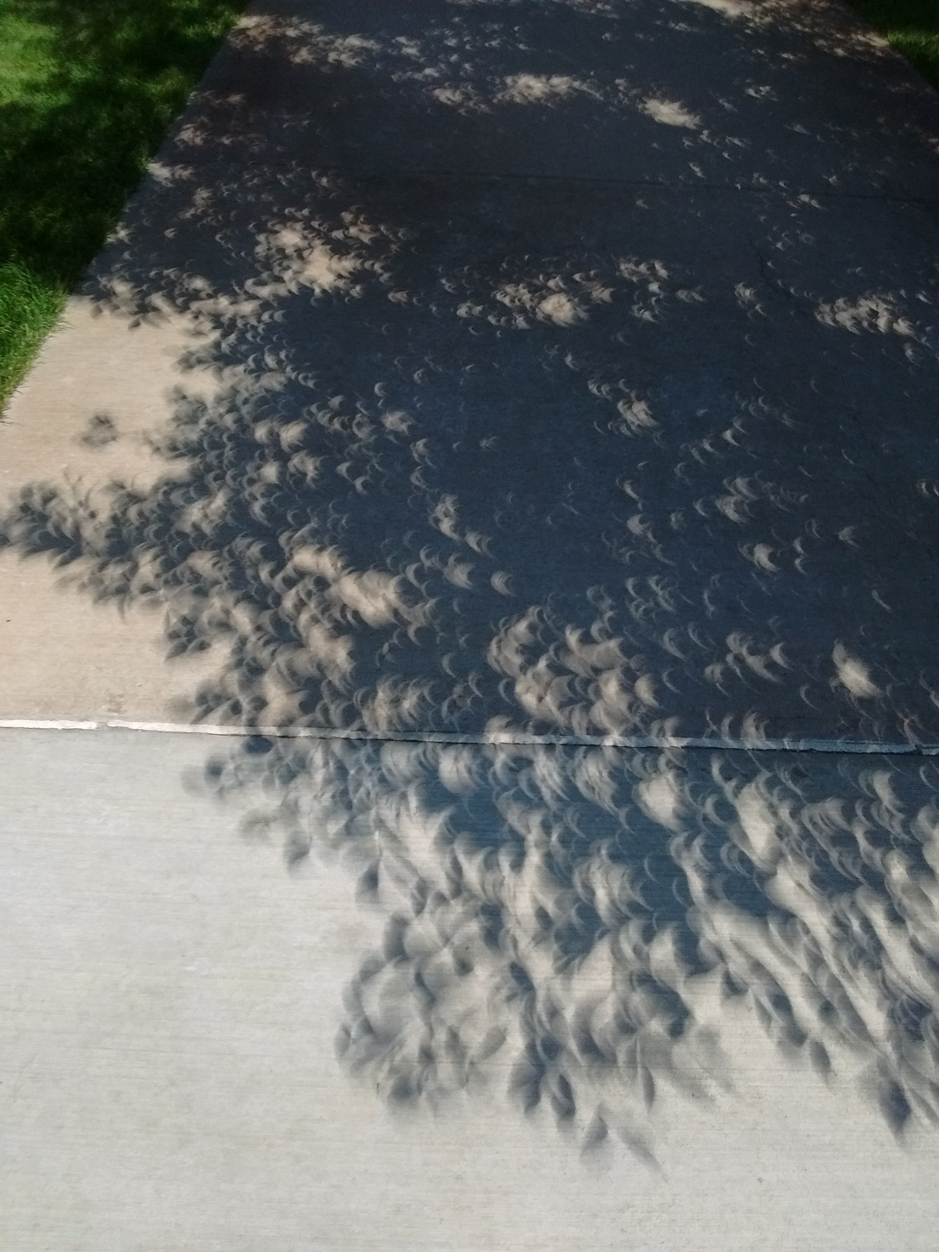
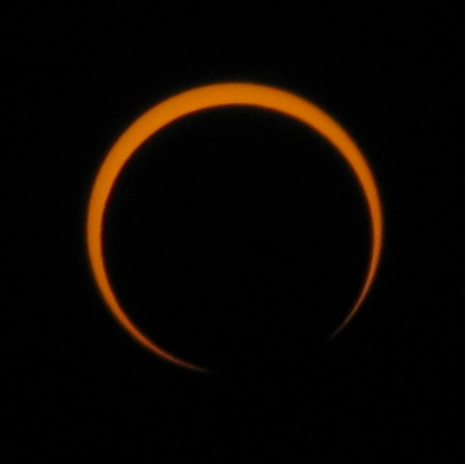
During solar eclipses it is easier to tell that we are seeing real pinhole images of the eclipsed Sun among the shadows of leaves.
Gaps between tree leaves make wonderful pinhole image displays as the Moon eclipses the Sun.
Upper left image by Cantavestrella. See Credits & Acknowledgements.

Slide 17
ADDITIONAL INFORMATION
Outreach for the NASA PUNCH mission
Link for Feedback
Valuable References
Credits & Acknowledgements
Links to PUNCH & PUNCH Outreach Products
CONTACT:
Dr. Cherilynn Morrow, Outreach Director for the NASA PUNCH mission [cherilynn.morrow@gmail.com]

Slide 18
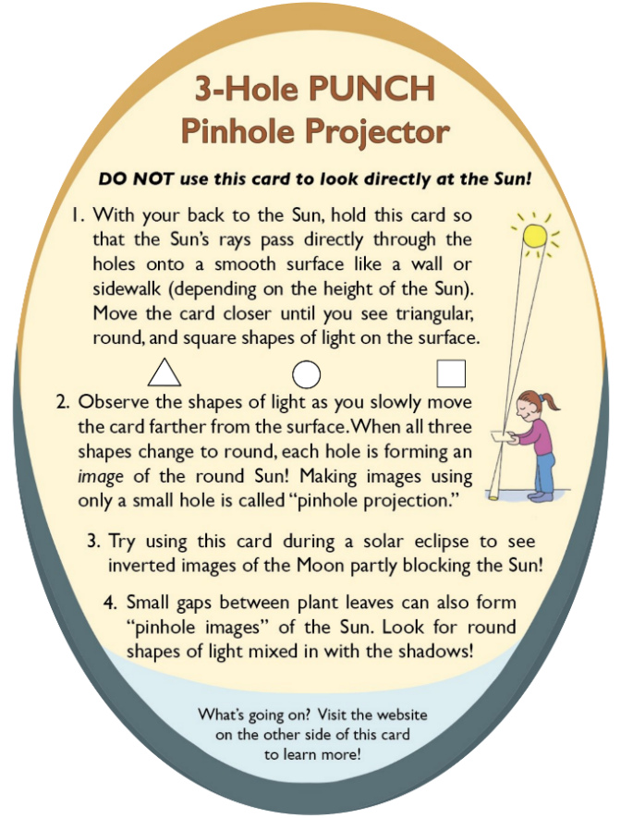
PLEASE GIVE US YOUR FEEDBACK
We take all feedback very seriously and are using it to keep improving our projector and this presentation.
Outreach for the NASA PUNCH mission
Please scan the QR code or go to this URL to give us feedback
​https://tinyurl.com/PinholeFeedback
Insights gained?
Remaining questions?
Ideas for improvements?
MARK 3 Version
Final Release for use up to and including the Annular Eclipse on 14 Oct 2023
FRONT
BACK

Slide 19
Valuable References
Lenses and Pinholes: What Does “In Focus” Mean?
A brief and clear explanation about what it means to be “in focus”: https://www.physicsforums.com/insights/lenses-pinholes-focus-mean/
2. How a Pinhole Camera Works (Part 1)
Excellent diagrams:
https://www.scratchapixel.com/lessons/3d-basic-rendering/3d-viewing-pinhole-camera
3. Real image: Collection of focus points made by converging light rays
We love the simple but insightful stick-figure:
https://www.wikiwand.com/en/Real_image
4. Your Eyes See Upside Down and Reversed
Lucid explanation by an eye doctor (MD) relating human eye to a pinhole camera: https://bceye.com/retinal-image-inverted-reversed/
5. Camera Obscura
The history of this wondrous effect, including reference to a possible paleo-camera:
https://en.wikipedia.org/wiki/Camera_obscura http://paleo-camera.com/archeo-optics/
6. Making, Measuring and Testing the “Optimal” Pinhole
A thorough and playful journey through the technical details of pinhole photography: https://www.35mmc.com/26/10/2020/making-measuring-and-testing-the-optimal-pinhole-pinhole-adventures-part-3-by-sroyon/

Slide 20
Credits & Acknowledgements
Primary Authors of the Explanatory Presentations:
Cherilynn Morrow, Robert Bigelow, and Mike Zawaski
cherilynn.morrow@gmail.com , arca965@gmail.com, and mjzawaski@gmail.com
Research & Development Team for the 3-Hole PUNCH Pinhole Projector
Cherilynn Morrow (editor-in-chief, concept development, field testing, photos)
Robert Bigelow (concept development, technical specifications, text reviewer, photos)
Briana Ingermann (graphic design, text developer, field testing, procurement of printing, photos)
Mike Zawaski (reviewer/consultant on explanatory presentation, graphic support, photos)
Sanlyn Buxner (head of field testing and evaluation, photos)
Jason Trump, Nina Byers, Geoff Skelton (text reviewer, field testing, reviewer of explanatory presentations)
Marisa Bevington & Marialis Rosario Franco (text reviewers, Spanish language translation)
GB Cornucopia, Bobbye Middendorf, Jeremy Osowski, Stacy Wolff (text reviewers, field testers, photo collaborators)
Craig DeForest (PUNCH PI, product review and approval, field tester)
Sarah Gibson (PUNCH Project Scientist, product review and approval)
Nicki Viall (PUNCH Mission Scientist, field tester, product review and approval)
Ronnie Killough (PUNCH Program Manager, field tester)
Gilly Gilbert (PUNCH Associate Investigator, field tester)
Countless others (who participated in field testing events and gave us their feedback)
Thank you also to our web developer Don Kolinski for posting and updating our work on the PUNCH website.

Slide 21
Please proceed to Section 2:
Observing Pinhole Images of the Sun in Our Everyday Environments
NASA PUNCH website: https://punch.space.swri.edu /
Scan here to access all PUNCH Outreach products or visit:
https://punch.space.swri.edu/punch_outreach_products.php
For questions or to request our 1-page monthly newsletter: Contact PUNCHOutreach@gmail.com
Photo: Alan Friedman

