Slide 1
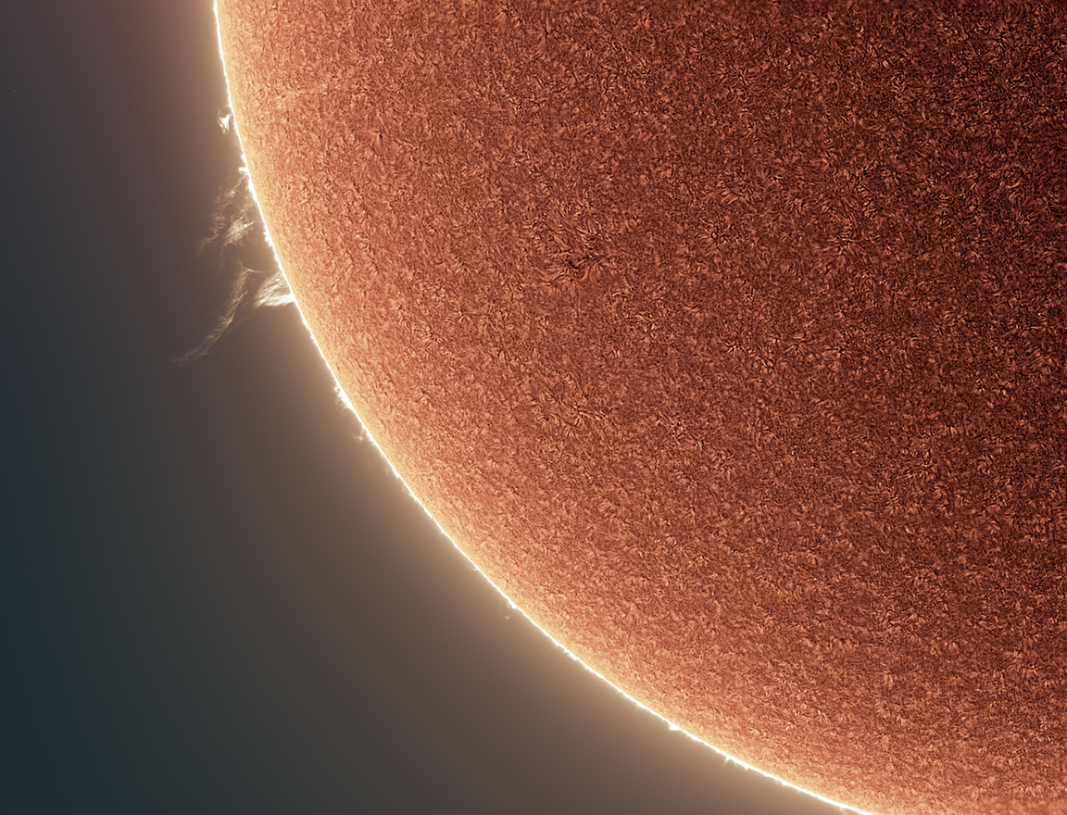
Welcome to Section 2:
Observing Pinhole Images of the Sun in Our Everyday Environments
NASA PUNCH website: https://punch.space.swri.edu /
Scan here to access all PUNCH Outreach products or visit:
https://punch.space.swri.edu/punch_outreach_products.php
For questions or to request our 1-page monthly newsletter: Contact PUNCHOutreach@gmail.com
Photo: Alan Friedman

Slide 2
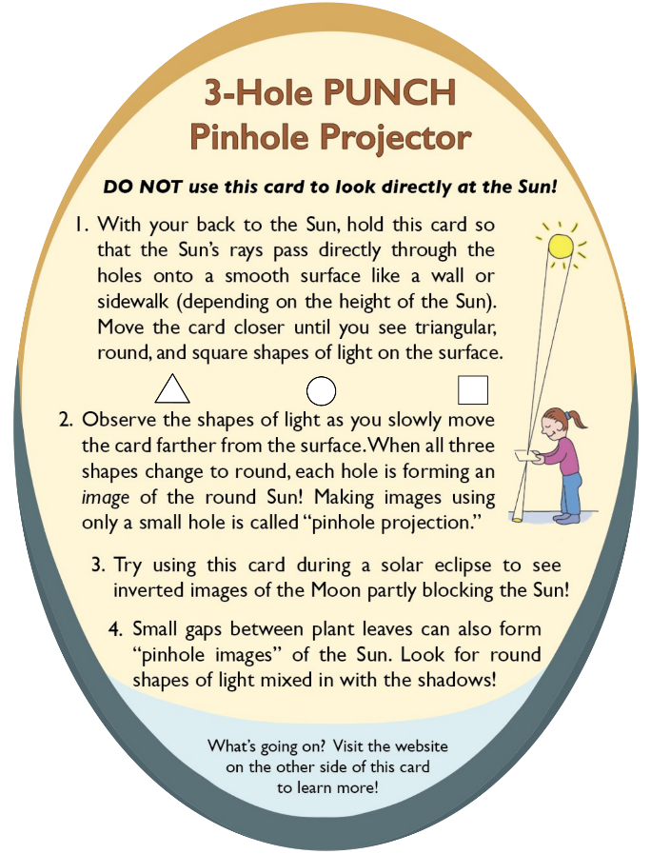
[Really] Understanding Pinhole Projection of the Sun
Outreach for the NASA PUNCH mission
Follow along with our playful learning adventure!
And PLEASE give us feedback on these questions at the link below:
Insights gained?
Remaining questions?
Ideas for improvements?
​https://tinyurl.com/PinholeFeedback
MARK 3 Version
Final Release for use up to and including the Annular Eclipse on 14 Oct 2023
FRONT
BACK

Slide 3
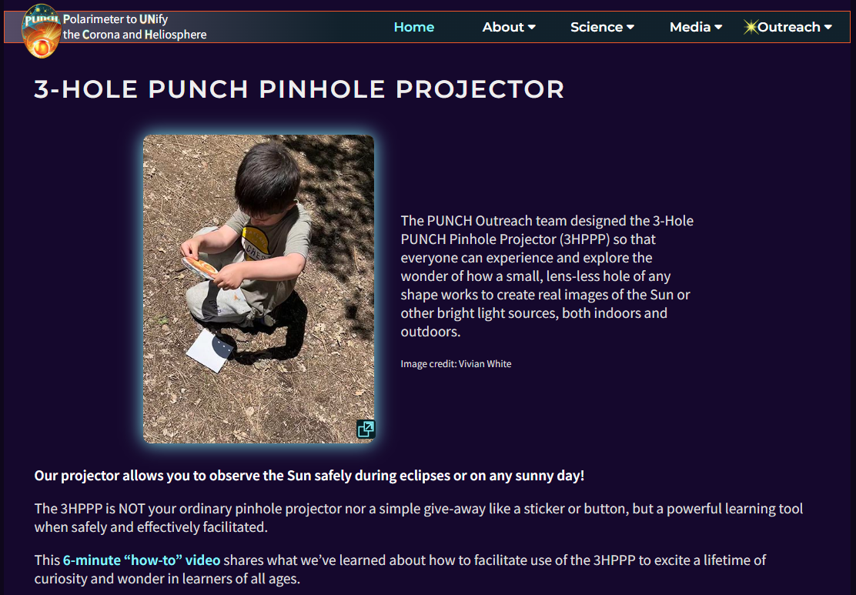
Essential viewing: 6-minute “how-to-facilitate” video [ https://punch.space.swri.edu/punch_outreach_pinholeprojector.php ]
Outreach for the NASA PUNCH mission

Slide 4
[Really] Understanding Pinhole Projection of the Sun
Introducing Bhanu
[BAH-noo]
Bhanu means
“ray of light”
in Sanskrit
Outreach for the NASA PUNCH mission
Bhanu helps guide our way through these Sections. You are in Section 2 of 5.
Section | Title of Section | Description of Section
1 | How to Use the 3-Hole PUNCH Pinhole Projector | introduces the 3-Hole PUNCH Pinhole Projector, demonstrates how to use it both outdoors and indoors, and describes its differences from a pinhole camera/viewer.
2 | Observing Pinhole Images of the Sun in Our Everyday Environments | teaches you how to observe the phenomenon of pinhole images of the Sun in our everyday world, both indoors and outdoors.
3 | Exploring Pinhole Projection Using Your Own Hands | invites you to explore the behavior of pinhole projection by experimenting with your own hands (try both palms up!)
4 | Explaining and Understanding How Pinhole Imaging Happens | interactively guides your quest for explanations and deeper understanding of how pinhole imaging happens. After this, you will really understand why small, lens-less holes can create images.
5 | APPENDICES A-E: More Insights & Fun Resources | offers more insights & resources (e.g., explaining the relationship between pinhole images and the view through “eclipse” glasses)
CONTACT:
Dr. Cherilynn Morrow, Outreach Director for the NASA PUNCH mission [cherilynn.morrow@gmail.com]

Slide 5
Pinhole Projection of the Sun
Outreach for the NASA PUNCH mission
2. Observing Pinhole Images of the Sun in Our Everyday Environments
Bahnu says: Be alert to seeing pinhole images of the Sun every sunny day! The leaves in bushes and trees are like Nature’s camera but almost nobody notices. Learn to see this wonder hiding in plain sight and help others to see it too!
CONTACT:
Dr. Cherilynn Morrow, Outreach Director for the NASA PUNCH mission [cherilynn.morrow@gmail.com]

Slide 6
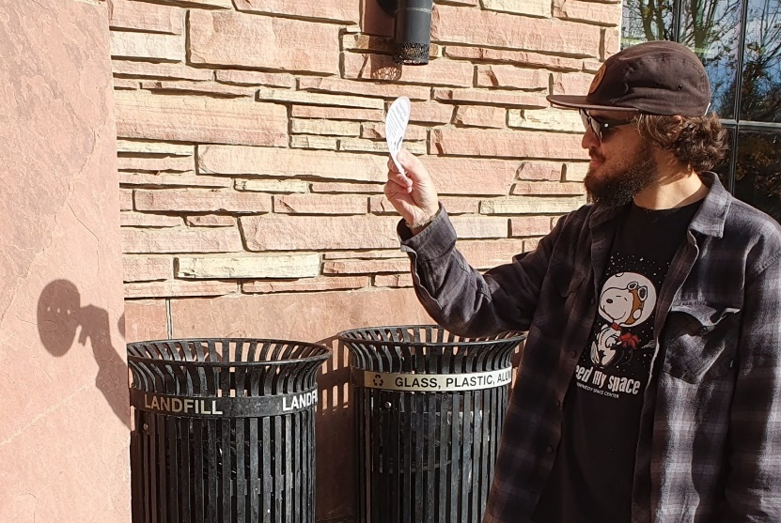
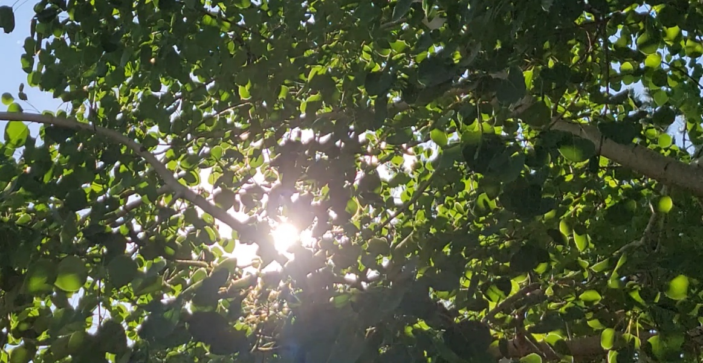
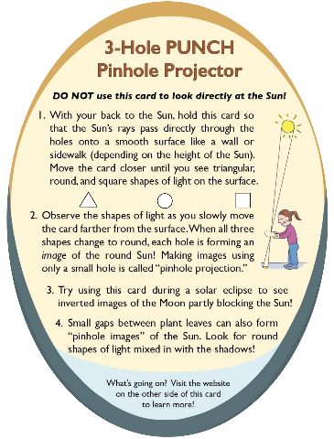
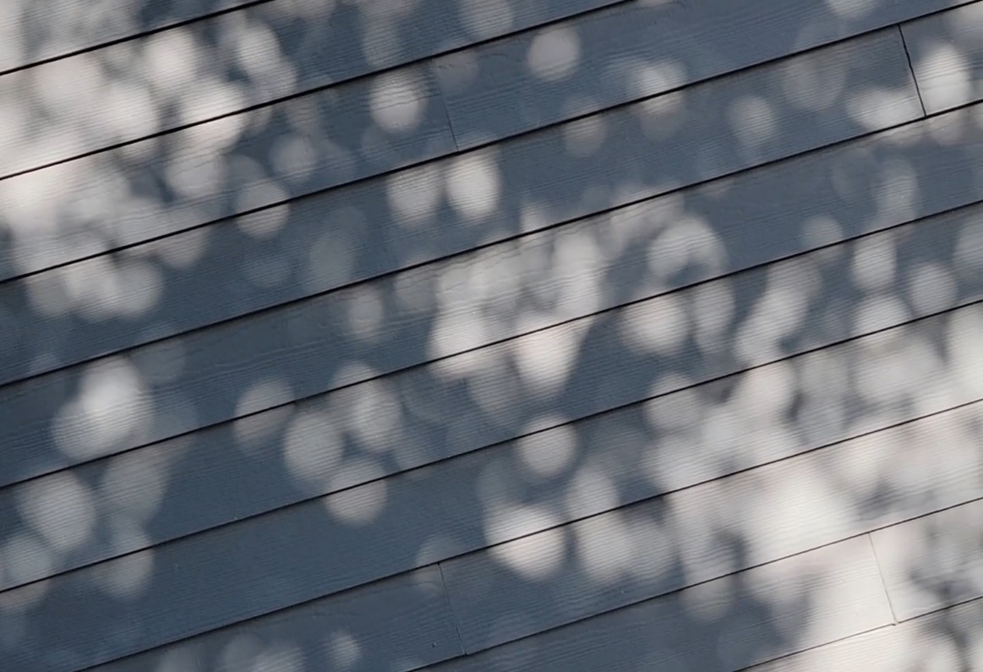
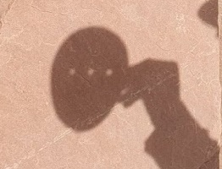
Pinhole Projection of the Sun
Gaps between leaves are like the “pinholes” of our projector, and even these odd-shaped gaps create round images of our sun!
Sunlight comes from this direction
Sunlight passes through odd-shaped gaps between the leaves
JO is observing in the morning in Dec
projection surface
projection surface
The images of the Sun on the side of the building are round even though the gaps between leaves have odd shapes.
Image of round Sun through square hole

Slide 7
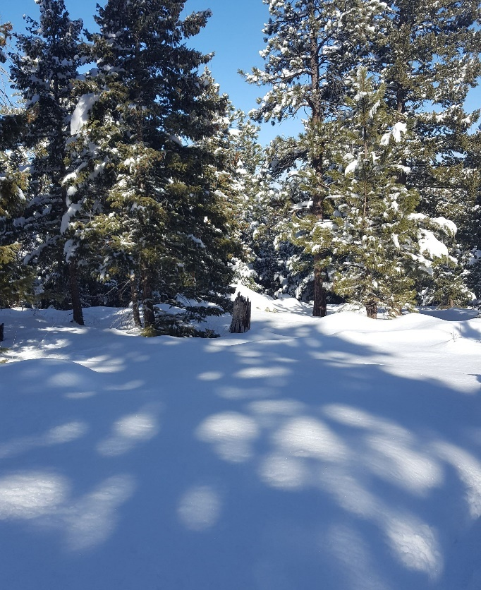
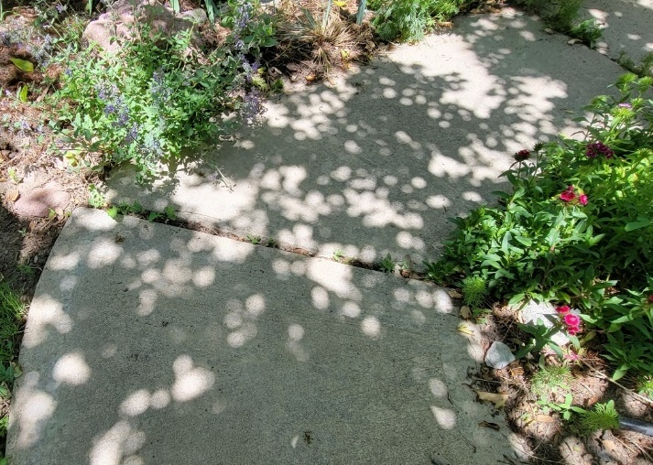
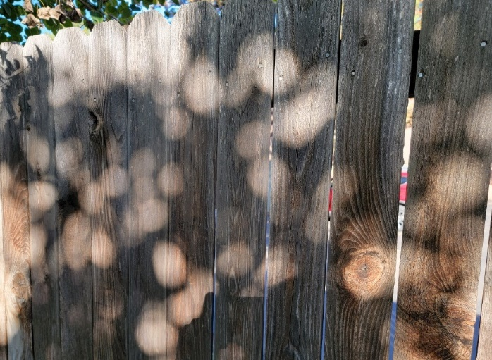
Pinhole Projection of the Sun
We can find “pinhole images” of the round Sun all around us.
These are REAL images of the actual Sun – our star!
We can find them at all times of the day and all times of the year.
We find them amid the shadows of trees with leaves or needles.
We find them on sidewalks, on snow, on fences, and buildings.
Outreach for the NASA PUNCH mission
The images of the Sun come in all sizes and may be more round or more oval-like depending on the angle between the incoming sunlight and the projection surface.

Slide 8
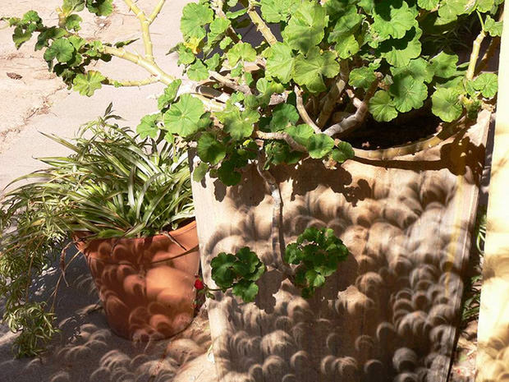
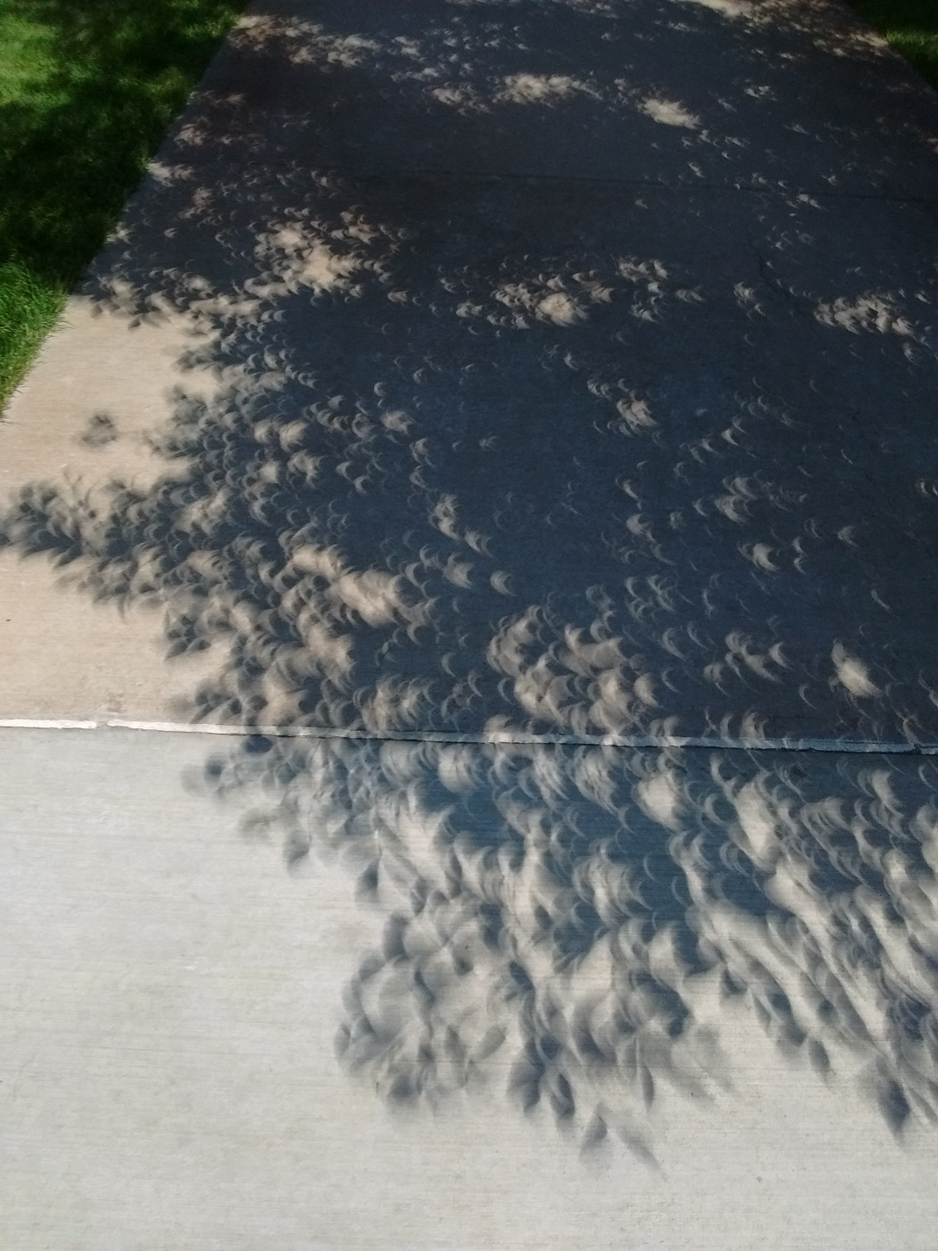
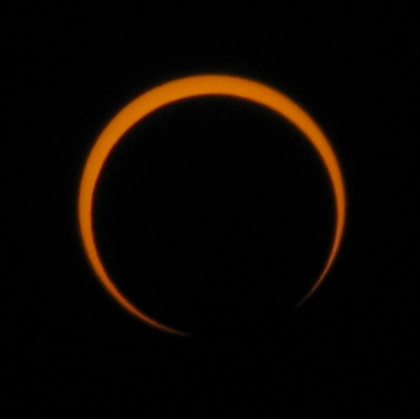
During solar eclipses it is easier to tell that we are seeing real images of the Sun.
Gaps between tree leaves make wonderful pinhole image displays as the Moon eclipses the Sun.
Upper left image by Cantavestrella. See Credits & Acknowledgements for other photo credits.

Slide 9
Notice that some of the dimmer images are in sharper focus.
Images of the round Sun projected on a sidewalk as midday sunlight passes through the small gaps between leaves of a tree

Slide 10
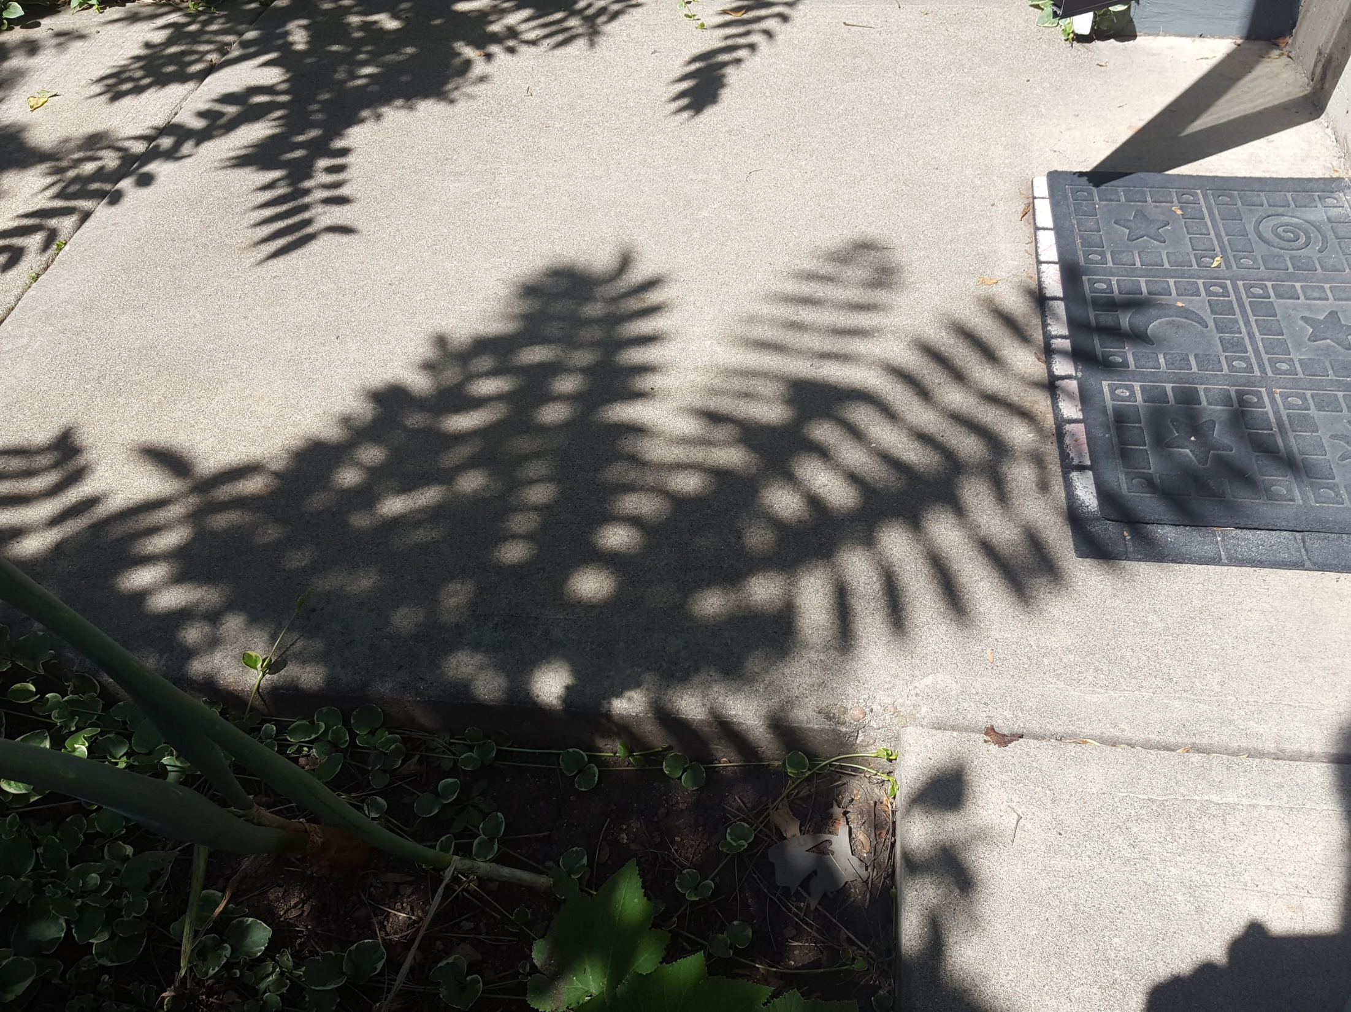
Notice the combination of regular shadows and pinhole projected images of the Sun.
Images of the round Sun projected on a sidewalk as sunlight passes through the small gaps near the base of fern-like leaves.

Slide 11
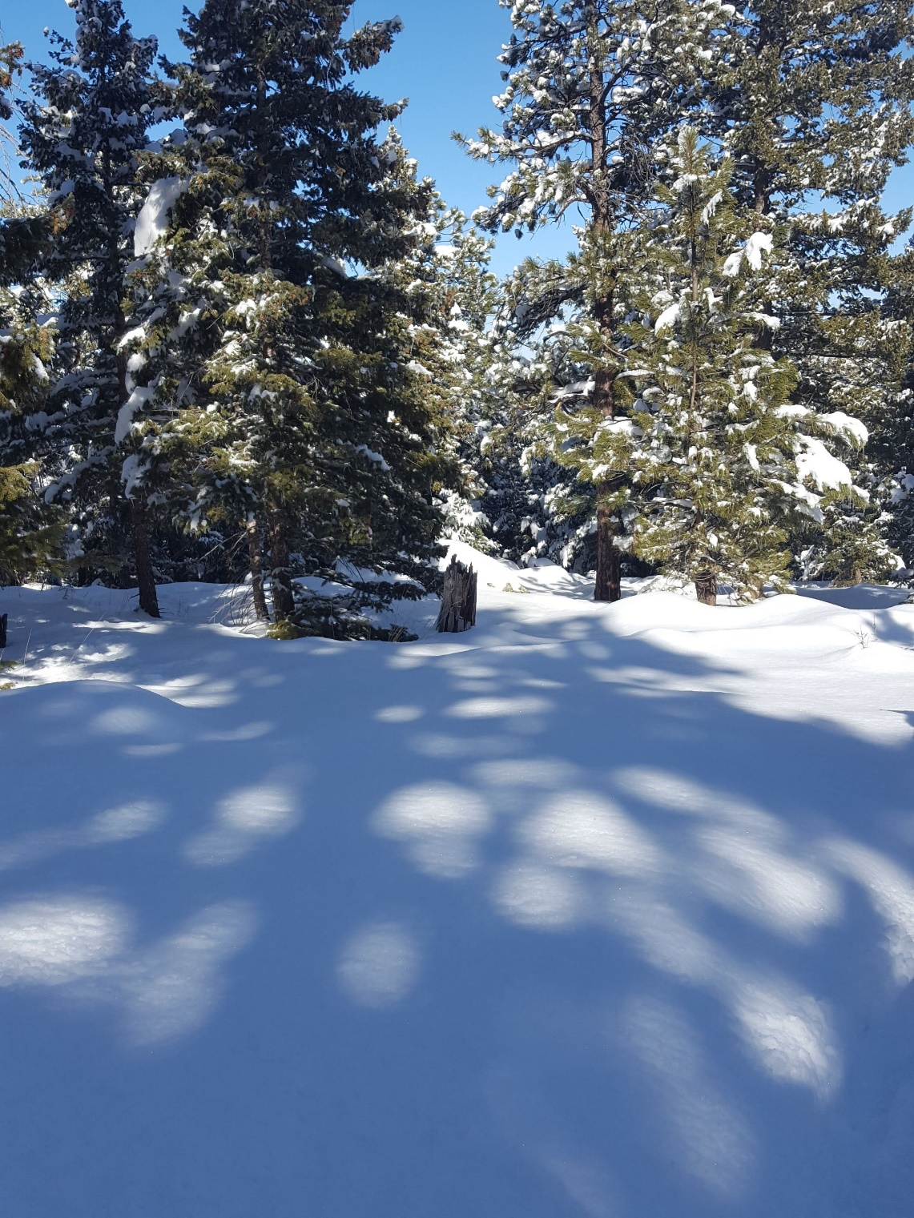
Notice how much larger these images are beneath the tall Ponderosa Pine trees.
Images of the Sun projected on the snow as low-angle sunlight streams through gaps among the pine needles

Slide 12
Morning & evening are great times to see pinhole images of the Sun on vertical surfaces. Why?
Images of the round Sun projected on a fence as morning sunlight passes through the small gaps between leaves of a tree

Slide 13
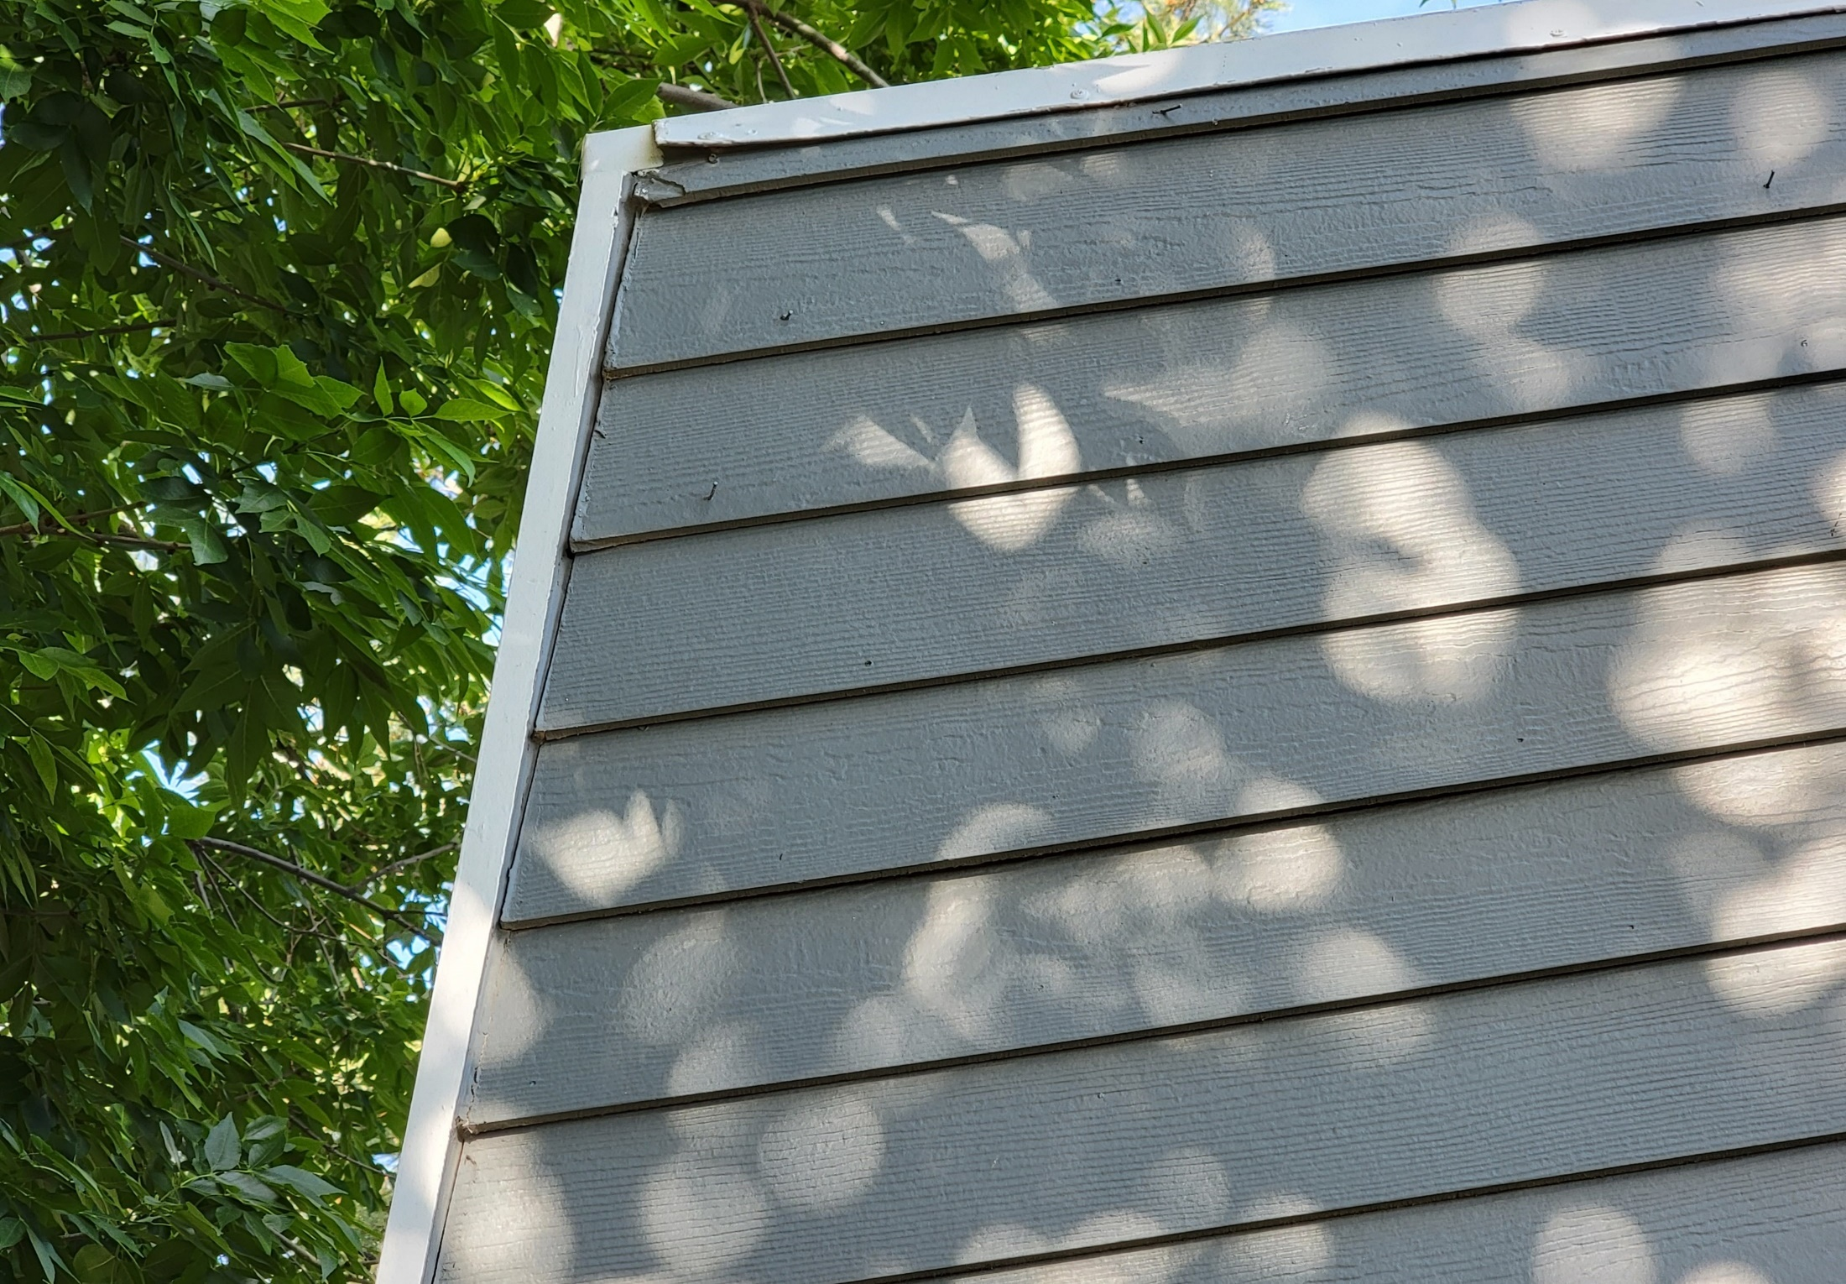
Images of the round Sun projected on a building as morning sunlight streams through small gaps between leaves of a tree

Slide 14
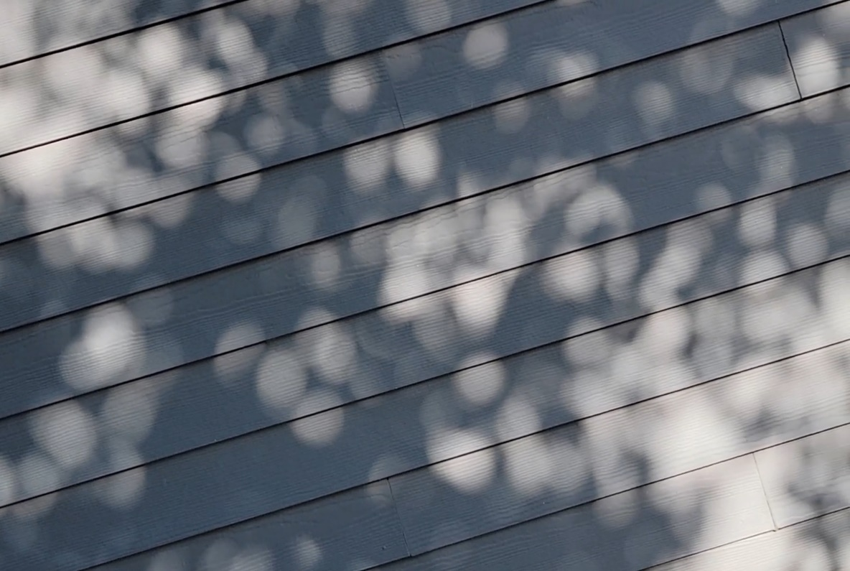
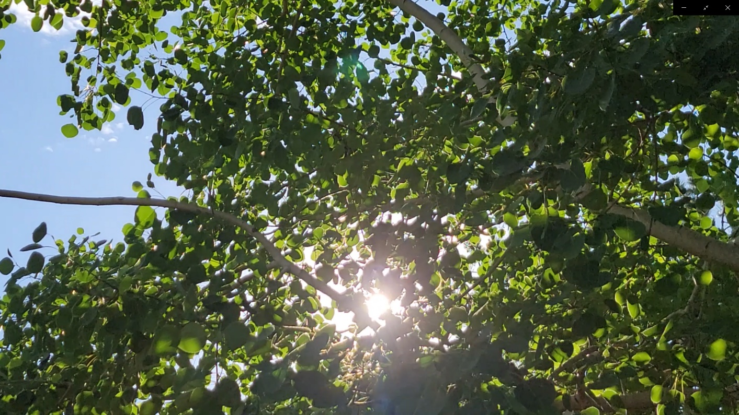
Pinhole Projection of the Sun
Pinhole images of the Sun projected on a building as morning sunlight streams through gaps between the leaves of an Aspen tree.
When the Sun is lower in the sky (early morning and late afternoon) it is easier to see pinhole images of the Sun on a vertical surface.

Slide 15
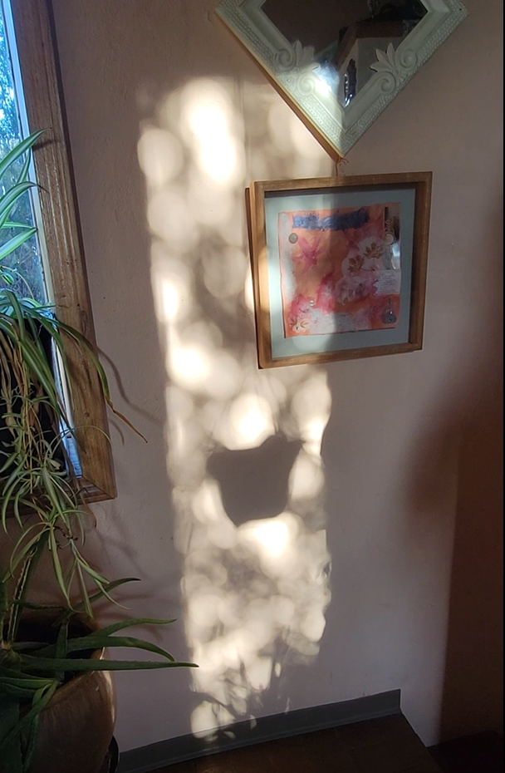
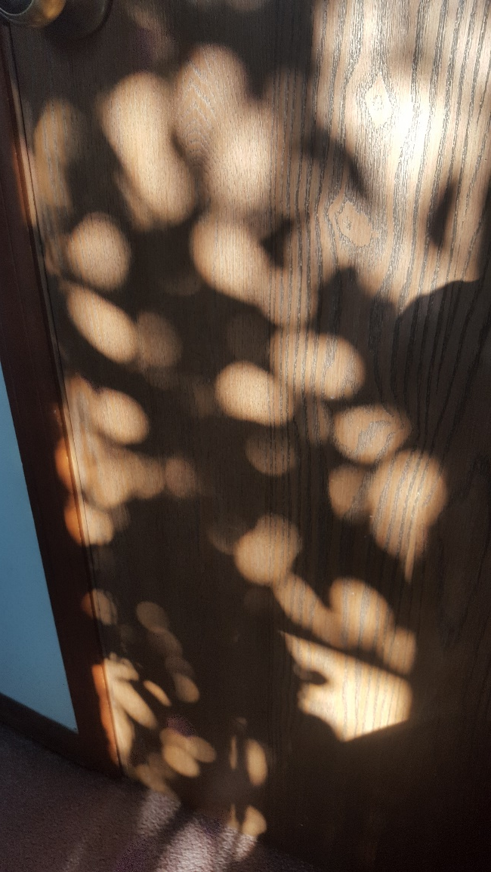
Pinhole Projection of the Sun
We can also find pinhole images of the Sun INSIDE when sunlight shines through the leaves of a tree or bush outside a window
Outreach for the NASA PUNCH mission
Images of the round Sun projected on a wall as late afternoon sunlight passes through leaves outside a window.

Slide 16
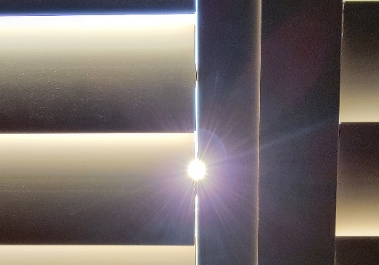
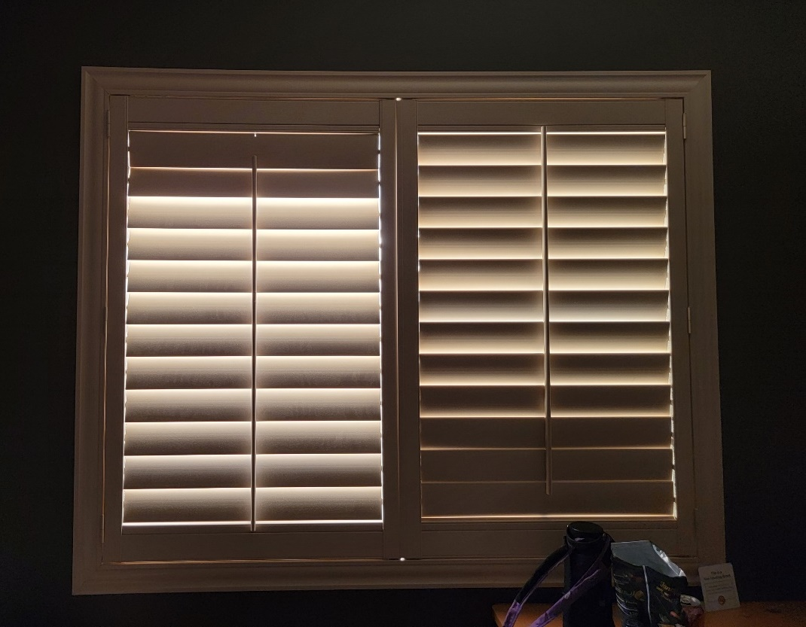
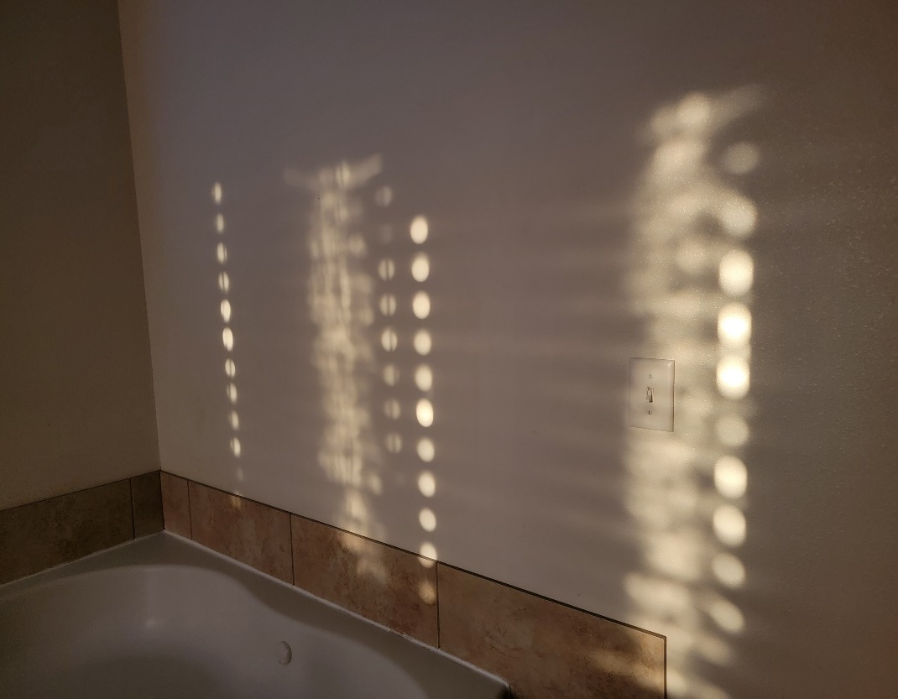
Pinhole Projection of the Sun
Look for pinhole images of the Sun when sunlight passes through the narrow gaps at the edges of window blinds.
These small gaps at the edges of the blinds are long, thin rectangles
But see how perfectly round are the images of the Sun they project on the wall!
Images of the Sun projected on a hotel room wall as morning sunlight passes through gaps at the sides of window blinds.

Slide 17
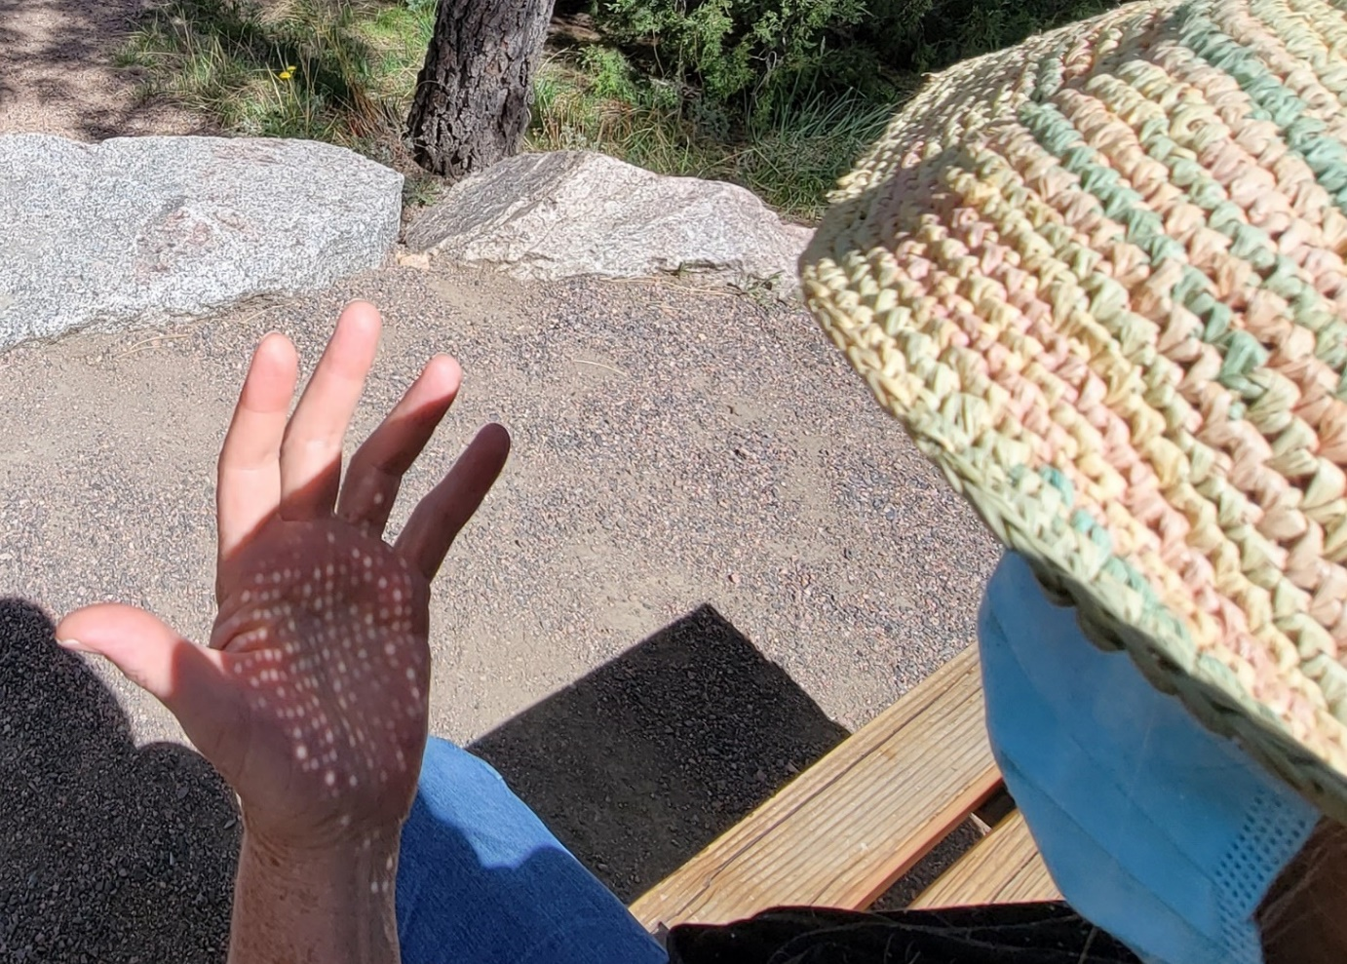
Pinhole Projection of the Sun
You can also find pinhole images of the Sun as sunlight passes through the tight weave of a straw hat
Outreach for the NASA PUNCH mission
The size and clarity of pinhole images depend on the size of the hole and the distance between the hole and the surface on which the images are projected (in this case CM’s hand).

Slide 18
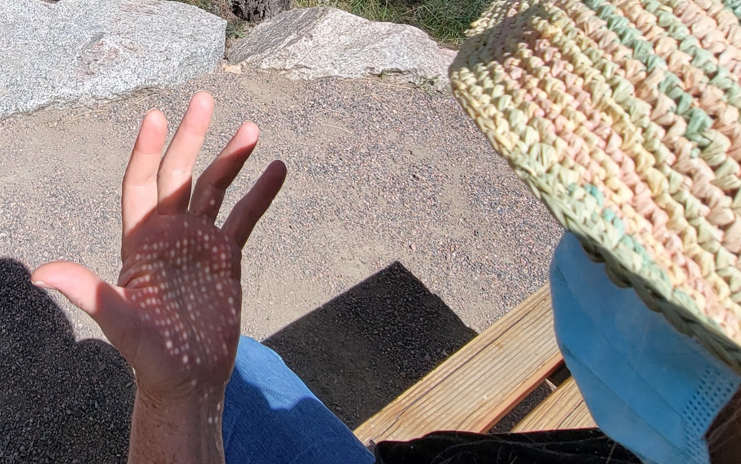
What else can you find that will create pinhole images of the Sun?
Dozens of pinhole images of the Sun are projected on CM’s hand as the Sun shines through the tiny gaps in her straw hat.

Slide 19
ADDITIONAL INFORMATION
Outreach for the NASA PUNCH mission
Link for Feedback
Valuable References
Credits & Acknowledgements
Links to PUNCH & PUNCH Outreach Products
CONTACT:
Dr. Cherilynn Morrow, Outreach Director for the NASA PUNCH mission [cherilynn.morrow@gmail.com]

Slide 20
[Really] Understanding Pinhole Projection of the Sun
Outreach for the NASA PUNCH mission
Follow along with our playful learning adventure!
And PLEASE give us feedback on these questions at the link below:
Insights gained?
Remaining questions?
Ideas for improvements?
​https://tinyurl.com/PinholeFeedback
MARK 3 Version
Final Release for use up to and including the Annular Eclipse on 14 Oct 2023
FRONT
BACK

Slide 21
Valuable References
Lenses and Pinholes: What Does “In Focus” Mean?
A brief and clear explanation about what it means to be “in focus”: https://www.physicsforums.com/insights/lenses-pinholes-focus-mean/
2. How a Pinhole Camera Works (Part 1)
Excellent diagrams:
https://www.scratchapixel.com/lessons/3d-basic-rendering/3d-viewing-pinhole-camera
3. Real image: Collection of focus points made by converging light rays
We love the simple but insightful stick-figure:
https://www.wikiwand.com/en/Real_image
4. Your Eyes See Upside Down and Reversed
Lucid explanation by an eye doctor (MD) relating human eye to a pinhole camera: https://bceye.com/retinal-image-inverted-reversed/
5. Camera Obscura
The history of this wondrous effect, including reference to a possible paleo-camera:
https://en.wikipedia.org/wiki/Camera_obscura http://paleo-camera.com/archeo-optics/
6. Making, Measuring and Testing the “Optimal” Pinhole
A thorough and playful journey through the technical details of pinhole photography: https://www.35mmc.com/26/10/2020/making-measuring-and-testing-the-optimal-pinhole-pinhole-adventures-part-3-by-sroyon/

Slide 22
Credits & Acknowledgements
Primary Authors of the Explanatory Presentations:
Cherilynn Morrow, Robert Bigelow, and Mike Zawaski
cherilynn.morrow@gmail.com , arca965@gmail.com, and mjzawaski@gmail.com
Research & Development Team for the 3-Hole PUNCH Pinhole Projector
Cherilynn Morrow (editor-in-chief, concept development, field testing, photos)
Robert Bigelow (concept development, technical specifications, text reviewer, photos)
Briana Ingermann (graphic design, text developer, field testing, procurement of printing, photos)
Mike Zawaski (reviewer/consultant on explanatory presentation, graphic support, photos)
Sanlyn Buxner (head of field testing and evaluation, photos)
Jason Trump, Nina Byers, Geoff Skelton (text reviewer, field testing, reviewer of explanatory presentations)
Marisa Bevington & Marialis Rosario Franco (text reviewers, Spanish language translation)
GB Cornucopia, Bobbye Middendorf, Jeremy Osowski, Stacy Wolff (text reviewers, field testers, photo collaborators)
Craig DeForest (PUNCH PI, product review and approval, field tester)
Sarah Gibson (PUNCH Project Scientist, product review and approval)
Nicki Viall (PUNCH Mission Scientist, field tester, product review and approval)
Ronnie Killough (PUNCH Program Manager, field tester)
Gilly Gilbert (PUNCH Associate Investigator, field tester)
Countless others (who participated in field testing events and gave us their feedback)
Thank you also to our web developer Don Kolinski for posting and updating our work on the PUNCH website.

Slide 23
Please proceed to Section 3:
Exploring Pinhole Projection with Your Own Hands
NASA PUNCH website: https://punch.space.swri.edu /
Scan here to access all PUNCH Outreach products or visit:
https://punch.space.swri.edu/punch_outreach_products.php
For questions or to request our 1-page monthly newsletter: Contact PUNCHOutreach@gmail.com
Photo: Alan Friedman

