Slide 1
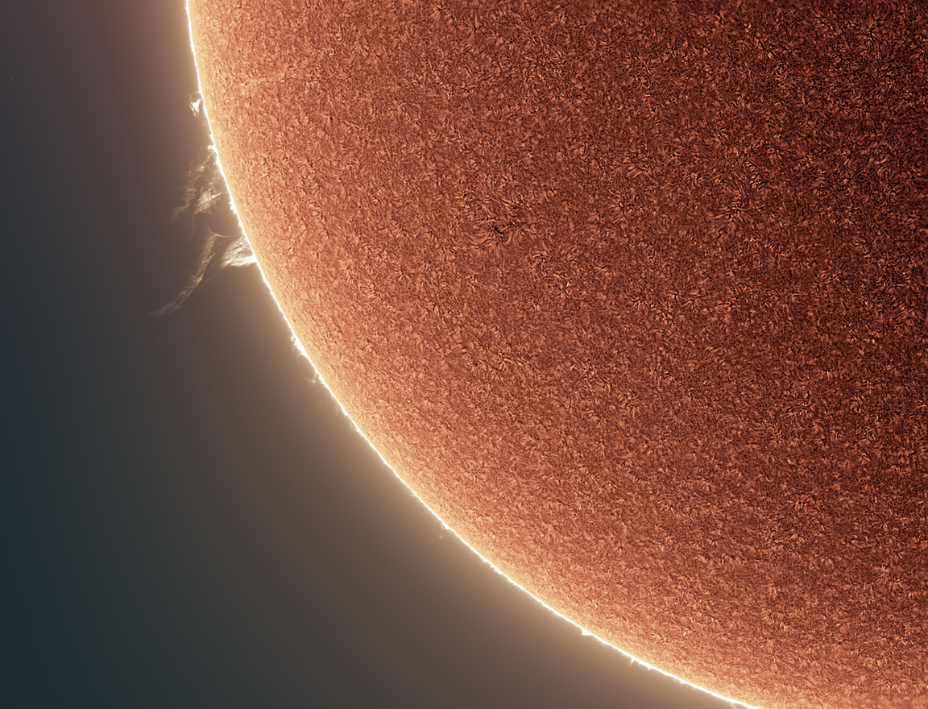
Welcome to Section 4:
Explaining and Understanding How Pinhole Imaging Happens
NASA PUNCH website: https://punch.space.swri.edu /
Scan here to access all PUNCH Outreach products or visit:
https://punch.space.swri.edu/punch_outreach_products.php
For questions or to request our 1-page monthly newsletter: Contact PUNCHOutreach@gmail.com
Photo: Alan Friedman

Slide 2
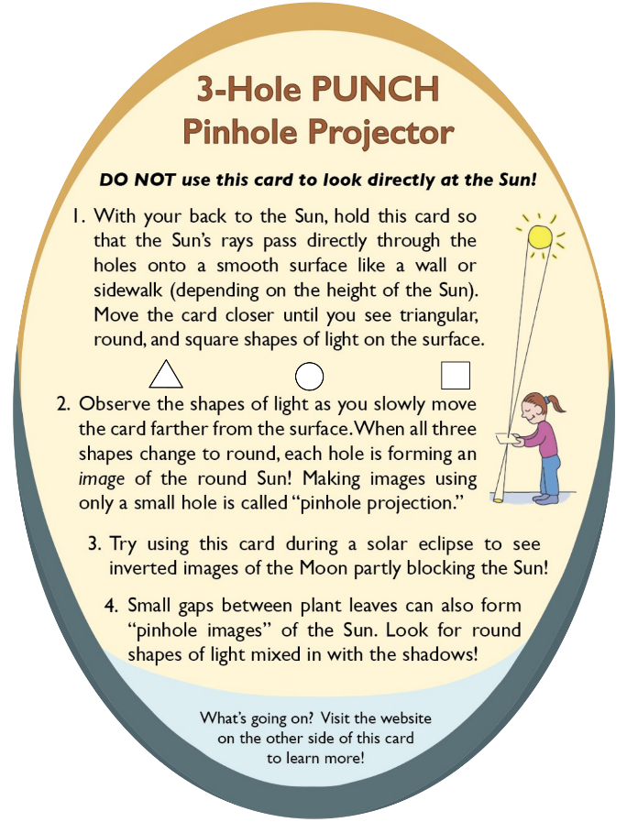
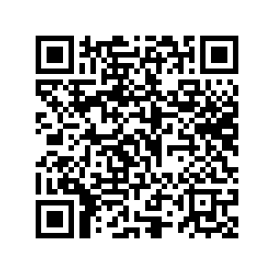
[Really] Understanding Pinhole Projection of the Sun
Outreach for the NASA PUNCH mission
Follow along with our playful learning adventure!
And PLEASE give us feedback on these questions at the link below:
Insights gained?
Remaining questions?
Ideas for improvements?
​https://tinyurl.com/PinholeFeedback
MARK 3 Version
Final Release for use up to and including the Annular Eclipse on 14 Oct 2023
FRONT
BACK

Slide 3
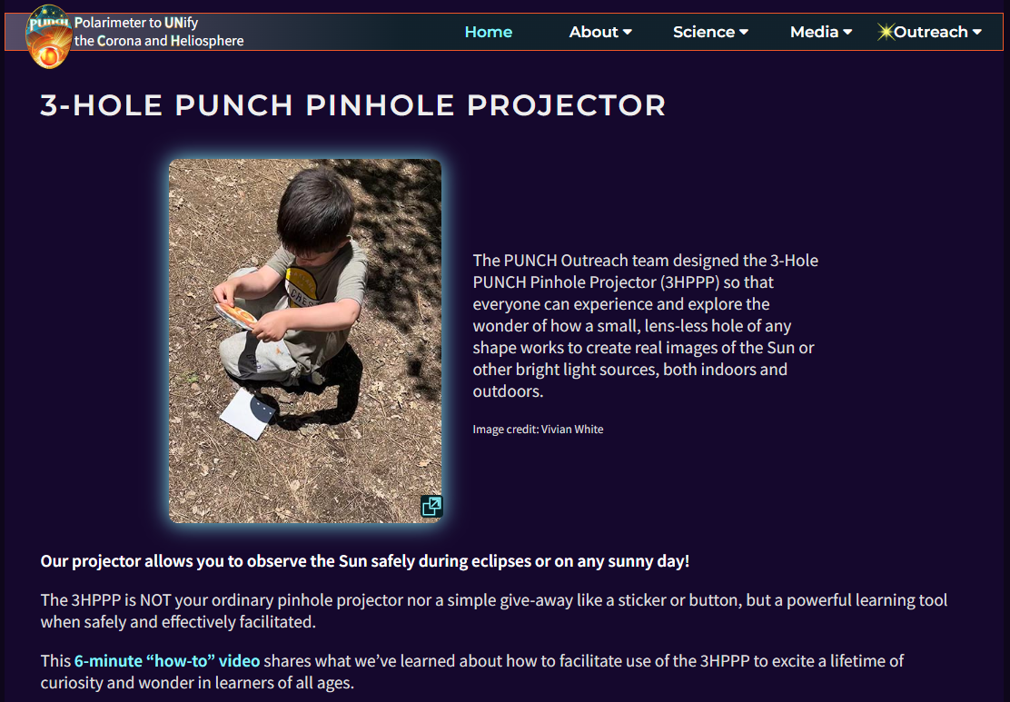
Essential viewing: 6-minute “how-to-facilitate” video [ https://punch.space.swri.edu/punch_outreach_pinholeprojector.php ]
Outreach for the NASA PUNCH mission

Slide 4
[Really] Understanding Pinhole Projection of the Sun
Introducing Bhanu
[BAH-noo]
Bhanu means
“ray of light”
in Sanskrit
Outreach for the NASA PUNCH mission
Bhanu helps guide our way through these Sections. You are in Section 4 of 5.
Section | Title of Section | Description of Section
1 | How to Use the 3-Hole PUNCH Pinhole Projector | introduces the 3-Hole PUNCH Pinhole Projector, demonstrates how to use it both outdoors and indoors, and describes its differences from a pinhole camera/viewer.
2 | Observing Pinhole Images of the Sun in Our Everyday Environments | teaches you how to observe the phenomenon of pinhole images of the Sun in our everyday world, both indoors and outdoors.
3 | Exploring Pinhole Projection Using Your Own Hands | invites you to explore the behavior of pinhole projection by experimenting with your own hands (try both palms up!)
4 | Explaining and Understanding How Pinhole Imaging Happens | guides your quest for explanations and deeper understanding of how pinhole imaging happens. After this, you will really understand why small, lens-less holes can create images.
5 | APPENDICES A-E: More Insights & Fun Resources | offers more insights & resources (e.g., explaining the relationship between pinhole images and the view through “eclipse” glasses)
CONTACT:
Dr. Cherilynn Morrow, Outreach Director for the NASA PUNCH mission [cherilynn.morrow@gmail.com]

Slide 5
Pinhole Projection of the Sun
Outreach for the NASA PUNCH mission
4. Explaining and Understanding How Pinhole Imaging Happens
Bahnu says: Find the courage to be confused!
Lots of things worthy of our understanding are worth the discomfort of not understanding them at first. Confusion is a sign that you are on the path to a new insight. Persevere!
CONTACT:
Dr. Cherilynn Morrow, Outreach Director for the NASA PUNCH mission [cherilynn.morrow@gmail.com]

Slide 6
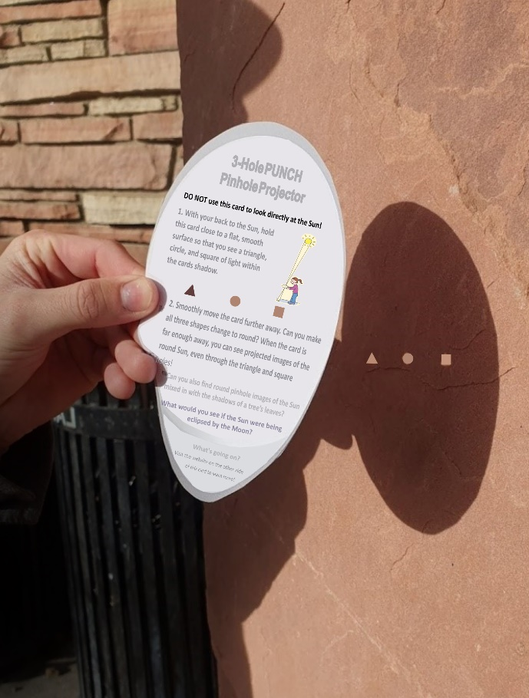
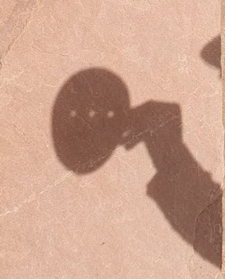
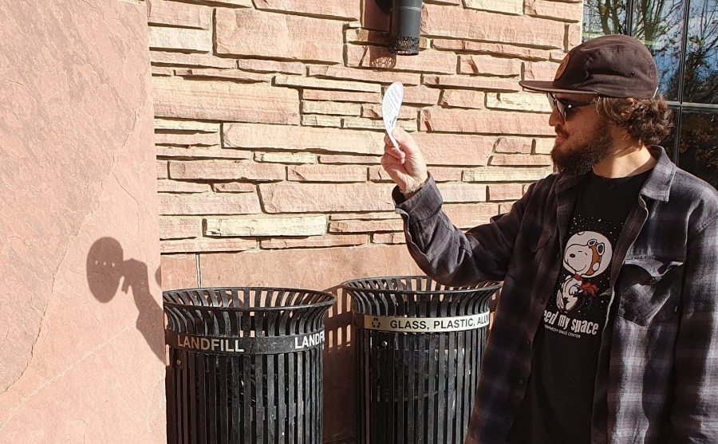
1. Projector close to surface. Triangle, round, and square shapes of light are sharp.
2. Projector farther away from surface. All three shapes of light are round and fuzzier.
Case 1
Smooth flat
projection surface
Case 2
Outreach for the NASA PUNCH mission
Were you able to observe both Case 1 and Case 2?
Image of round Sun through square hole
Sunlight comes from this direction and passes thru the holes
square shape of light
KEY QUESTION: Why don’t we see round images of the Sun when the projector is held closer to the projection surface (Case 1), but we do see them when we move it farther away (Case 2)?
JO is observing in the morning in Dec

Slide 7
Pinhole Projection of the Sun
From our exploration of how pinhole projection of the Sun behaves we have collected two key questions:
Outreach for the NASA PUNCH mission
1. Why don’t we see round images of the Sun when the projector is held closer to the projection surface (Case 1), but we do see them when we move it farther away (Case 2)?
2. How can small, non-round holes formed by gaps between leaves, strands of a straw hat, fingers of our hands, and by our pinhole projectors create images of the round Sun?

Slide 8
Pinhole Projection of the Sun
Outreach for the NASA PUNCH mission
If you are not familiar with ray tracing, OR if you would like to experience our novel way of preparing learners to understand ray tracing, please continue to the next slide.
If you are already familiar with ray tracing, go to slide 34.

Slide 9
Pinhole Projection of the Sun
From our exploration of how pinhole projection of the Sun behaves we have collected two key questions:
Outreach for the NASA PUNCH mission
To address our two questions, we first need to study how light emitted or reflected from an object interacts with the “pinhole” card to reach a projection surface.
Bhanu will help. Because we should not look directly at the Sun, we will pretend that Bhanu is the Sun, and our eye is viewing Bhanu from the perspective of different positions on the projection surface.
Sun Bhanu

Slide 10
To safely explore how light reflected from Bhanu passes through a pinhole to a projection surface, we view Bhanu through a small, non-round hole.
Outreach for the NASA PUNCH mission
Bhanu
[BAH-noo]
Bhanu means
“ray of light”
in Sanskrit
NEVER look at the Sun through the holes in a pinhole projector!

Slide 11
To make your own observations find an object like Bhanu to view that can represent the Sun
Outreach for the NASA PUNCH mission
An object about a foot (~30 cm) tall works well. Your object should have different features at the top and bottom and ideally left and right.
Sun Your object (our Bhanu)
Bhanu
[BAH-noo]
Bhanu means “ray of light”
in Sanskrit
Bhanu is ideal for our exploration.
The bear has a brown head and blue feet, plus a bow on the left, but not on the right.

Slide 12
Then find or create a small hole to use for this activity.
If you do not have a 3-Hole PUNCH pinhole projector, then make a card with small hole.
Outreach for the NASA PUNCH mission
You can use a 3 x 5 card or a section of a cereal box. Cut a small (~5 mm) square hole near the center of it.
BACK

Slide 13
If you cannot use or make a card with a hole, then you can use a small gap in your fingers
Outreach for the NASA PUNCH mission
Any shape of small hole works for this activity.

Slide 14
Place the object you have selected a few feet away from you.
Outreach for the NASA PUNCH mission
Bhanu
[BAH-noo]
For an object about a foot (~30 cm) tall, a distance of 4 to 5 feet (1.2 to 1.5 m) away from you works well.

Slide 15
Hold the card next to your eye and look through the hole at your chosen object
Outreach for the NASA PUNCH mission
Make sure you can see ALL of your object. If you cannot see the whole object, then increase the distance between you and the object until you can.
MZ is using the hole in a piece of paper to follow along with this activity.
Eye
Your object represents the Sun
Card with hole
Projection surface
To learn how sunlight interacts with a pinhole, we view light reflected from your object (Bhanu) as if it were light emitted from the Sun. Your eye receives light as if it were a particular location on a projection surface.
15

Slide 16
Starting with the card close to your eye and seeing the whole object….
Move the card a bit farther away from your eye while looking at the object through the hole.
Outreach for the NASA PUNCH mission
How far do you have to move the card from your eye before you can no longer see the whole object?
Notice that the farther away you hold the card, the less of the object you see directly through the hole.

Slide 17
How much of the object you can see depends on the distance between your eye and the card with the hole
Card with hole is closer to your eye
Eye
Card with hole
Projection surface
Card with hole is farther from your eye
Eye
Card with hole
Projection surface

Slide 18
What happens if we change the viewpoint of our eye?
Card with hole is farther from your eye
Eye
Card with hole
Projection surface
Card with hole is farther from your eye
Head moved DOWN to look through the hole
??
??
Eye
Card with hole
Projection surface

Slide 19
To change the viewpoint of your eye through the hole…
Hold the card steady at a distance where you cannot see the whole object, but only the middle parts.
Move your head DOWN just a little bit while still looking at the object through the hole.
Outreach for the NASA PUNCH mission
Which part of the object can you see?
??

Slide 20
When you move your head DOWN while holding the card steady, you should be able to see the upper parts of the object.
Outreach for the NASA PUNCH mission
Which part of the object can you see?
The top of the object

Slide 21
Keeping your card steady, now move your head UP just a bit while still looking at the object through the hole.
Outreach for the NASA PUNCH mission
Which part of the object can you see?
??

Slide 22
When you move your head UP while holding the card steady, you should be able to see the lower parts of the object.
Outreach for the NASA PUNCH mission
Which part of the object can you see?
The bottom

Slide 23
When the card is farther away from your eye and you move your head UP, you can see the lower parts of the object (including Bhanu’s feet) through the hole.
Card with hole is farther from your eye
Eye
Card with hole
Head moved UP to look through the hole
Card with hole is farther from your eye
Eye
Only light from Bhanu’s lower parts can reach the eye
Card with hole
Projection surface

Slide 24
When the card is farther away from your eye and you move your head DOWN, you can see the upper parts of the object (including Bhanu’s head) through the hole.
Card with hole is farther from your eye
Eye
Card with hole
Card with hole is farther from your eye
Head moved DOWN to look through the hole
Eye
Only light from Bhanu’s upper parts can reach the eye
Card with hole
Projection surface

Slide 25
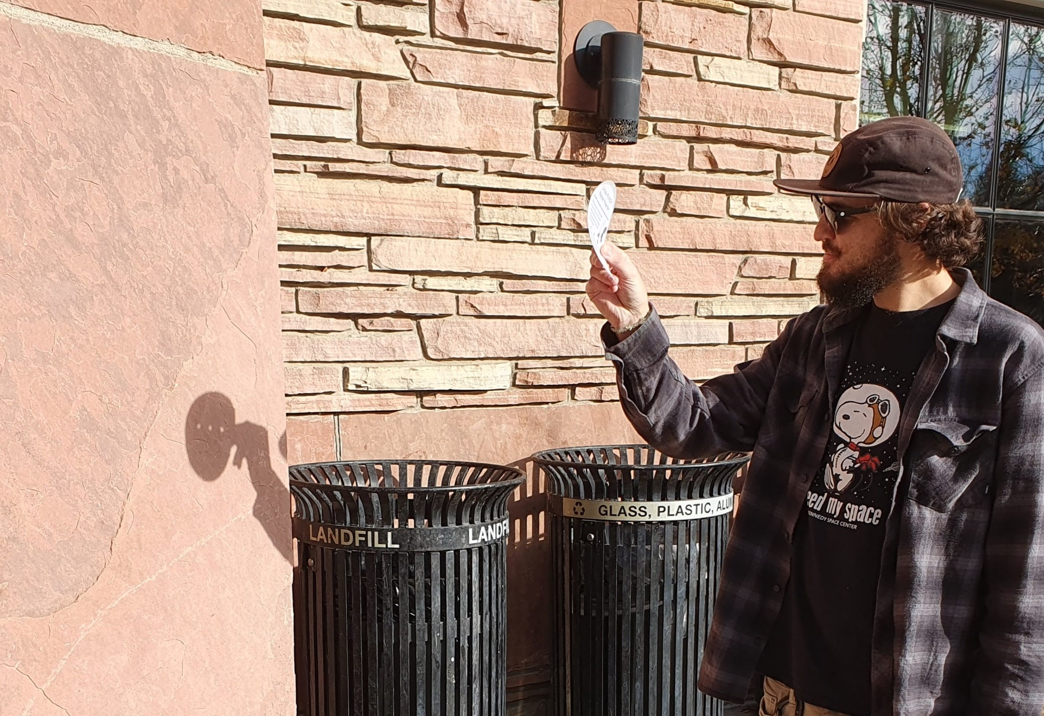
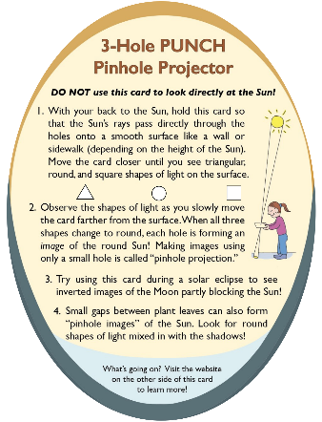
NEVER EVER look at the Sun through the holes! We are using Bhanu (your object) to represent the Sun. Bhanu is helping us to SAFELY learn how sunlight passes through the hole to reach the projection surface.
Outreach for the NASA PUNCH mission
Your object represents the Sun
Smooth flat projection surface
The position of our eye as we look at Bhanu is like a place on this projection surface. We want to know: Which parts of the projection surface receive light from which parts of Bhanu?
JO is holding the 3-Hole PUNCH Pinhole Projector
NEVER EVER look at the Sun through the holes!

Slide 26
Seeing your object (Bhanu)
from the different eye positions
Every point on your object (Bhanu) reflects light (from sources in the room) in all directions. This is shown at two points:
the tan lines from Bhanu’s ear and
the blue lines from Bhanu’s foot.
Card with hole
Smooth flat projection surface
Head raised up
Head in middle
Head lowered down
As you look at Bhanu through the hole from the “middle eye” viewpoint, your eye receives light only from the middle parts of Bhanu. This part of the projection surface cannot receive any light rays from Bhanu’s ear (tan lines) or foot (blue lines) because they are blocked by the card.

Slide 27
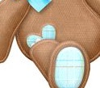
Seeing your object (Bhanu)
from the different eye positions
The viewpoint of your eye is like a location on the projection surface. We want to know: Which parts of the projection surface receive light from which parts of Bhanu?
Card with hole
Smooth flat projection surface
Head raised up
Head in middle
Head lowered down
When you looked through the hole at Bhanu from lower and higher viewpoints you could see that:
only light from the upper parts of Bhanu would reach the lower parts of the projection surface, and
only light from the lower parts of Bhanu would reach the upper parts of the projection surface.

Slide 28
Now return to your card with the hole:
1. Hold the card steady at a distance from your eye where you cannot see all of your object (Bhanu), but just the middle parts.
2. Move your head around to change your direction of viewing the object through the hole: up, down, left, right, and so on.
Outreach for the NASA PUNCH mission
Move head up
Move head left
See Bhanu’s feet
Move head right
Don’t see Bhanu’s bow
See Bhanu’s bow
Move head down
As you move your head around, notice that you can receive reflected light from all parts of the object, even though you cannot see the whole object from one single perspective.
See Bhanu’s head

Slide 29
Pinhole Projection of the Sun
To understand pinhole imaging of the Sun, keep the Bhanu activity in mind. It is important to hold this distinction between seeing the whole object at once from a single perspective (Case 1) and seeing only parts of the object from corresponding opposite perspectives (Case 2).
Outreach for the NASA PUNCH mission
Case 1
Case 2

Slide 30
For safety reasons during the previous activity, your object (our Bhanu) has represented the Sun. To advance our exploration we now turn Bhanu back into the Sun.
Outreach for the NASA PUNCH mission
In the diagrams on the next three slides, Bhanu becomes the Sun.
Sun Bhanu
The different viewpoints of your eye while looking at Bhanu through the hole now return to being locations on a smooth flat projection surface that receives the Sun’s light through the hole.
NEVER look at the Sun through the holes in the card!

Slide 31
The distance between the card with the hole and the smooth flat projection surface determines how much of the Sun’s disk would be visible to the projection surface from a single viewpoint.
Smooth flat projection surface
NEVER look at the Sun through the holes in the card!
CASE 1 - closer
Case 1 is like holding the card close to your eye and seeing ALL of the object at once
In CASE 1, the projection surface would receive light from all of the Sun’s disk from a single viewpoint
Card with hole
Smooth flat projection surface
CASE 2 - farther
In CASE 2, the projection surface would receive light from only part of the Sun’s disk from a single viewpoint.
Case 2 is like holding the card farther from your eye and seeing PART of the object
Card with hole

Slide 32
In Case 2, when the card with the hole is farther away from the projection surface, the lower part of the projection surface only receives light from the upper part of the Sun.
Smooth flat projection surface
NEVER look at the Sun through the holes in the card!
Light from the upper part of the Sun would only reach the lower part of the projection surface.
Lower part of projection surface
Card with hole
This is like when you lowered your head to see the top of the object through the hole.
Eye
Only light from Bhanu’s upper parts can reach the eye
Head moved DOWN to look through the hole
Card with hole

Slide 33
In Case 2, when the card with the hole is farther away from the projection surface, the upper part of the projection surface only receives light from the lower part of the Sun.
Smooth flat projection surface
NEVER look at the Sun through the holes in the card!
Upper part of projection surface
Light from the lower part of the Sun would only reach the upper part of the projection surface.
Card with hole
This is like when you raised your head to see the bottom of the object through the hole.
Head moved UP to look through the hole
Eye
Only light from Bhanu’s lower parts can reach the eye
Card with hole

Slide 34
Pinhole Projection of the Sun
PLEASE NOTE
The Sun is VERY far away compared to distances between the projection surface and the card-with-the-hole. Thus, it is impossible to make diagrams (such as those on the next slides) with the proper scale.
To make the principles of pinhole projection clear we adjust the size of the Sun in the diagrams. This allows us to illustrate how the apparent size of the Sun compares to the size of the hole (as seen from the projection surface).
Size of hole
Apparent size of Sun relative to the hole
When there is a closer distance between the card-with-the-hole and the projection surface, the Sun appears smaller relative to the hole.
When there is greater distance between the card-with-the-hole and the projection surface, the apparent size of the Sun is larger relative to the hole.

Slide 35
Pinhole Projection of the Sun
If the projection surface is close enough to the card-with-the-hole then we get shapes of light and no imaging on the projection surface. [CASE 1]
Size of hole
Apparent size of Sun relative to the hole
This is like seeing the whole Bhanu
from a single perspective.
If the projection surface is farther from the card-with-the-hole then we begin to get the imaging effect where light from particular parts of the Sun only reaches particular parts of the projection surface. [CASE 2]
Size of hole
Apparent size of Sun relative to the hole
This is like seeing only part of Bhanu
from a single perspective.

Slide 36
Pinhole Projection of the Sun
Now we are ready to address our questions
1. Why don’t we see round images of the Sun when the projector is held closer to the projection surface (Case 1), but we do see them when we move it farther away (Case 2)?
2. How can small, non-round holes formed by gaps between leaves, strands of a straw hat, fingers of our hands, and by our pinhole projectors create images of the round Sun?

Slide 37
Pinhole Projection of the Sun
Why don’t we get solar images when the projector is held closer to the surface?
CASE 1
Smooth flat projection surface
At this closer distance between the card and projection surface, light from every part of the Sun’s disk can be received through every part of the hole to the projection surface.
Card with hole
CASE 1
Sun
When the Sun’s apparent size is smaller than the square hole, we see a square shape of light on the projection surface
Apparent size of Sun relative to the hole
Size of hole
In CASE 1, light from every part of the Sun can pass through every part of the hole. So, light from any part of the Sun can reach every part of the projection surface that is directly behind the hole.
Light from everywhere on the Sun fills the hole, making a shape of light on the projection surface with the same shape as the hole.

Slide 38
Pinhole Projection of the Sun
How can small, non-round holes create images of the round Sun?
CASE 2
At this larger distance between the card and projection surface, only light from part of the Sun’s disk can pass directly through the hole to the projection surface.
Card with hole
Smooth, flat projection surface
The Sun’s apparent size is larger than the square hole.
Sun
Apparent size of Sun relative to the hole
Size of hole
In CASE 2, only light from near the center of the Sun can pass through the hole to the projection surface. Parallel rays coming from the outer parts of the Sun (dashed lines) are blocked by the card. BUT…

Slide 39
Pinhole Projection of the Sun
How can small, non-round holes create images of the round Sun?
BUT…light rays coming in at an angle from the outer parts of the Sun can pass through the hole to reach the projection surface.
Card with hole
Smooth, flat projection surface
CASE 2
The Sun’s apparent size is larger than the square hole.
Bhanu was the Sun so we could learn how this works.
Sun
Light from the upper part of the Sun arrives at the bottom part of the projection surface (red dashed line). And light from the lower part of the Sun arrives at the top part of the projection surface (green dotted line).
Recall when we pretended Bhanu was the Sun. You shifted your head up to see the bottom of Bhanu (eye at green arrow tip), and you shifted your head down to see the top of Bhanu (eye at red arrow tip).

Slide 40
Pinhole Projection of the Sun
How can small, non-round holes create images of the round Sun?
CASE 2
Only light from the inner part of the Sun’s disk can pass directly through the hole to the projection surface.
Card with hole
Smooth, flat projection surface
CASE 2
We see a circular shape of light on the projection surface
Sun
IMAGE NOT to SCALE
Light from outer parts of the Sun’s disk can only reach the projection surface at an angle.
Not to Scale
The Sun’s apparent size is larger than the size of hole
Because the Sun’s disk is round, sunlight from outer parts of the Sun forms a ring of light that surrounds the central shape of light. In this case, we start to form a fuzzy, inverted image of the round Sun through the square hole (or any other shape of hole with comparable size).

Slide 41
Pinhole Projection of the Sun
How can small, non-round holes create images of the round Sun?
Card with hole
CASE 2
We see a circular shape of light on the projection surface
Sun
IMAGE NOT to SCALE
Smooth, flat projection surface
We start to see an image of the Sun because there begins to be correspondence between light coming from a particular region of the Sun and light received at a particular (opposite) region of the projection surface (top-to-bottom, left-to-right). This correspondence is key to image formation. The tighter the correspondence, the sharper the inverted image on the projection surface. In Case 1, there is no such correspondence and so no image forms.

Slide 42
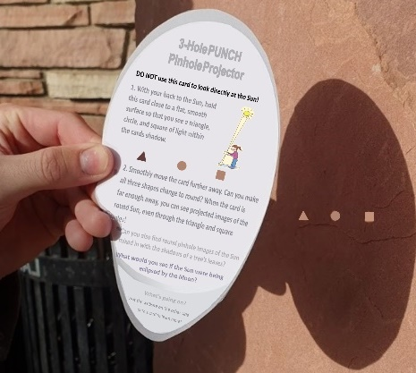
Pinhole Projection of the Sun
How can small, non-round holes create inverted images of the round Sun?
CASE 1: No imaging of the Sun. Light from every part of the Sun can pass through every part of each of the holes (square, triangle, and round) to the projection surface.
Case 1
See hole-shaped light shapes on projection surface
Sun
CASE 1
Projector held closer to the smooth, flat projection surface => see hole shapes of light.
Card with hole is closer to surface
Smooth flat projection surface
CASE 2: Start to form images of the Sun. Light from outside the center of the Sun must pass through the holes at an angle. This starts to force a correspondence between places on the Sun and places on the projection surface, which is necessary for images of the Sun to start forming.
Case 2
The 3 holes each make a fuzzy round shape of light on the surface
Sun
CASE 2
Projector held farther from the smooth, flat projection surface => fuzzy, inverted images of the round Sun.
Card with hole is farther from surface
Smooth flat projection surface

Slide 43
Pinhole Projection of the Sun
Pinhole Images seen on the projection surface are “inverted” both top-to-bottom and left-to-right.
Card with square hole
CASE 2
We see a circular shape of light on the projection surface
Sun
IMAGE NOT to SCALE
Smooth, flat projection surface
Q: Why do we see an inverted image when light from an object is projected through a pinhole onto a surface?
A: Because light from the Sun passes through the hole and arrives at the opposite side of the projection surface, top-to-bottom AND right-to-left. [Note the little sunspot]

Slide 44
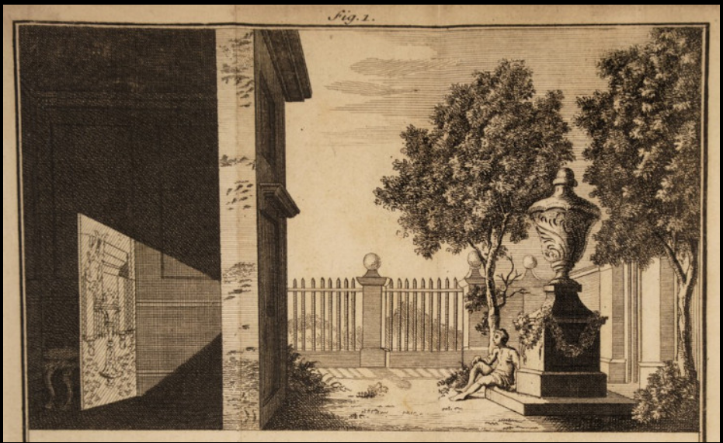
Our pinhole projector is based on the same principles as the famous “camera obscura” effect.
The image in the darkened space is inverted both top-to-bottom AND left-to-right.
1. Use the blue lines to find the top & bottom of the statue in both the real scene and the projected image on the board in the darkened area.
2. Use the yellow line to find the head of the person in both the real scene and the projected image on the board in the darkened area.
Can you also use the yellow line to find the head of the person in both the real scene and the
3. By noting the position of the seated man in both the real scene and the projected image, can you see that the image is inverted both top-to-bottom AND left-to-right?
Also see: https://en.wikipedia.org/wiki/Camera_obscura

Slide 45
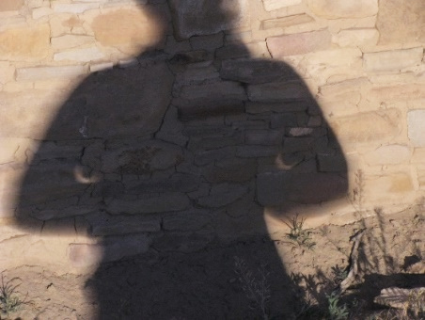
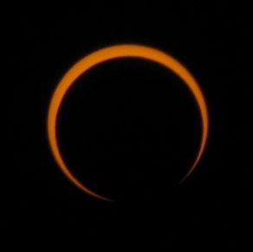
How are Pinhole Images of Eclipses Inverted?
See Section 5: APPENDIX A
Discovering How Pinhole Images of Eclipses are Inverted
An indoor demo using the 3-Hole PUNCH Pinhole Projector with an F-shaped light source [Super neat! Don’t miss it!]
A 3-slide demo using images from the 2017 solar eclipse
A 6-slide interactive inquiry using images from the 2012 Annular Eclipse seen from Pueblo Bonito, Chaco Canyon, NM
Outreach for the NASA PUNCH mission
Pinhole images through gaps at elbows
View through solar protection glasses
See how these contemporaneous images of the eclipsed Sun are the same but inverted left-to-right and top-to-bottom

Slide 46
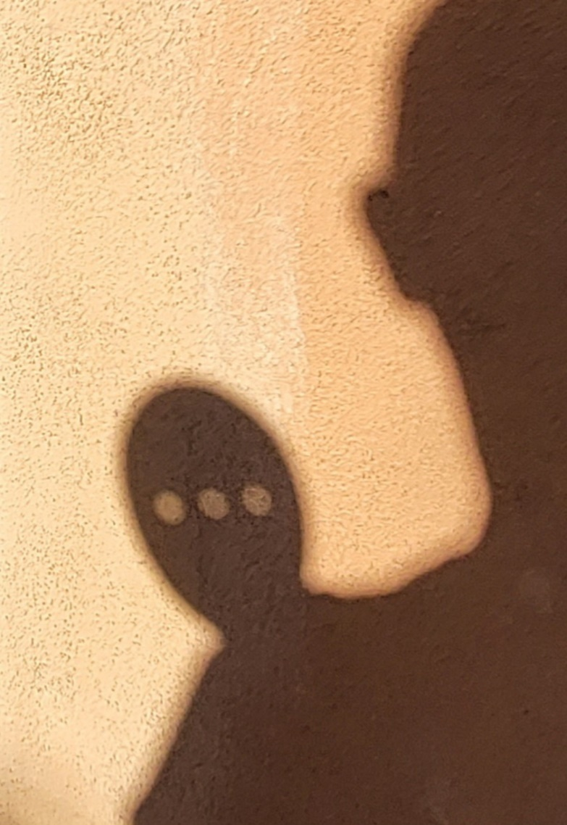
Why are our Projector Images Fuzzy?
Why Aren’t They in Focus?
Outreach for the NASA PUNCH mission
See Section 5: APPENDIX B
What Does it Mean to be in Focus?

Slide 47
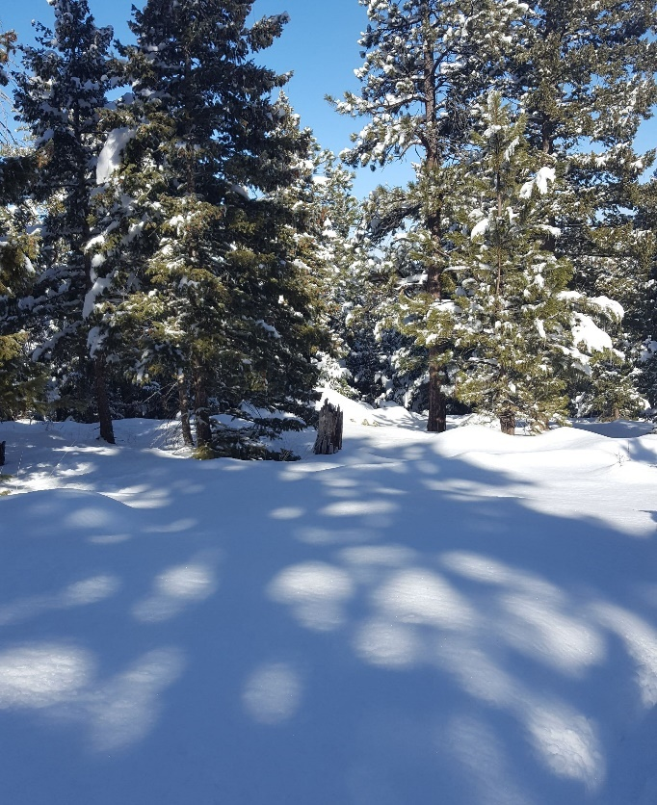
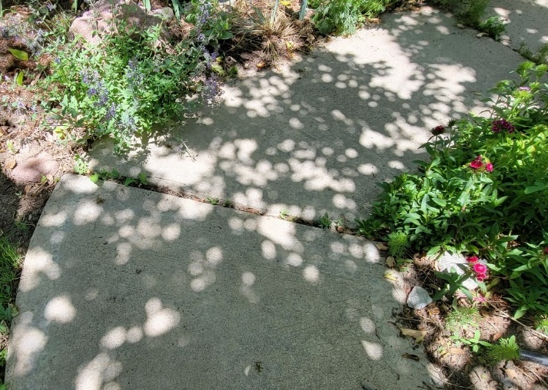
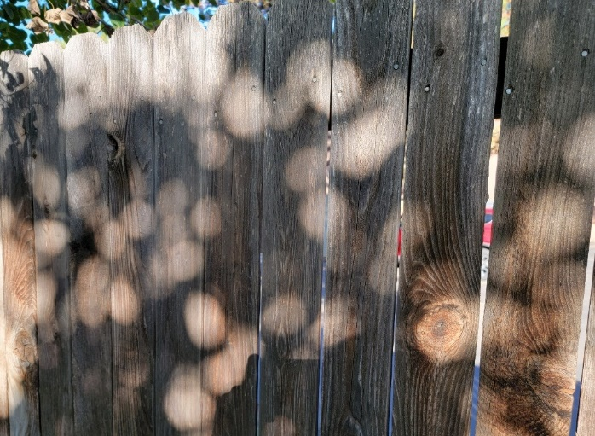
THANK YOU!
Thank you for your curiosity about pinhole projection!
We hope you’ve gained some enjoyable insights and will continue to explore!
Outreach for the NASA PUNCH mission
PLEASE SEE ADDITIONAL INFO On the Next Slides (Section 5)
Pinhole Images of the Sun are Everywhere.
Keep an eye out every sunny day!
Bhanu

Slide 48
ADDITIONAL INFORMATION
Outreach for the NASA PUNCH mission
Link for Feedback
Valuable References
Credits & Acknowledgements
Links to PUNCH & PUNCH Outreach Products
CONTACT:
Dr. Cherilynn Morrow, Outreach Director for the NASA PUNCH mission [cherilynn.morrow@gmail.com]

Slide 49
[Really] Understanding Pinhole Projection of the Sun
Outreach for the NASA PUNCH mission
Follow along with our playful learning adventure!
And PLEASE give us feedback on these questions at the link below:
Insights gained?
Remaining questions?
Ideas for improvements?
​https://tinyurl.com/PinholeFeedback
MARK 3 Version
Final Release for use up to and including the Annular Eclipse on 14 Oct 2023
FRONT
BACK

Slide 50
Valuable References
Lenses and Pinholes: What Does “In Focus” Mean?
A brief and clear explanation about what it means to be “in focus”: https://www.physicsforums.com/insights/lenses-pinholes-focus-mean/
2. How a Pinhole Camera Works (Part 1)
Excellent diagrams:
https://www.scratchapixel.com/lessons/3d-basic-rendering/3d-viewing-pinhole-camera
3. Real image: Collection of focus points made by converging light rays
We love the simple but insightful stick-figure:
https://www.wikiwand.com/en/Real_image
4. Your Eyes See Upside Down and Reversed
Lucid explanation by an eye doctor (MD) relating human eye to a pinhole camera: https://bceye.com/retinal-image-inverted-reversed/
5. Camera Obscura
The history of this wondrous effect, including reference to a possible paleo-camera:
https://en.wikipedia.org/wiki/Camera_obscura http://paleo-camera.com/archeo-optics/
6. Making, Measuring and Testing the “Optimal” Pinhole
A thorough and playful journey through the technical details of pinhole photography: https://www.35mmc.com/26/10/2020/making-measuring-and-testing-the-optimal-pinhole-pinhole-adventures-part-3-by-sroyon/

Slide 51
Credits & Acknowledgements
Primary Authors of the Explanatory Presentations:
Cherilynn Morrow, Robert Bigelow, and Mike Zawaski
cherilynn.morrow@gmail.com , arca965@gmail.com, and mjzawaski@gmail.com
Research & Development Team for the 3-Hole PUNCH Pinhole Projector
Cherilynn Morrow (editor-in-chief, concept development, field testing, photos)
Robert Bigelow (concept development, technical specifications, text reviewer, photos)
Briana Ingermann (graphic design, text developer, field testing, procurement of printing, photos)
Mike Zawaski (reviewer/consultant on explanatory presentation, graphic support, photos)
Sanlyn Buxner (head of field testing and evaluation, photos)
Jason Trump, Nina Byers, Geoff Skelton (text reviewer, field testing, reviewer of explanatory presentations)
Marisa Bevington & Marialis Rosario Franco (text reviewers, Spanish language translation)
GB Cornucopia, Bobbye Middendorf, Jeremy Osowski, Stacy Wolff (text reviewers, field testers, photo collaborators)
Craig DeForest (PUNCH PI, product review and approval, field tester)
Sarah Gibson (PUNCH Project Scientist, product review and approval)
Nicki Viall (PUNCH Mission Scientist, field tester, product review and approval)
Ronnie Killough (PUNCH Program Manager, field tester)
Gilly Gilbert (PUNCH Associate Investigator, field tester)
Countless others (who participated in field testing events and gave us their feedback)
Thank you also to our web developer Don Kolinski for posting and updating our work on the PUNCH website.

Slide 52
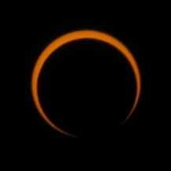
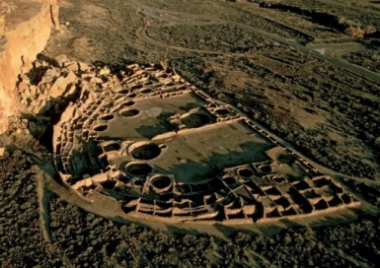
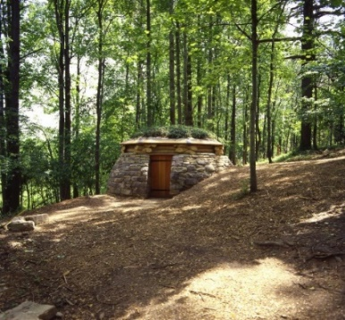
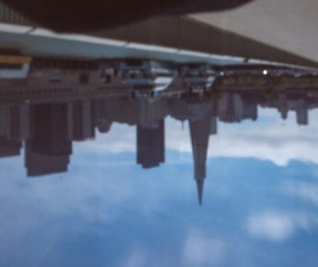
5. APPENDICES
A. Discovering How Pinhole Images of Eclipses are Inverted
Using images from the 2017 and 2012 Eclipses
Outreach for the NASA PUNCH mission
B. Why are the 3-Hole PUNCH Pinhole Projector Images Fuzzy?
What does it mean to be in focus?
C. What is the Difference Between a Pinhole and a Lens?
Finding new appreciation for what the lens of an eye or a camera is doing
D. Why Doesn’t Our Pinhole Projector Have Pin-Sized Holes?
Includes: DESIGN TRADE-OFFs for our Pinhole Projector
E. A Shortlist of Our Favorite Pinhole-Related Resources

Slide 53
Please proceed to Section 5:
Appendices A-E
more insights and fun resources
NASA PUNCH website: https://punch.space.swri.edu /
Scan here to access all PUNCH Outreach products or visit:
https://punch.space.swri.edu/punch_outreach_products.php
For questions or to request our 1-page monthly newsletter: Contact PUNCHOutreach@gmail.com
Photo: Alan Friedman

