Slide 1
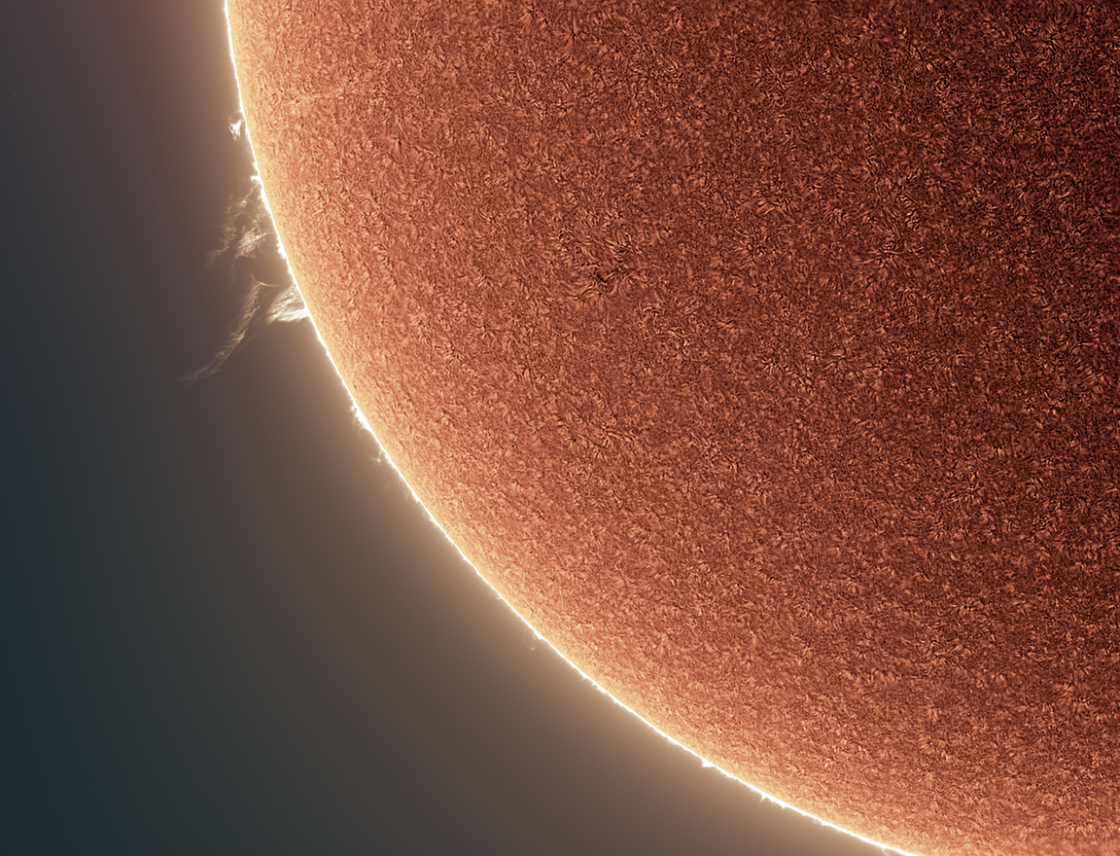
Welcome to Section 5: Appendices A-E
With More Insights and Fun Resources
NASA PUNCH website: https://punch.space.swri.edu /
Scan here to access all PUNCH Outreach products or visit:
https://punch.space.swri.edu/punch_outreach_products.php
For questions or to request our 1-page monthly newsletter: Contact PUNCHOutreach@gmail.com
Photo: Alan Friedman

Slide 2
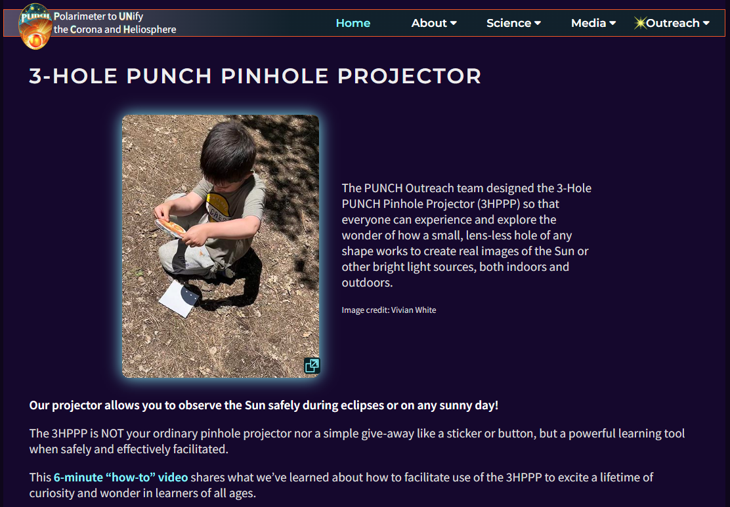
Essential viewing: 6-minute “how-to-facilitate” video [ https://punch.space.swri.edu/punch_outreach_pinholeprojector.php ]
Outreach for the NASA PUNCH mission

Slide 3
[Really] Understanding Pinhole Projection of the Sun
Introducing Bhanu
[BAH-noo]
Bhanu means
“ray of light”
in Sanskrit
Outreach for the NASA PUNCH mission
Bhanu helps guide our way through these Sections. You are in Section 5 of 5.
Section | Title of Section | Description of Section
1 | How to Use the 3-Hole PUNCH Pinhole Projector | introduces the 3-Hole PUNCH Pinhole Projector, demonstrates how to use it both outdoors and indoors, and describes its differences from a pinhole camera/viewer.
2 | Observing Pinhole Images of the Sun in Our Everyday Environments | teaches you how to observe the phenomenon of pinhole images of the Sun in our everyday world, both indoors and outdoors.
3 | Exploring Pinhole Projection Using Your Own Hands | invites you to explore the behavior of pinhole projection by experimenting with your own hands (try both palms up!)
4 | Explaining and Understanding How Pinhole Imaging Happens | interactively guides your quest for explanations and deeper understanding of how pinhole imaging happens. After this, you will really understand why small, lens-less holes can create images.
5 | APPENDICES A-E: More Insights & Fun Resources | offers more insights & resources (e.g., explaining the relationship between pinhole images and the view through “eclipse” glasses)
CONTACT:
Dr. Cherilynn Morrow, Outreach Director for the NASA PUNCH mission [cherilynn.morrow@gmail.com]

Slide 4
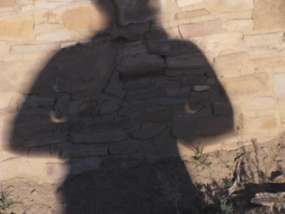
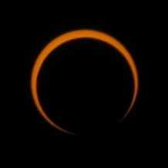
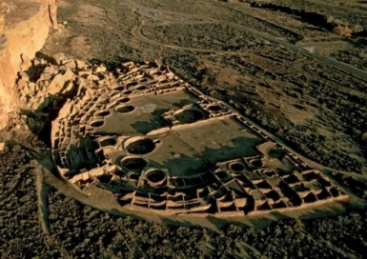
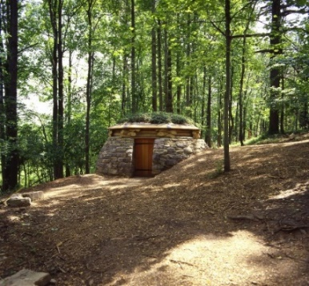
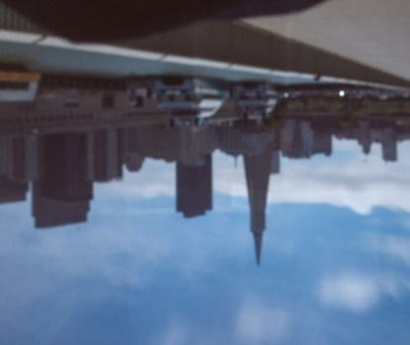
5. APPENDICES
A. Discovering How Pinhole Images of Eclipses are Inverted (Slide 5)
Using images from the 2017 and 2012 Eclipses
Outreach for the NASA PUNCH mission
B. Why are the 3-Hole PUNCH Pinhole Projector Images Fuzzy? (Slide 18)
What does it mean to be in focus?
C. What is the Difference Between a Pinhole and a Lens? (Slide 23)
Finding new appreciation for what the lens of an eye or a camera is doing
D. Why Doesn’t Our Pinhole Projector Have Pin-Sized Holes? (Slide 24)
Includes: DESIGN TRADE-OFFs for our Pinhole Projector
E. A Shortlist of Our Favorite Pinhole-Related Resources (Slide 29)

Slide 5
APPENDIX A
Discovering How Pinhole Images of Eclipses are Inverted
Outreach for the NASA PUNCH mission
CONTACT:
Dr. Cherilynn Morrow, Outreach Director for the NASA PUNCH mission [cherilynn.morrow@gmail.com]

Slide 6
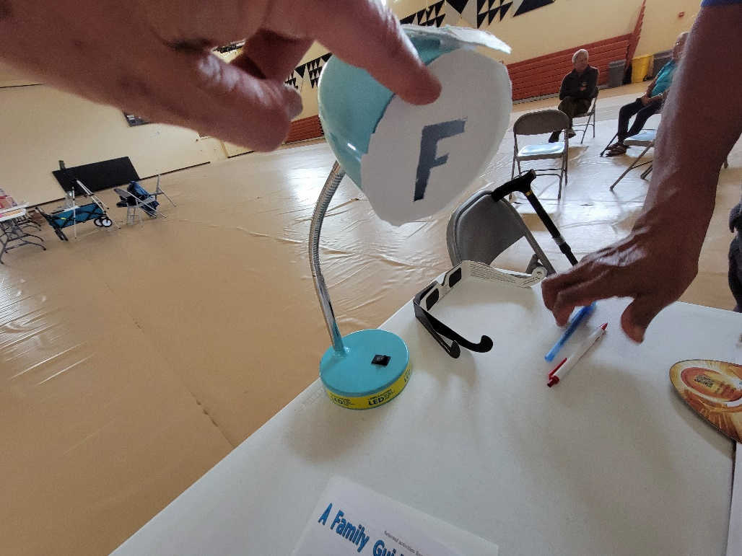
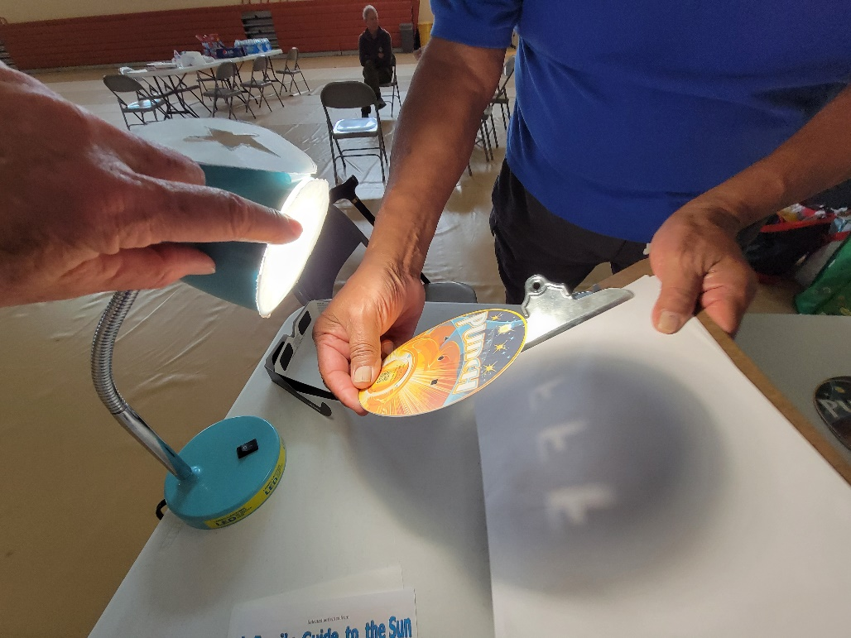
APPENDIX A1
A Pinhole Projector’s Images are Inverted Top-to-Bottom and Left-to-Right
The images on the projection surface are F-shaped because the cut-out makes the light source F-shaped. But notice the pinhole images are upside down and flipped left-to-right.
Lamp OFF
Lamp ON
projection surface
The mask changes the shape of the light source.
The Projector holes are each imaging the F-shape of the light source. An “F” makes it easy to see how pinhole images are upside down and flipped left-to-right.
NOTE: If the Projector were held closer to the surface, we would still see the triangular, round, and square-shaped holes.
NOTE: See Section 1 for a neat demo using a star-shaped mask.
pinhole images
CONTACT:
Dr. Cherilynn Morrow, Outreach Director for the NASA PUNCH mission [cherilynn.morrow@gmail.com]

Slide 7
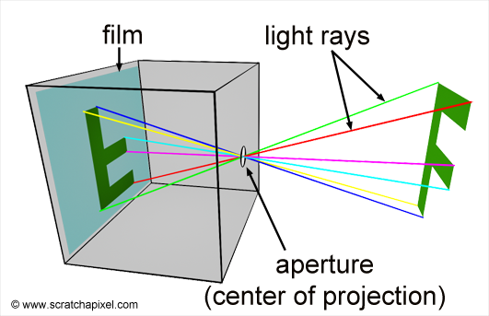
APPENDIX A2
A Pinhole Inverts Images Inverted Both Top-to-Bottom and Left-to-Right
Outreach for the NASA PUNCH mission
Start with the green line at the top left of the F. Trace the line with your fingers to see where it goes on the projection surface. Notice how this works for each colored line.
Start here. Trace the green line to the left.
Notice that the light from the top on one side of the F can only get to the bottom on the opposite side of the projection surface. Light traveling in other directions from the starting point is blocked by the box. This creates the correspondence between the light source and the projection surface needed to form an image.
projection surface
pinhole
Adapted from Figure 4
https://www.scratchapixel.com/lessons/3d-basic-rendering/3d-viewing-pinhole-camera/how-pinhole-camera-works-part-1.html
CONTACT:
Dr. Cherilynn Morrow, Outreach Director for the NASA PUNCH mission [cherilynn.morrow@gmail.com]

Slide 8
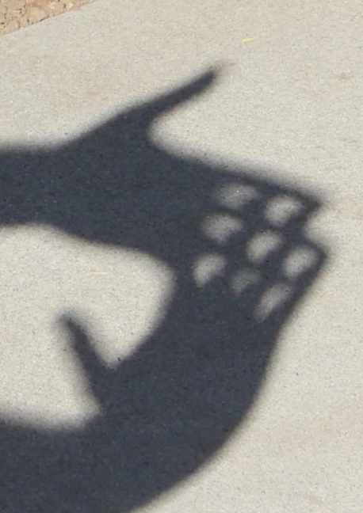
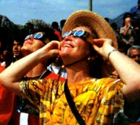
APPENDIX A3
How does the pinhole projection compare to what you see through solar protection glasses?
Outreach for the NASA PUNCH mission
2. Here’s what you would see through solar protection glasses at the same time.
1. Pinhole images of the round Sun being partially eclipsed by the Moon: Card and Hand methods.
CM observing a solar eclipse
3. Compare the images. How can we make sense of the difference in appearance between the pinhole images and what we see through the solar protection glasses?

Slide 9
APPENDIX A4
During a solar eclipse, it is easier to tell that a pinhole image is inverted compared to direct viewing.
Outreach for the NASA PUNCH mission
TOP
Appearance through solar protection glasses (re-created using Starry Night)
BOTTOM
BOTTOM
BOTTOM
Flipped top-to-bottom
(along the green line of symmetry)
TOP
TOP
Pinhole image of the round Sun eclipsed by the Moon
BOTTOM
Then flipped left-to-right*
(looks like the pinhole image)
* Same if we’d flipped left-to-right first before flipping top-to-bottom
TOP

Slide 10
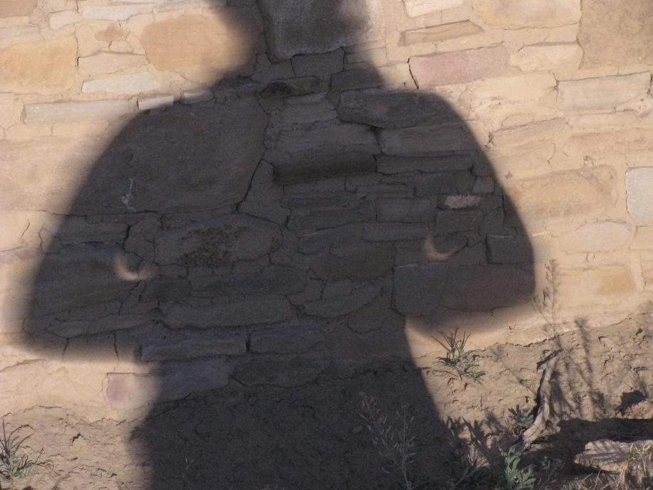
APPENDIX A5
You can also show that these pinhole images are inverted (upside down & left-to-right) compared to filtered viewing.
Outreach for the NASA PUNCH mission
CM is using her arms to project two pinhole images of the setting sun while it is eclipsed by the Moon. 20 May 2012, Chaco Canyon, ~6:30 pm
A filtered image of the eclipse as it was seen in the sky at about the same time 20 May 2012, Chaco Canyon, 6:34 pm.
The following six slides (APPENDIX A4-A9) will guide you step-by-step through this inquiry.

Slide 11
APPENDIX A6 Discovering How Pinhole Images of Eclipses Are Inverted
The next 5 slides guide you through an inquiry to discover how pinhole images of eclipses are inverted compared to direct, filtered viewing of what is in the sky.
Outreach for the NASA PUNCH mission
The two images (elbow pinhole images, and the filtered view of how the eclipse appeared in the sky) were made within minutes of one another while observing the 20 May 2012 annular solar eclipse from the plaza of Pueblo Bonito in Chaco Canyon, New Mexico. Enjoy!

Slide 12
APPENDIX A7 Discovering How Pinhole Images of Eclipses Are Inverted
Can you show that these pinhole images are upside down and flipped left-to-right compared to the image of a partial eclipse as it appeared in the sky?
Outreach for the NASA PUNCH mission
CM is using her arms to project two pinhole images of the setting sun while it is eclipsed by the Moon. 20 May 2012, Chaco Canyon, ~6:30 pm
A filtered image of the eclipse as it was seen in the sky at about the same time 20 May 2012, Chaco Canyon, 6:34 pm.
The next few slides lead you step by step through the process.
Do your best to imagine the answers before advancing the slides.

Slide 13
APPENDIX A8 Discovering How Pinhole Images of Eclipses Are Inverted
Follow steps 1-3 below one-at-a-time using the next slides. Carry out process step #1 using the the sky image (below, right)
Outreach for the NASA PUNCH mission
CM is using her arms to project two pinhole images of the setting sun while it is eclipsed by the Moon. 20 May 2012, Chaco Canyon, ~6:30 pm
A filtered image of the eclipse as it was seen in the sky at about the same time 20 May 2012, Chaco Canyon, 6:34 pm.
FOLLOW THESE PROCESS STEPS: Try to imagine the response to the bold step before advancing the slide
1. Find the line of symmetry in the sky image. This line divides the image into two identical halves.
If you could fold the image across this line it would match up exactly with the other side.
2. Now rotate the image upside down so the top goes to the bottom and bottom goes to the top
3. Now flip the image left to right to see if it will look like the pinhole images

Slide 14
APPENDIX A9 Discovering How Pinhole Images of Eclipses Are Inverted
The green line is very close to a line of symmetry which divides the image into two identical halves. Now imagine carrying out step #2 below. Try to predict how the image will look before checking the answer on next slide.
Outreach for the NASA PUNCH mission
TOP
BOTTOM
CM is using her arms to project two pinhole images of the setting sun while it is eclipsed by the Moon. 20 May 2012, Chaco Canyon, ~6:30 pm
A filtered image of the eclipse as it was seen in the sky at about the same time 20 May 2012, Chaco Canyon, 6:34 pm.
FOLLOW THESE PROCESS STEPS: Try to imagine the response to the bold step before advancing the slide
1. Find the line of symmetry in the sky image. This line divides the image into two identical halves.
If you could fold the image across this line it would match up exactly with the other side.
2. Now rotate the image upside down so the top goes to the bottom and bottom goes to the top
3. Now flip the image left to right to see if it will look like the pinhole images

Slide 15
APPENDIX A10 Discovering How Pinhole Images of Eclipses Are Inverted
Is this the same as the pinhole images? Not yet. Now imagine carrying out step #3 below. Try to predict how the image will look before checking the answer on the next slide. Do you think it will look like the pinhole images?
Outreach for the NASA PUNCH mission
BOTTOM
TOP
CM is using her arms to project two pinhole images of the setting sun while it is eclipsed by the Moon. 20 May 2012, Chaco Canyon, ~6:30 pm
The filtered sky image of the eclipse turned upside down
FOLLOW THESE PROCESS STEPS: Try to imagine the response to bold step before advancing the slide
1. Identify the line of symmetry in the sky image. Label top and bottom.
2. Rotate the image upside down so the top goes to the bottom and bottom goes to the top
3. Now flip the image left to right to see if it will look like the pinhole images

Slide 16
APPENDIX A11 Discovering How Pinhole Images of Eclipses Are Inverted
YES! We see that the pinhole images are inverted (upside down and flipped left-to-right) compared to what we see in the sky.
Outreach for the NASA PUNCH mission
BOTTOM
TOP
CM is using her arms to project two pinhole images of the setting sun while it is eclipsed by the Moon. 20 May 2012, Chaco Canyon, ~6:30 pm
The filtered sky image of the eclipse turned upside down AND flipped left-to-right looks like the pinhole images.
PROCESS STEPS:
1. Identify the line of symmetry in the sky image. Label top and bottom.
2. Rotate the image upside down so the top goes to the bottom and bottom goes to the top
3. Then flip the image left to right to see if it will look like the pinhole images

Slide 17
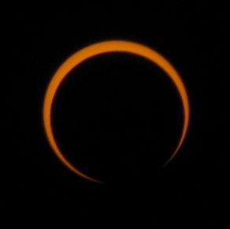
APPENDIX A12 Visual Summary: Now Can You Imagine the Flips?
View through solar protection glasses
Corresponding Pinhole images

Slide 18
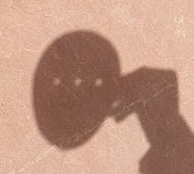
APPENDIX B
Why are the 3-Hole PUNCH Pinhole Projector Images of the Sun Fuzzy?
Outreach for the NASA PUNCH mission
What does it mean to be “in focus”?
CONTACT:
Dr. Cherilynn Morrow, Outreach Director for the NASA PUNCH mission [cherilynn.morrow@gmail.com]

Slide 19
APPENDIX B1
What Does it Mean to be in Focus?
Why are images fuzzy (un-focused) using the 3-Hole PUNCH pinhole Projector?
The solar images from our projector are fuzzy (or un-focused) because the three holes are not far enough away from the projection surface. For the sharpest image to form, our ~5 mm holes, would have to be about 12 meters (~40 feet) away from the projection surface (about the height of a medium-sized tree).
Focal length for sharp images
Sharp, inverted image of the round Sun
Note 1-to-1 correspondence between location on Sun and location on projection surface
Card with hole
Smooth flat projection surface
This distance is called the focal length. The sharper image would also be larger and dimmer because the light spreads out over the longer distance, and thus would be harder to see in broad daylight.
Notes:
The size of the aperture is so small that among the many rays that are reflected off at P, a point on the surface of an object in the scene, only one of these rays enter the camera (in reality it's never exactly one ray, but more a bundle of light rays or photons composing a very narrow beam of light). In figure 3, we can see how one single light ray among the many reflected at P passes through the aperture. In figure 4, we have colored six of these rays to track their path to the film plane more easily; notice one more time by following these rays how they form an image of the object rotated by 180 degrees. In geometry, the pinhole is also called the center of projection; all rays entering the camera converge to this point and diverge from it on the other side.
To summarize: light striking an object is reflected back in random directions in the scene but only one of these rays (or more exactly a bundle of these rays traveling along the same direction) enters the camera and strike the film in one single point. To each point in the scene corresponds a single point on the film.

Slide 20
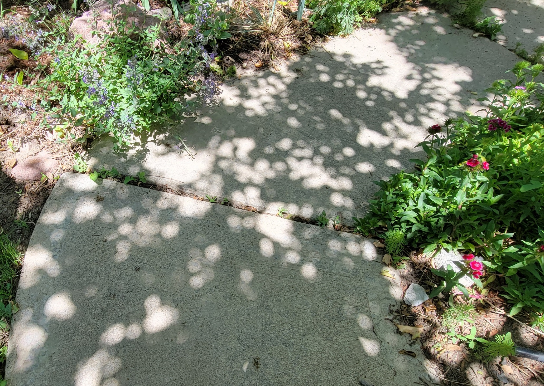
Nature Can Get the “Equation” Right
In the shade of this 20-ft Rocky Mountain maple tree, we can see some sharper but dimmer images of the Sun. These are due to “pinhole” gaps between the leaves that are located at about the right distance (the focal length) above the sidewalk for their size. The shade provides enough darkening for the dimmer images to be perceived.
Notice that some of the dimmer images are in sharper focus.
Images of the round Sun projected on a sidewalk as midday sunlight passes through the small gaps between leaves of a tree

Slide 21
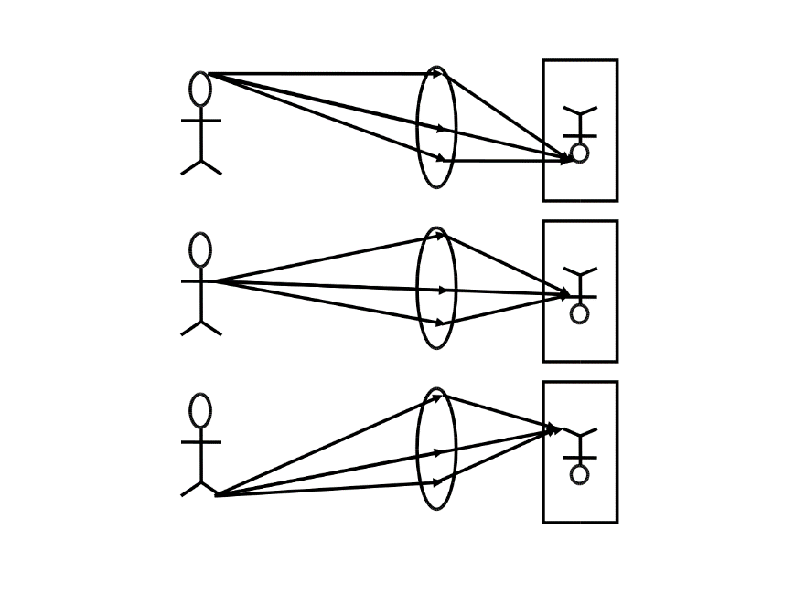
APPENDIX B3
What Does it Mean to be in Focus?
Why are images fuzzy (un-focused) using the 3-Hole PUNCH pinhole Projector?
When a pinhole is a focal length away from a projection surface (depicted in the diagram below), light from each particular place on the Sun passes through the hole to a particular opposite place on the projection surface. This tight one-to-one correspondence between light emitted from locations on the Sun and light received at corresponding locations on the projection surface forms a focused image of the Sun.
Focal length for sharp images
Note 1-to-1 correspondence between location on Sun and location on projection surface
Sharp, inverted image of the round Sun
Card with hole
Smooth flat projection surface
What is the Difference Between a Pinhole and a Lens?
See Appendix C
Notes:
The size of the aperture is so small that among the many rays that are reflected off at P, a point on the surface of an object in the scene, only one of these rays enter the camera (in reality it's never exactly one ray, but more a bundle of light rays or photons composing a very narrow beam of light). In figure 3, we can see how one single light ray among the many reflected at P passes through the aperture. In figure 4, we have colored six of these rays to track their path to the film plane more easily; notice one more time by following these rays how they form an image of the object rotated by 180 degrees. In geometry, the pinhole is also called the center of projection; all rays entering the camera converge to this point and diverge from it on the other side.
To summarize: light striking an object is reflected back in random directions in the scene but only one of these rays (or more exactly a bundle of these rays traveling along the same direction) enters the camera and strike the film in one single point. To each point in the scene corresponds a single point on the film.

Slide 22
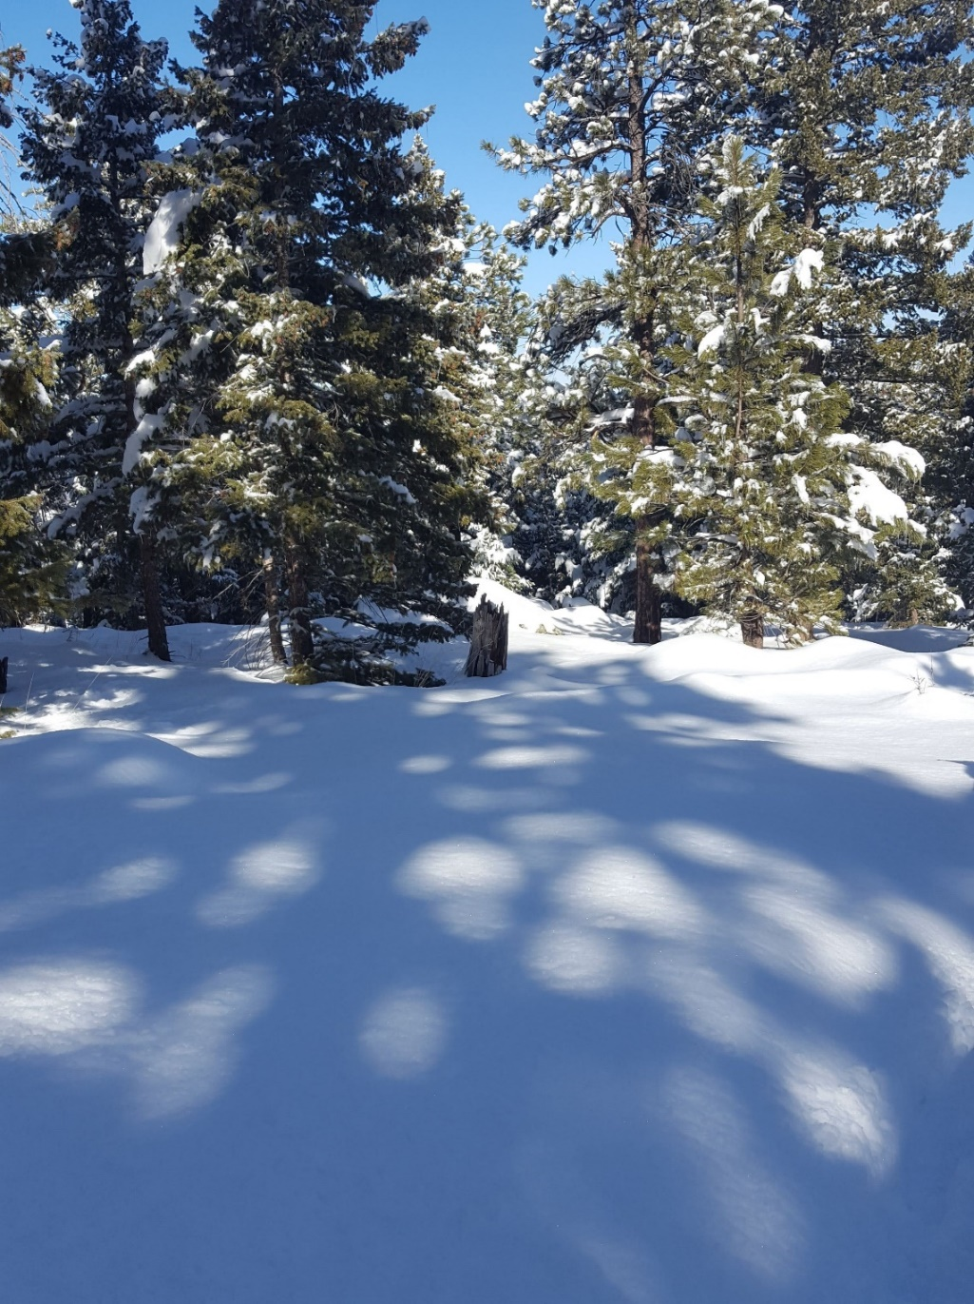
Ponderosa Pines Can Have Pine-Sized Pinholes
APPENDIX B4
The larger the “pinhole” gaps, the longer the focal length, and so taller trees like these Rocky Mountain Ponderosa Pine can produce some large, well-focused images as the sunlight streams through the gaps between their branches and needles.
But if the gaps are too large, they do not form solar images, but simply cast shadows of their shapes on the surface. Note the fascinating lack of shadows that look much like pine needles or branches.
Larger “pinhole” gaps have longer focal lengths and can make larger images beneath tall trees.

Slide 23
APPENDIX C
Difference Between a “Pinhole” and a Lens?
Our study of pinhole imaging helps us to better appreciate what an eye or camera lens is doing to support image formation
The “holes” in the 3-Hole PUNCH Pinhole projector are acting as a limited sort of lens to form inverted images. To form an image, each region of the projection surface must receive the light from a corresponding region of the object.
The diagram at the right shows the formation of an inverted image with a lens. In each of the three rows (1-3), only the central ray would contribute to a pinhole image.
A lens bends (refracts) the light, which allows more light from any particular region on the object to be focused on the corresponding region of the projection surface. This creates a better and brighter image at the focal length of the lens.
Pinhole images are dimmer than when a lens is used because less light comes from any particular region of the object to a corresponding region on the projection surface.
1
2
3
https://www.wikiwand.com/en/Real_image
Our study of pinhole imaging helps us to better appreciate what an eye or camera lens is doing to support image formation. The lens is bending more light from a particular region of an object (say the head) to a particular region of a light-sensitive surface (e.g., the bottom of the projection surface). This helps to create a brighter and clearer image than a pinhole could produce in the same amount of time.

Slide 24
APPENDIX D
Why doesn’t our Pinhole Projector have Pin-sized holes?
Outreach for the NASA PUNCH mission
What are the trade-offs in the design of our 3-Hole PUNCH Pinhole Projector that have led us to choose larger (~5 mm) holes instead of pinholes? First, we must be reminded how pinhole cameras work.
CONTACT:
Dr. Cherilynn Morrow, Outreach Director for the NASA PUNCH mission [cherilynn.morrow@gmail.com]

Slide 25
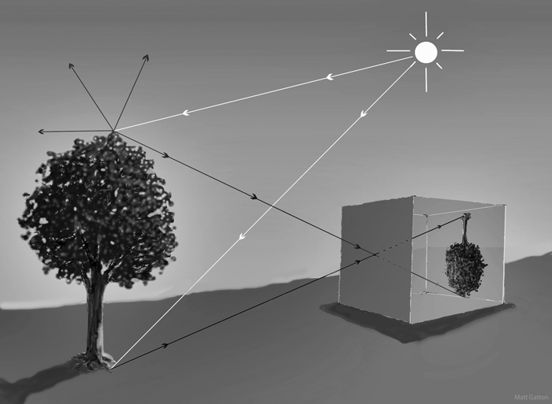
APPENDIX D1 Why Doesn’t Our Projector Have Pin-Sized Holes?
A pin-sized hole can focus light over a much shorter distance than the larger holes of our pinhole projector, so a sharp image can be formed inside a pinhole camera box.
Outreach for the NASA PUNCH mission
Pinhole cameras do not typically make images of the Sun. Instead, they make images of objects that REFLECT sunlight. How does this work?
1. We can see things because they either emit or reflect light.
2. The white rays represent light emitted from the Sun.
3. The black rays represent sunlight reflected from a point on the tree.
4. All points on the tree reflect sunlight in all directions (shown only for the top of the tree).
5. The pinhole is so small that only one ray of light from each particular point on the tree makes it through the pinhole to a particular corresponding point on the projection surface.
6. This forms a sharp, inverted image on the projection surface.
Projection surface
pinhole
Permission granted for one-time educational use on 9 Jan 2023
Image Credit: Matt Gatton http://paleo-camera.com/archeo-optics/

Slide 26
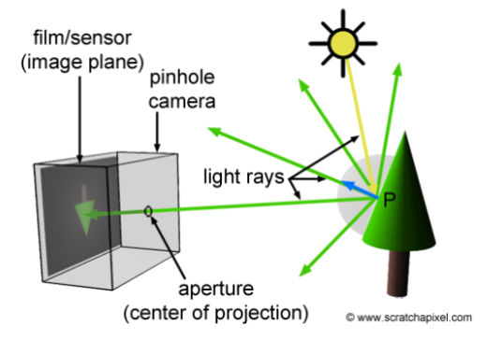
APPENDIX D2 Why Doesn’t Our Projector Have Pin-Sized Holes?
How does a pinhole camera work?
projection surface
Light emitted from the Sun (yellow ray) strikes a leaf at the center of the tree (P) and is reflected in all directions (solid green rays).
Only one of the green streams of reflected light from this spot can make it through the tiny pinhole to reach the projection surface.
One stream from the top of the tree can get through the pinhole and reach the bottom of the surface (green dashed line).
One stream from the root at the base of the tree can make it to the top of the surface (brown dotted line).
Light reflects off all other parts of the tree and reaches an opposite part of the projection surface, forming an inverted image.
Most of the sunlight reflected from the different parts of the tree does not make it through the pinhole to the projection surface so the image is very dim.
Because the image is very dim, it needs to form inside a dark box to be seen or captured on film.
pinhole camera
Light rays
P
pinhole
Adapted from Figure 3
https://www.scratchapixel.com/lessons/3d-basic-rendering/3d-viewing-pinhole-camera
The hole of a pinhole camera is pin-sized (much smaller than our pinhole projectors). The hole is so small that only one of the many rays of light reflected from any particular point on the tree can pass through the hole to a corresponding, opposite location on the projection surface (top-to-bottom and left-to-right). This forms a focused, inverted image that would be too dim to see without the box to provide darkness for the projection surface.

Slide 27
APPENDIX D3 Why Doesn’t Our Projector Have Pin-Sized Holes?
A pin-sized pinhole geometrically forces a much tighter correspondence between light reflected from different parts of the tree and light received by opposite parts of a projection surface. The tighter this correspondence, the sharper the inverted image will be.
A larger hole would let more light through to make a brighter image, but it would also allow light from a larger region of the tree to reach a particular location on the projection surface. This reduces the tight correspondence and causes the image to be fuzzier. This same effect explains why the 3-Hole PUNCH pinhole projector produces brighter yet fuzzier images of the Sun. The images are inverted but you cannot tell unless there is an eclipse.
projection surface
pinhole camera
Light rays
P
pinhole
Adapted from Figure 3
https://www.scratchapixel.com/lessons/3d-basic-rendering/3d-viewing-pinhole-camera
The larger-hole design of our 3-Hole PUNCH pinhole projector compromises on the degree of image sharpness to ensure that enough light passes through the holes for image formation to be seen in broad daylight at hand-held distances without having to darken the projection surface.

Slide 28
APPENDIX D4 Why Doesn’t Our Projector Have Pin-Sized Holes?
SUMMARY of Design Trade-Offs for the
3-Hole PUNCH Pinhole Projector
Hole Sizes | Effect on What We See (or Don’t See) on the Projection Surface
Too large | If the holes are too large, images of the Sun cannot form over reasonable hand-held distances. You would only see the shape of the holes (triangle, round, and square) in the shadow of the projector (Case 1).
Too small | Smaller holes can produce sharper (more focused) images over shorter distances but if the holes are too small the images would be too dim to see in broad daylight and you would have to darken the projection surface like you do for a pinhole camera (which has pin-sized holes).
Size chosen for our projector | The ~5 mm hole size for our pinhole projector is intentionally in-between the extremes described in the previous two rows. Our projector produces fuzzy, yet clearly round, images of the Sun through the square and triangular holes when held far enough away from the projection surface. This larger-hole design compromises on the degree of image sharpness to ensure that enough light passes through the holes for image formation to be seen in broad daylight at hand-held distances without having to darken the projection surface.
Notes:
The size of the aperture is so small that among the many rays that are reflected off at P, a point on the surface of an object in the scene, only one of these rays enter the camera (in reality it's never exactly one ray, but more a bundle of light rays or photons composing a very narrow beam of light). In figure 3, we can see how one single light ray among the many reflected at P passes through the aperture. In figure 4, we have colored six of these rays to track their path to the film plane more easily; notice one more time by following these rays how they form an image of the object rotated by 180 degrees. In geometry, the pinhole is also called the center of projection; all rays entering the camera converge to this point and diverge from it on the other side.
To summarize: light striking an object is reflected back in random directions in the scene but only one of these rays (or more exactly a bundle of these rays traveling along the same direction) enters the camera and strike the film in one single point. To each point in the scene corresponds a single point on the film.

Slide 29
Outreach for the NASA PUNCH mission
APPENDIX E
Favorite Pinhole-Related Resources
[an evolving list]
E1: Build a Personal Pinhole Theatre (Exploratorium)
E2: A Public Pinhole Theatre in North Carolina (where you can visit)
E3: Solargraphy – Long Exposure Pinhole Photography (so simple & artful)
E4: Khan Academy Lesson about Virtual Cameras (very helpful aminations!)
E5: Khan Academy Article about Hasan Ibn al-Haytham– Extraordinary!
CONTACT:
Dr. Cherilynn Morrow, Outreach Director for the NASA PUNCH mission [cherilynn.morrow@gmail.com]

Slide 30
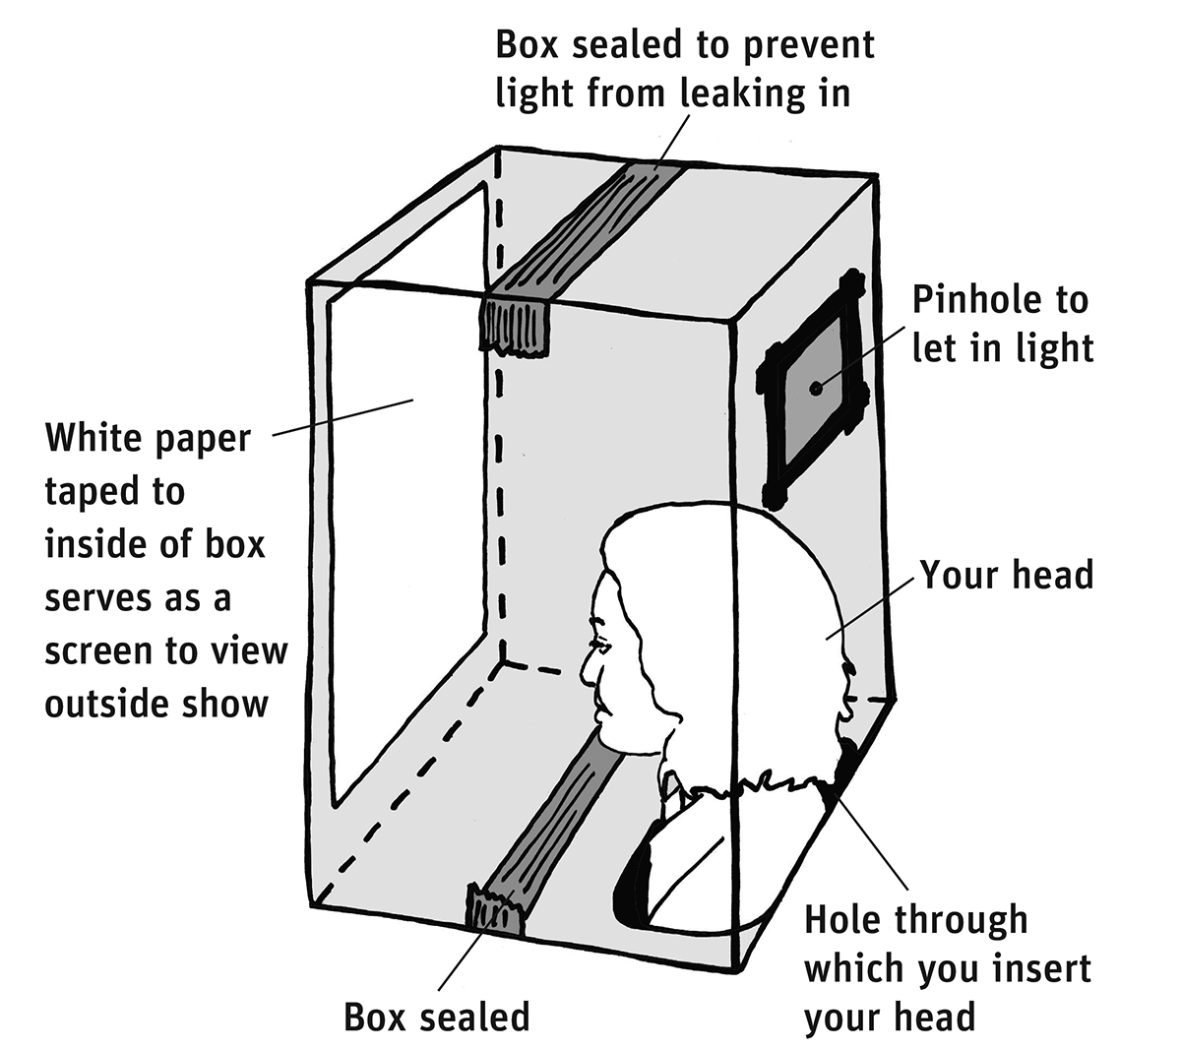
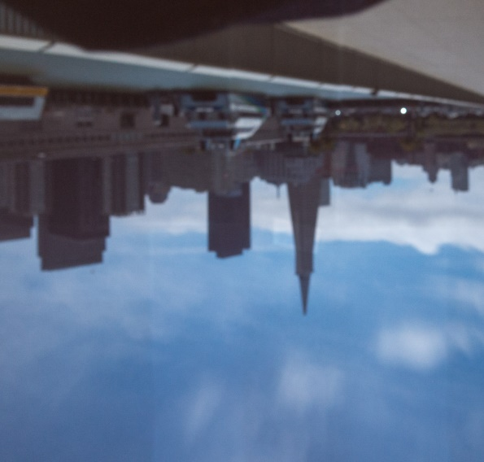
APPENDIX E1 Favorite Pinhole-Related Resources
1. A Personal Pinhole Theatre
https://www.exploratorium.edu/snacks/personal-pinhole-theater
Outreach for the NASA PUNCH mission
Your Personal Pinhole Theater is actually a giant camera obscura (Italian for “dark room”), or pinhole camera. Light rays from the sun reflect off every point on every object—including, say, a tree. The rays from the tree then hit the outside of the box, except where they can pass through the pinhole. Each light ray, in effect, carries an image of the point on the tree where it originated.

Slide 31
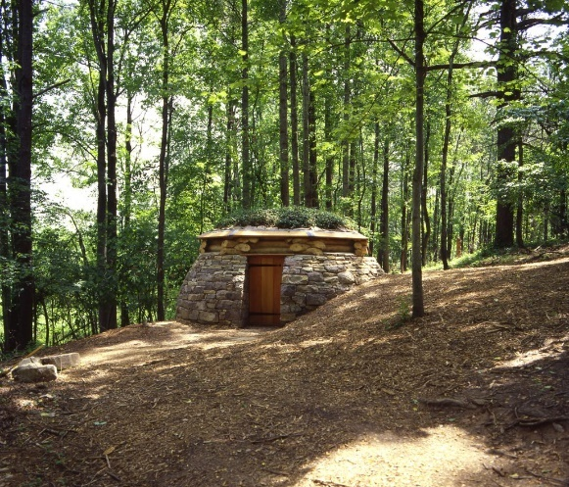
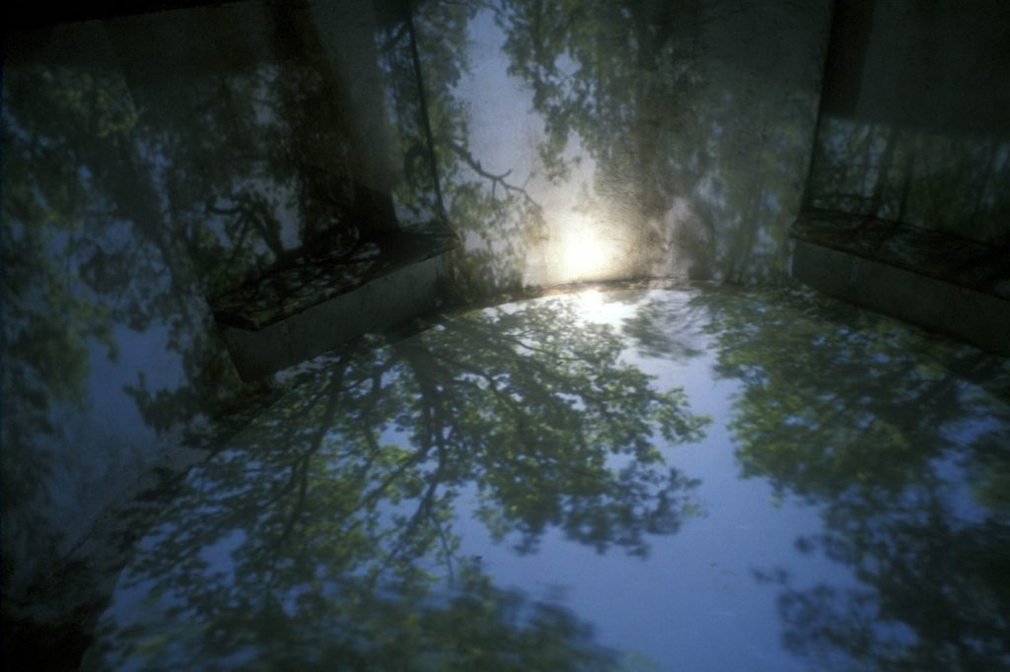
APPENDIX E2 Favorite Pinhole-Related Resources
3. A Public Pinhole Theatre
https://learn.ncartmuseum.org/artwork/cloud-chamber-for-the-trees-and-sky/
A work of art by Chris Drury: Cloud Chamber for the Trees and Sky
This structure functions as a camera obscura, or pinhole camera. As light passes through the hole in the roof, it creates an upside-down reflection of the sky and clouds on the ground beneath the viewer. It is a peaceful, dreamlike space where viewers can observe the natural world around them. ALSO SEE: https://www.atlasobscura.com/places/cloud-chamber-for-the-trees-and-sky

Slide 32
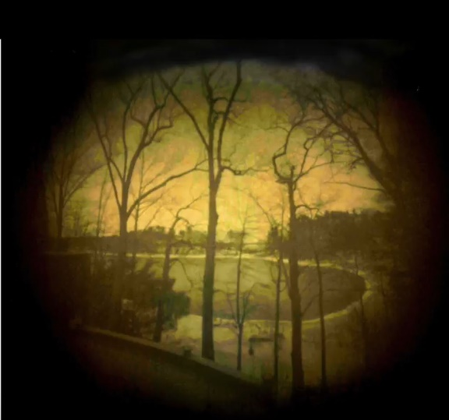
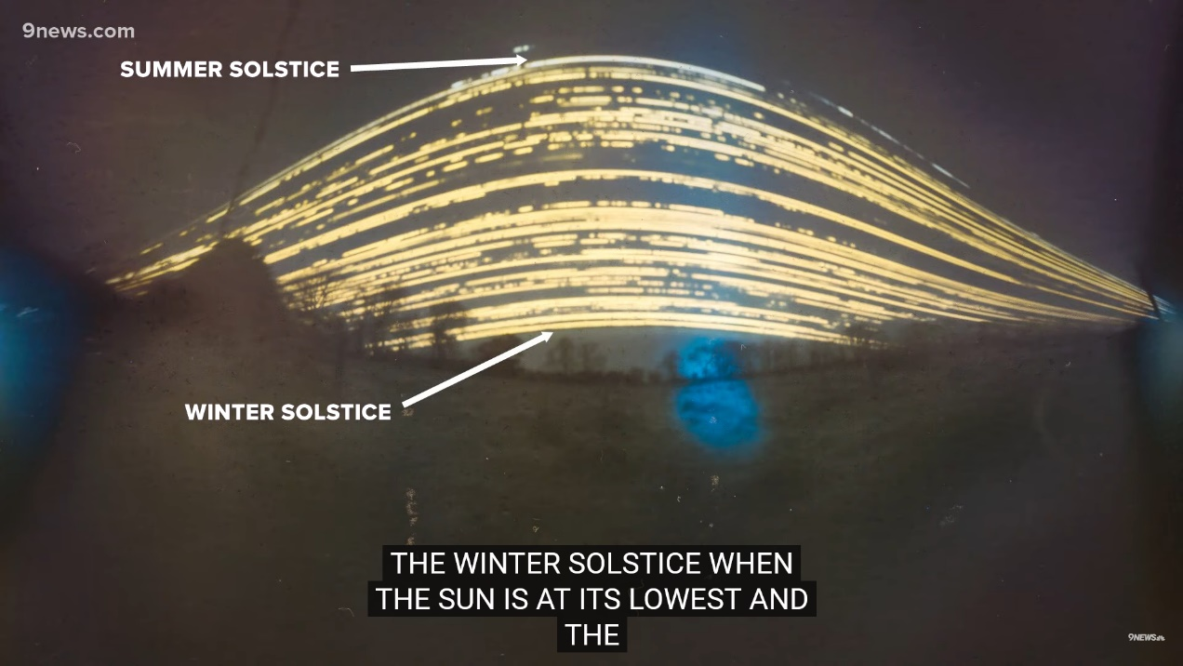
APPENDIX E3 Favorite Pinhole-Related Resources
3. Solargraphy: Long exposure pinhole photography
Solargraphy combines art, astronomy, and photography. It uses a lens-less pinhole camera to record the paths of the Sun, making its movements marvelously visible in landscapes.
Outreach for the NASA PUNCH mission
Solargraphs are pinhole photographs often made with a long exposure time. The solargraph (right below) was created over six months of time. Can you tell which paths are on the days of greatest daylight? The days of least daylight? Cloudy days?
https://www.youtube.com/watch?v=ddTV4ScvJRA
https://www.9news.com/article/weather/weather-colorado/home-made-camera-captures-long-exposure-of-the-sun-angle/73-a64dbc8c-bd9f-4813-9752-adfa78eb7f7b

Slide 33
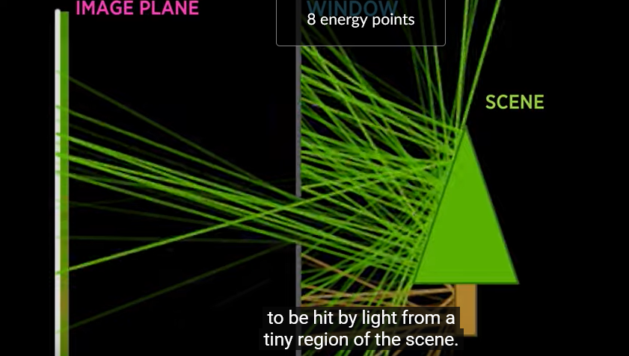
APPENDIX E4 Favorite Pinhole-Related Resources
4. Khan Academy Lesson about Virtual Cameras with helpful animations!
Course: Pixar in a Box > Unit 6. Lesson 1: How virtual cameras work
Outreach for the NASA PUNCH mission
https://www.khanacademy.org/computing/pixar/virtual-cameras/virtual-cameras-1/v/optics1-final

Slide 34
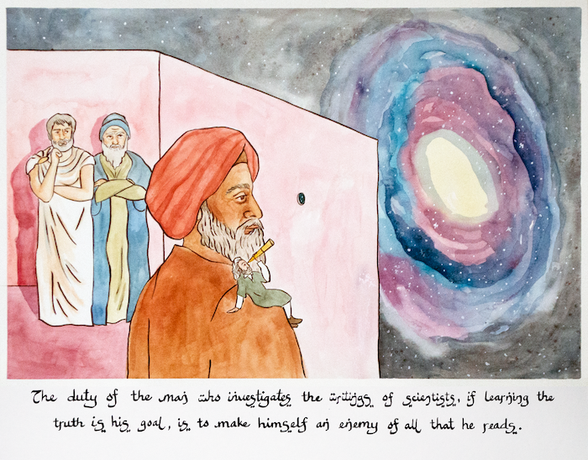
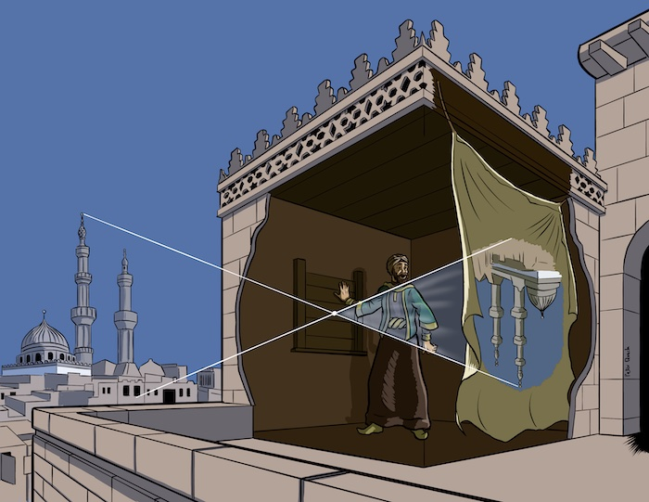
APPENDIX E5 Favorite Pinhole-Related Resources
4. Khan Academy Article about Hasan Ibn al-Haytham– Extraordinary!
500 years before the Scientific Revolution Hasan Ibn al-Haytham (a man who lived long ago in a region that we now call Iraq) revolutionized our understanding of how light moves through the Universe and how we see it. By observing the behavior of light in the camera obscura (right), he was able to understand that something similar must happen in our eyes. As light passes through the tiny opening in our eye—the pupil—it creates an upside-down projection on the back of our eye. Ibn al-Haytham was the first to argue that vision happens in the brain, not the eyes.
Outreach for the NASA PUNCH mission
https://www.khanacademy.org/humanities/big-history-project/solar-system-and-earth/knowing-solar-system-earth/a/the-universe-through-a-pinhole-hasan-ibn-al-haytham

Slide 35
ADDITIONAL INFORMATION
Outreach for the NASA PUNCH mission
Link for Feedback
Valuable References
Credits & Acknowledgements
Links to PUNCH & PUNCH Outreach Products
CONTACT:
Dr. Cherilynn Morrow, Outreach Director for the NASA PUNCH mission [cherilynn.morrow@gmail.com]

Slide 36
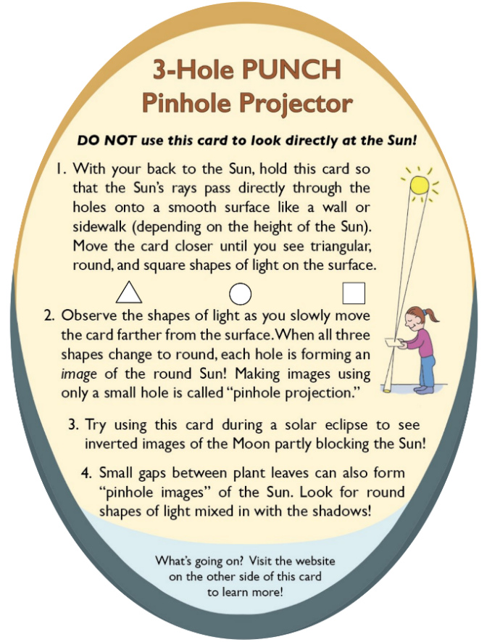
PLEASE GIVE US YOUR FEEDBACK
We take all feedback very seriously and are using it to keep improving our projector and this presentation.
Outreach for the NASA PUNCH mission
Please scan the QR code or go to this URL to give us feedback
​https://tinyurl.com/PinholeFeedback
Insights gained?
Remaining questions?
Ideas for improvements?
MARK 3 Version
Final Release for use up to and including the Annular Eclipse on 14 Oct 2023
FRONT
BACK

Slide 37
Valuable References
Lenses and Pinholes: What Does “In Focus” Mean?
A brief and clear explanation about what it means to be “in focus”: https://www.physicsforums.com/insights/lenses-pinholes-focus-mean/
2. How a Pinhole Camera Works (Part 1)
Excellent diagrams:
https://www.scratchapixel.com/lessons/3d-basic-rendering/3d-viewing-pinhole-camera
3. Real image: Collection of focus points made by converging light rays
We love the simple but insightful stick-figure:
https://www.wikiwand.com/en/Real_image
4. Your Eyes See Upside Down and Reversed
Lucid explanation by an eye doctor (MD) relating human eye to a pinhole camera: https://bceye.com/retinal-image-inverted-reversed/
5. Camera Obscura
The history of this wondrous effect, including reference to a possible paleo-camera:
https://en.wikipedia.org/wiki/Camera_obscura http://paleo-camera.com/archeo-optics/
6. Making, Measuring and Testing the “Optimal” Pinhole
A thorough and playful journey through the technical details of pinhole photography: https://www.35mmc.com/26/10/2020/making-measuring-and-testing-the-optimal-pinhole-pinhole-adventures-part-3-by-sroyon/

Slide 38
Credits & Acknowledgements
Primary Authors of the Explanatory Presentations:
Cherilynn Morrow, Robert Bigelow, and Mike Zawaski
cherilynn.morrow@gmail.com , arca965@gmail.com, and mjzawaski@gmail.com
Research & Development Team for the 3-Hole PUNCH Pinhole Projector
Cherilynn Morrow (editor-in-chief, concept development, field testing, photos)
Robert Bigelow (concept development, technical specifications, text reviewer, photos)
Briana Ingermann (graphic design, text developer, field testing, procurement of printing, photos)
Mike Zawaski (reviewer/consultant on explanatory presentation, graphic support, photos)
Sanlyn Buxner (head of field testing and evaluation, photos)
Jason Trump, Nina Byers, Geoff Skelton (text reviewer, field testing, reviewer of explanatory presentations)
Marisa Bevington & Marialis Rosario Franco (text reviewers, Spanish language translation)
GB Cornucopia, Bobbye Middendorf, Jeremy Osowski, Stacy Wolff (text reviewers, field testers, photo collaborators)
Craig DeForest (PUNCH PI, product review and approval, field tester)
Sarah Gibson (PUNCH Project Scientist, product review and approval)
Nicki Viall (PUNCH Mission Scientist, field tester, product review and approval)
Ronnie Killough (PUNCH Program Manager, field tester)
Gilly Gilbert (PUNCH Associate Investigator, field tester)
Countless others (who participated in field testing events and gave us their feedback)
Thank you also to our web developer Don Kolinski for posting and updating our work on the PUNCH website.

Slide 39
FIN!
Thanks for Exploring!
NASA PUNCH website: https://punch.space.swri.edu /
Scan here to access all PUNCH Outreach products or visit:
https://punch.space.swri.edu/punch_outreach_products.php
For questions or to request our 1-page monthly newsletter: Contact PUNCHOutreach@gmail.com
Photo: Alan Friedman

