Slide 1
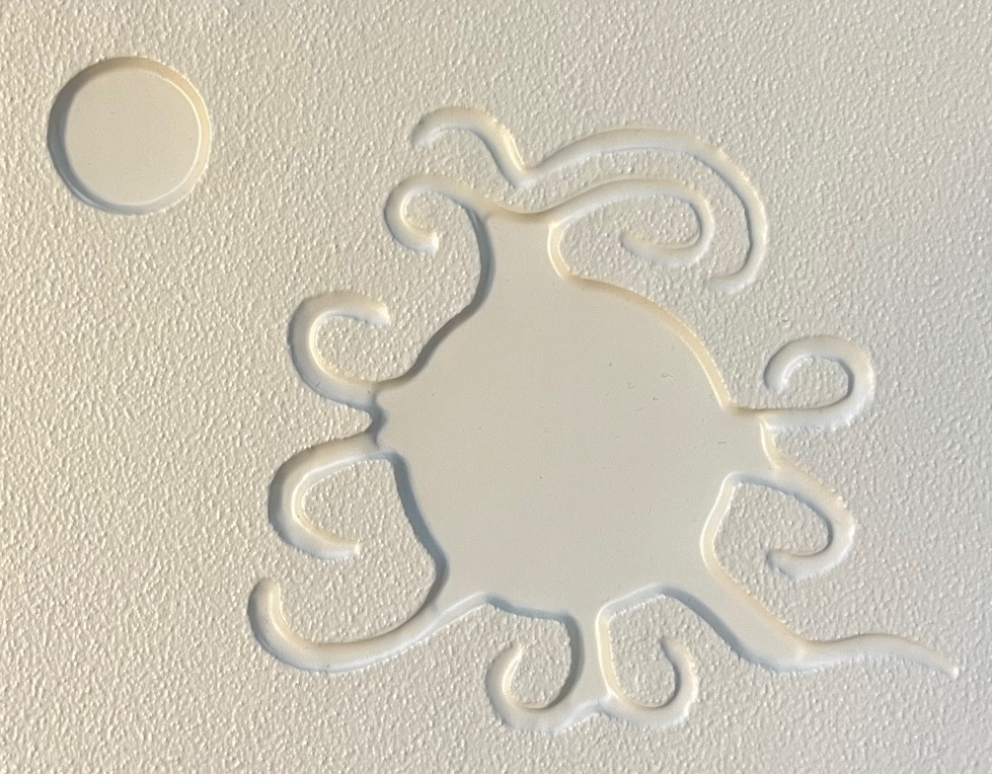
Graphic 1 enhanced: Sandstone petroglyph in Chaco Canyon Does this represent a total solar eclipse in 1097?
The subsequent slides in this document are the images that correspond to the
set of seven tactile-art representations used for the Petroglyph Inquiry.
Visuals to Support the Petroglyph Inquiry Email: punchoutreach@gmail.com
1
Aug 2024

Slide 2
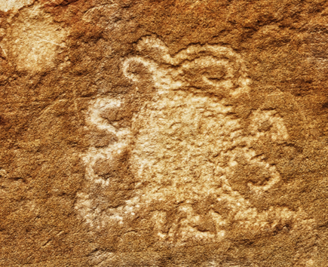
Graphic 1: Sandstone petroglyph in Chaco Canyon
Does this represent a total solar eclipse in 1097?
Visuals to Support the Petroglyph Inquiry Email: punchoutreach@gmail.com
2
Aug 2024

Slide 3
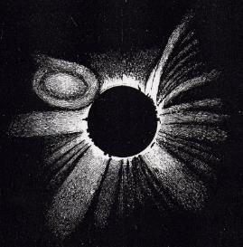
Graphic 2: 1860 Hand drawing of total solar eclipse with a solar storm in the Sun’s corona
Images of Solar Corona used for Thermoform Tactile-Art Graphics Email: punchoutreach@gmail.com
3
Aug 2024

Slide 4
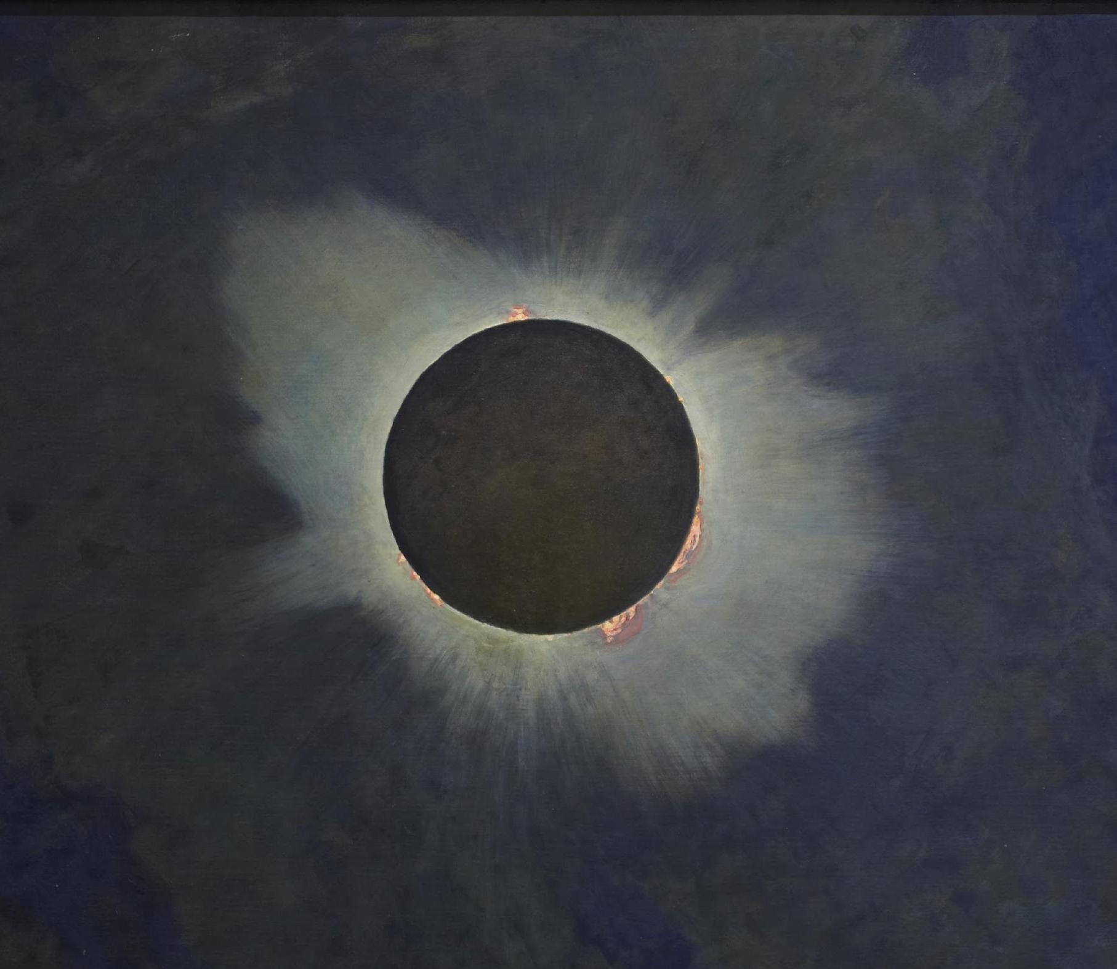
Graphic 3: 1918 Painting of total solar eclipse during a time of solar maximum
Visuals to Support the Petroglyph Inquiry Email: punchoutreach@gmail.com
4
Aug 2024

Slide 5
Graphic 4a: 1980 Ground-based photograph of total solar eclipse during a time of solar maximum
Visuals to Support the Petroglyph Inquiry Email: punchoutreach@gmail.com
5
Aug 2024

Slide 6
Graphic 4b: 1994 Ground-based photograph of total solar eclipse during a time of solar minimum
Visuals to Support the Petroglyph Inquiry Email: punchoutreach@gmail.com
6
Aug 2024

Slide 7
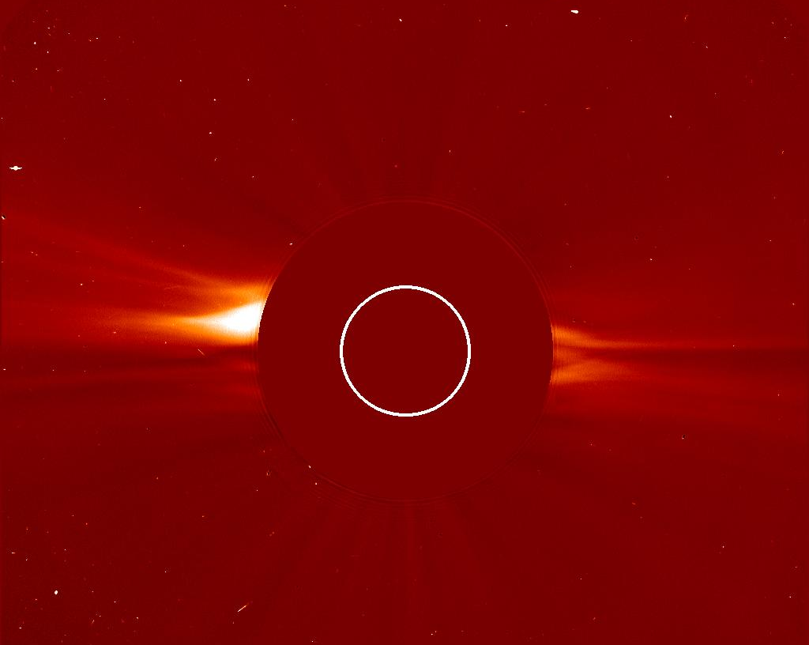
Graphic 5a: 1996 NASA spacecraft image using an occulting disk to mask the Sun and reveal its outer corona during a time of solar minimum
Visuals to Support the Petroglyph Inquiry Email: punchoutreach@gmail.com
7
Aug 2024

Slide 8
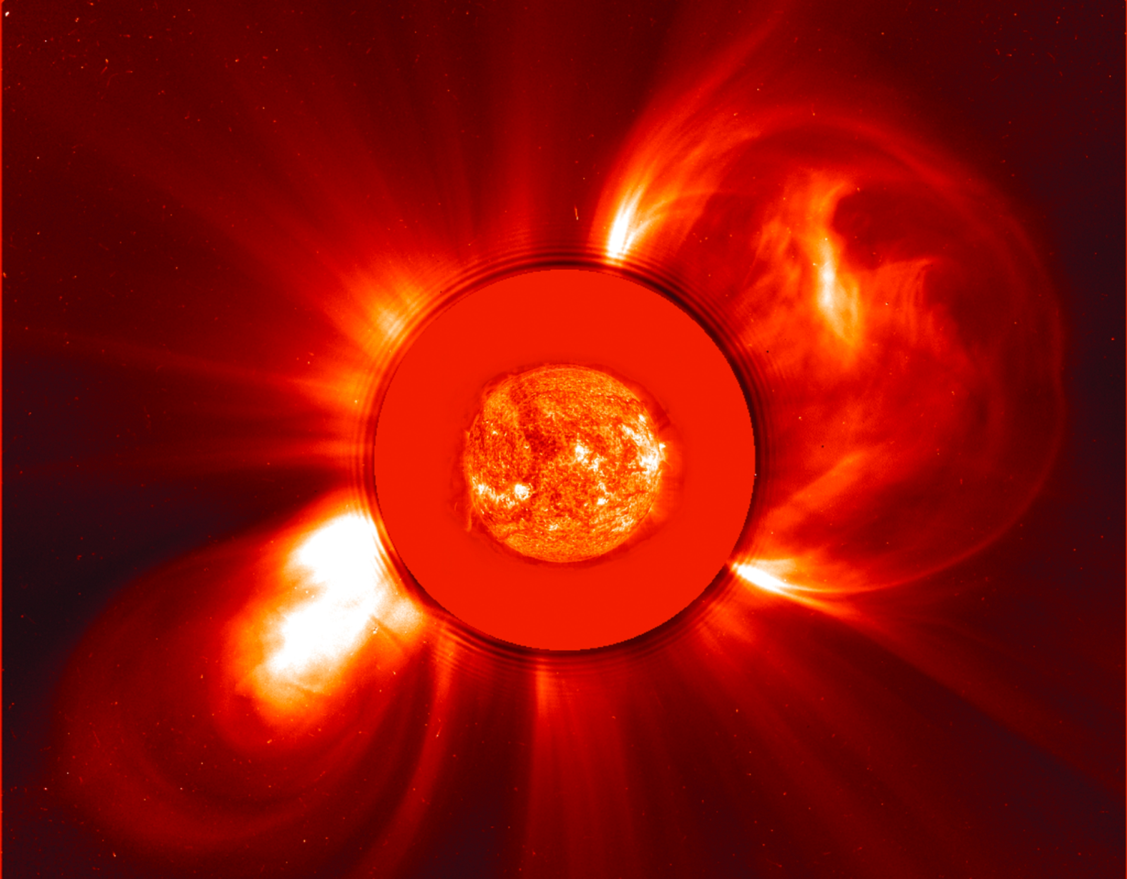
Graphic 5b: 2000 NASA spacecraft image using an occulting disk to mask the Sun and reveal its outer corona with two solar storms during a time of solar maximum
Visuals to Support the Petroglyph Inquiry Email: punchoutreach@gmail.com
8
Aug 2024

